Slide 1
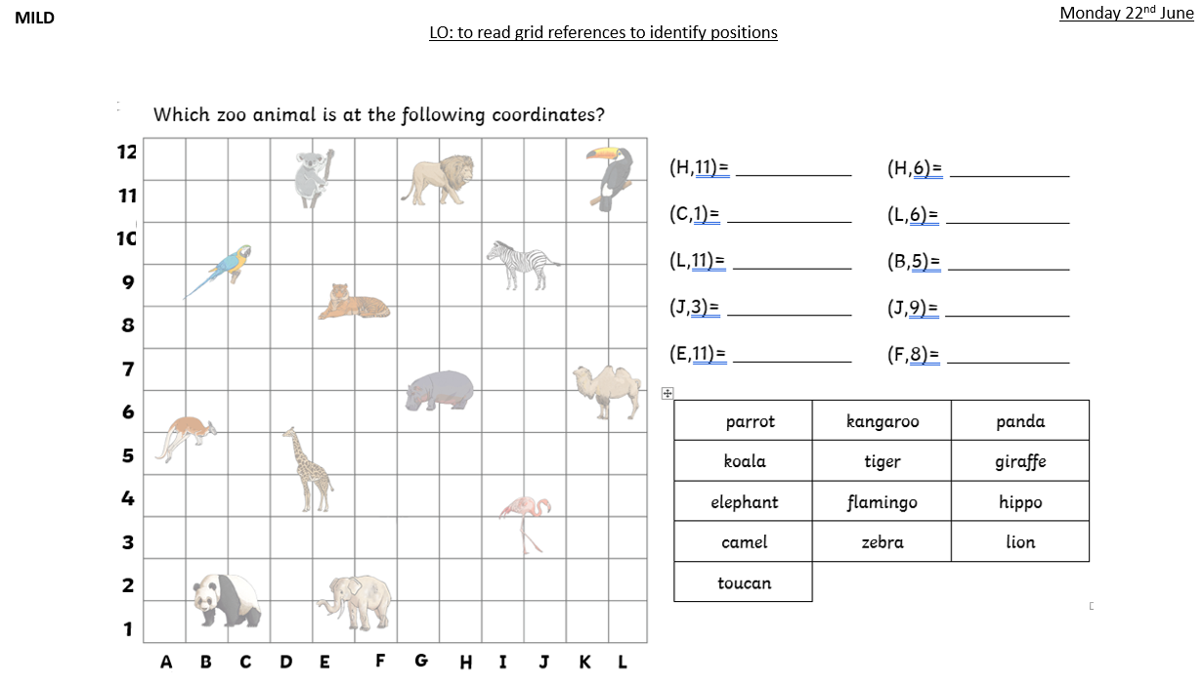

Slide 2
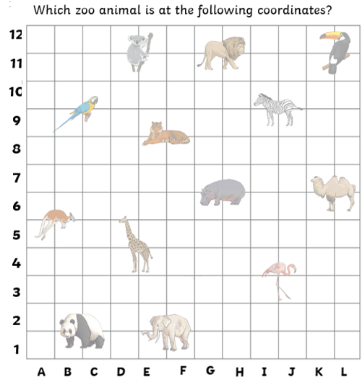
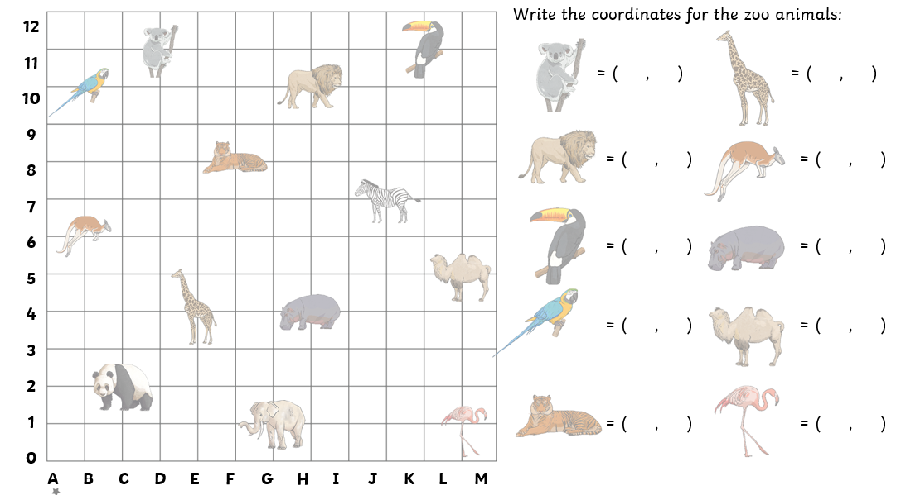
SPICY
Monday 22nd June
LO: to read grid references to identify positions

Slide 3


