Slide 1
Thursday 26th June 2020
LQ: Why did the Romans build roads?

Slide 2
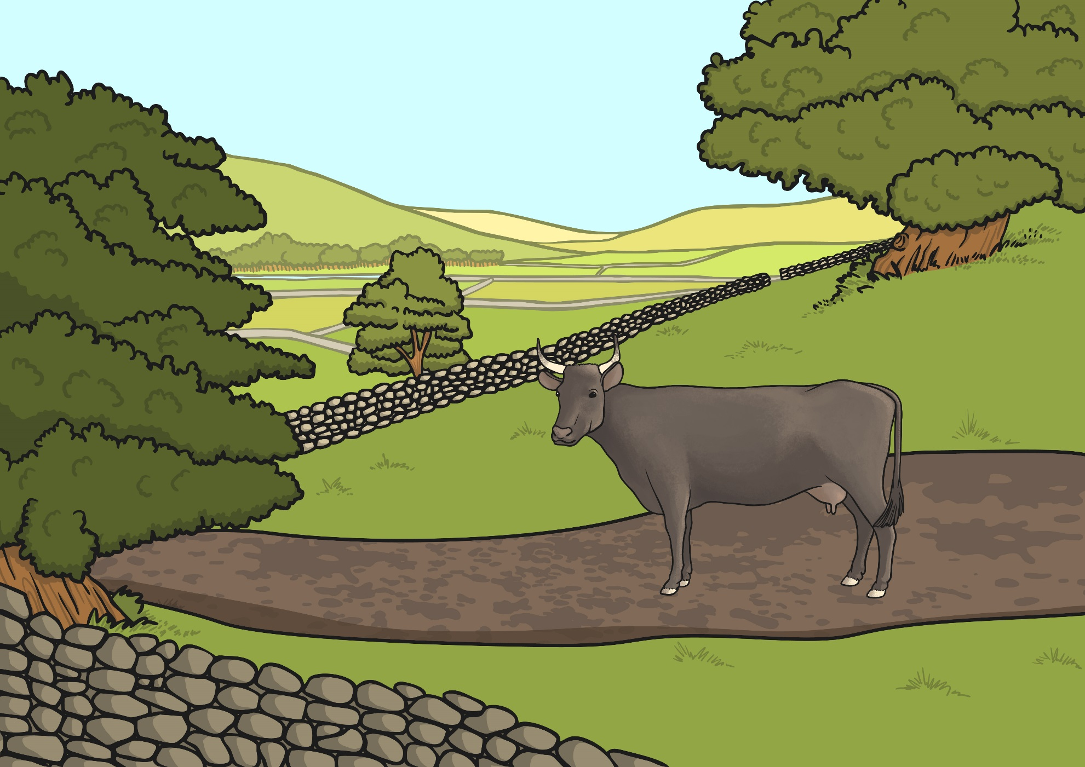
Before the Romans arrived, Britain had no proper roads. The Celts rode horses, walked and travelled in carts pulled by oxen along paths and tracks. These paths and tracks connected local farms and hamlets, and there were some longer routes for trade. These tracks were often in very poor condition.
Why do you think the Romans wanted to build new roads?
Can you think of 3 possible reasons?

Slide 3

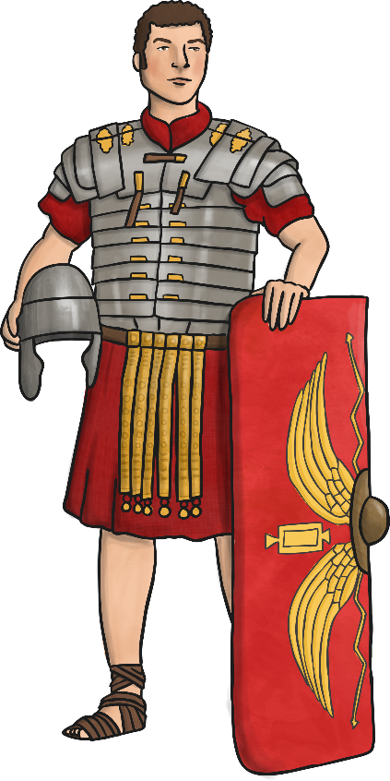
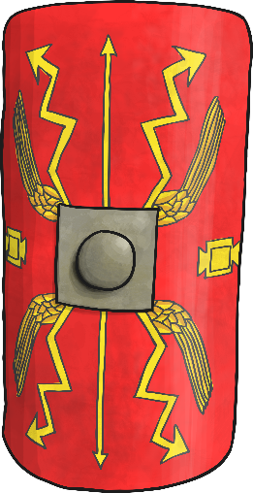

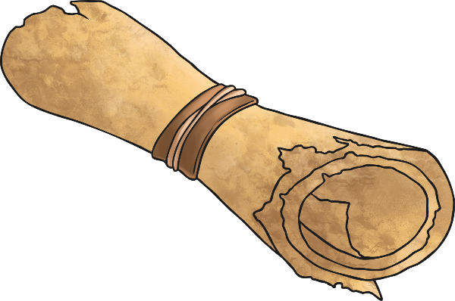
Roman Roads
Why did the Romans want better roads?
Did you think of any of these reasons?
Troops could be quickly moved from one place to another.
Supplies could be sent to different areas of the country.
Better links between places was good for trading.
The Emperor had more control if messages could be sent quickly.

Slide 4
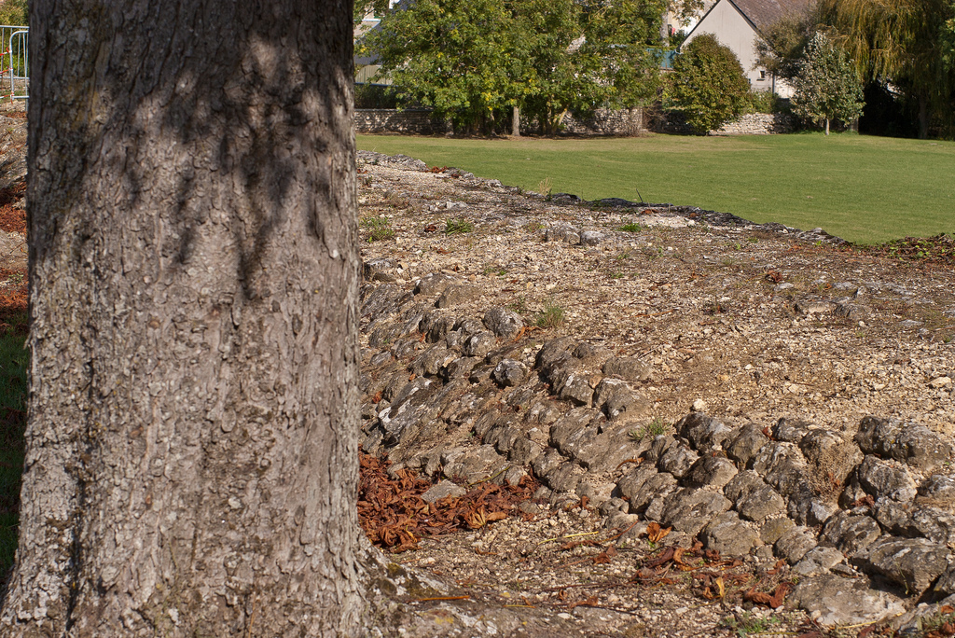
The Romans were famous for their long, straight roads. You can still see some Roman roads today, two thousand years after they were built.
Photo courtesy of sybarite48 (@flickr.com) - granted under creative commons licence - attribution

Slide 5

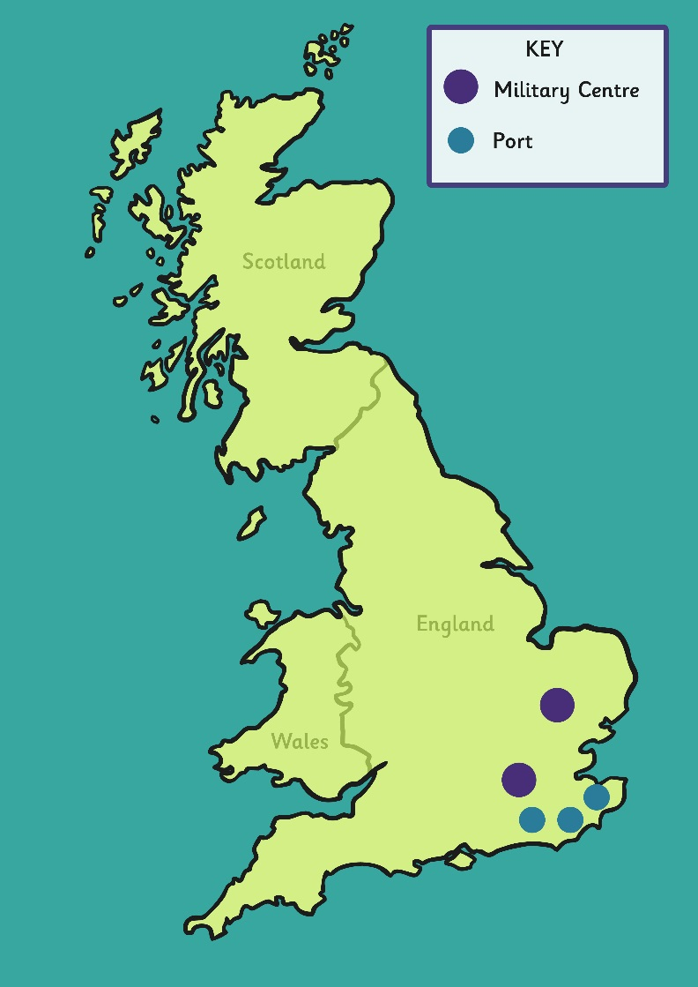
The First Roman Roads
Why was it important for the Romans to link the military centres to the ports?
The first roads linked ports with military centres.
Colchester
London
Richborough
Dover
Lympne

Slide 6
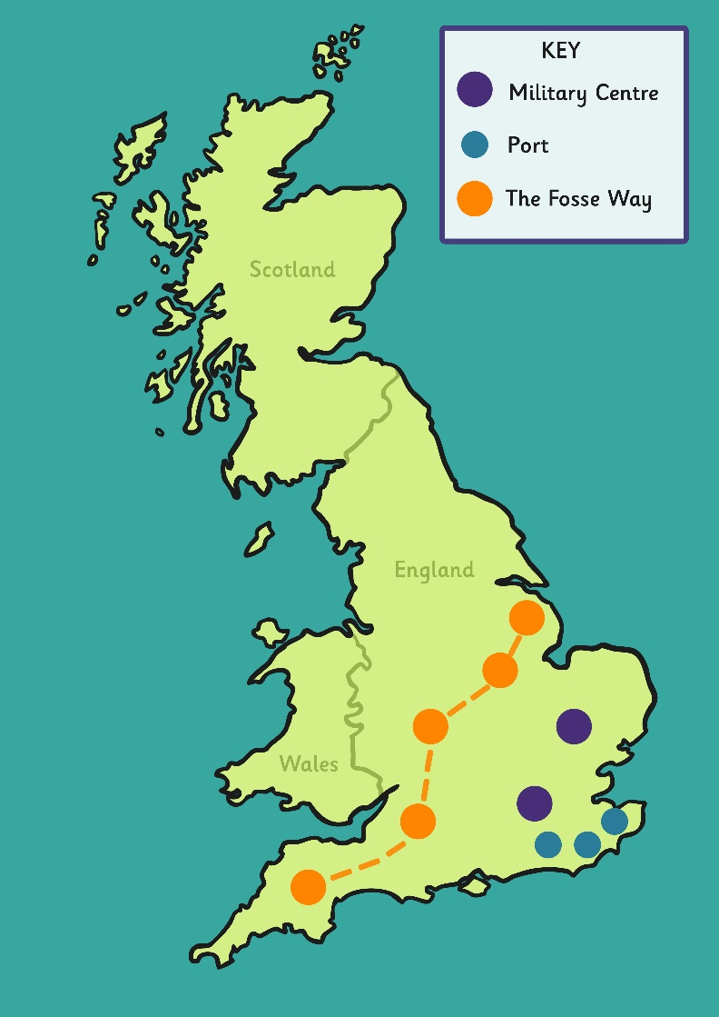
The First Roman Roads
The Fosse Way was the first great Roman road in Britain. It ran from Exeter to Lincoln, passing through Bath, Gloucester and Leicester.
Can you find The Fosse Way on your map?
The first roads linked ports with military centres.
Lincoln
Leicester
Colchester
Gloucester
Richborough
Bath
Dover
Exeter
London
Lympne

Slide 7

More Roman Roads
Over the years, the Romans continued to build more roads, linking to many places throughout Britain.
Eventually around 2,000 miles of Roman roads had been built.
The first roads linked ports with military centres.
York
Lincoln
Carlisle
Leicester
Other Routes
Chester to York
London to Lincoln to York
Chester to Carlisle
Chester
Colchester
Gloucester
Richborough
Bath
Dover
Exeter
London
Lympne

Slide 8
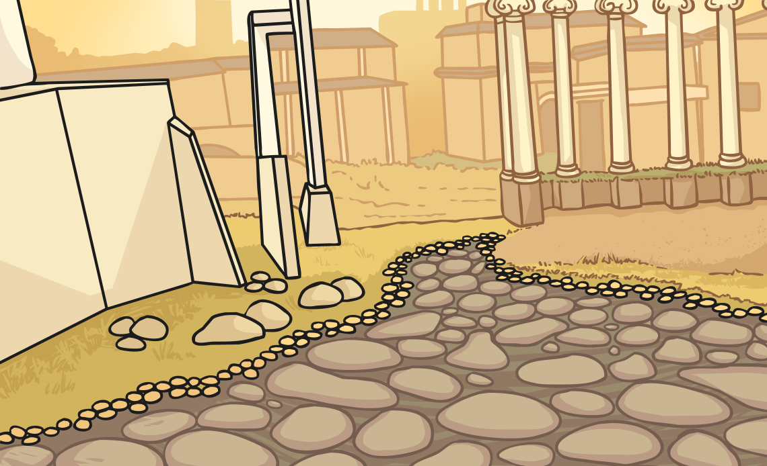
Building the Roads
Watch the video and think about the steps needed to build a Roman road. Click the play button below to open the link.

Slide 9

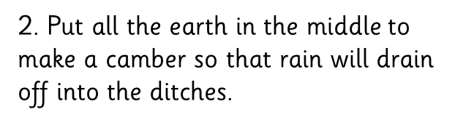
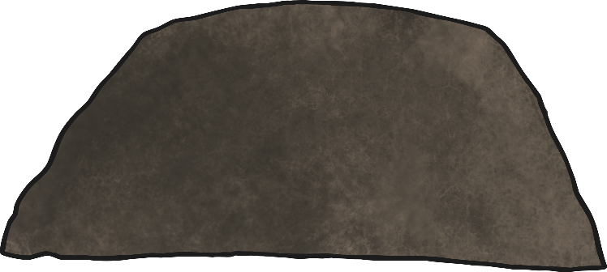
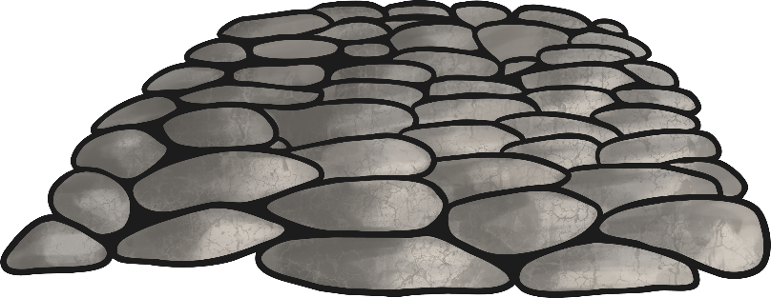
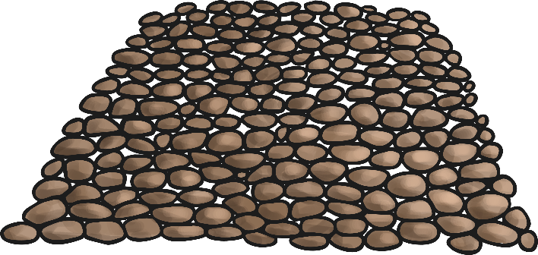
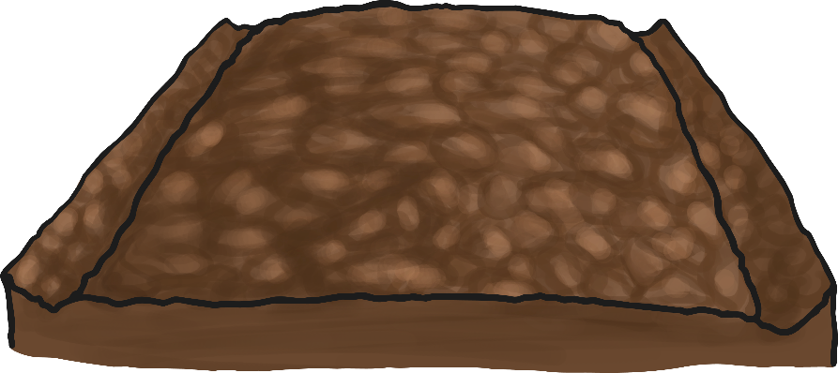
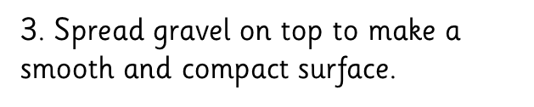

How did they build the roads?
To build a Roman road we would need to:

Slide 10
Roman Road Cross Section
Can you name the parts of this Roman road?
large stones
Paving stones cut to fit
gravel
broken stones/pebbles/sand/cement

Slide 11
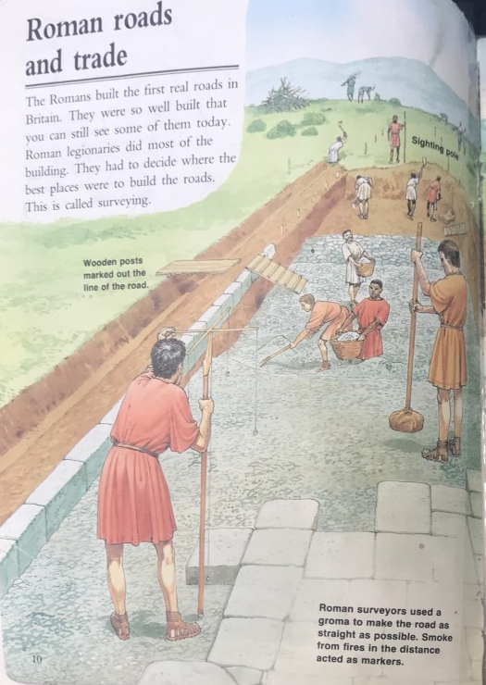
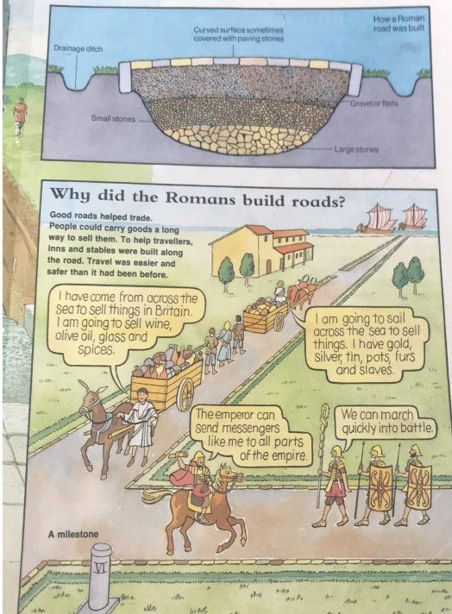

Slide 12



Your Task
Mild- Use the pictures from the previous slides to draw and label a diagram of a Roman road. Write a sentence to explain why the roads were straight.
Spicy-Use the information on Page 1 (history work sheets) to show where the main Roman roads were built in Britain.
Hot-Complete the Spicy challenge and then write a paragraph to explain how the roads helped the Roman Empire and improved people’s lives

