Slide 1
Friday 26th June 2020
LQ: Where do new plants come from?

Slide 2
Where do you think new plants come from?

Slide 3

Write down 3 things you know about life cycles already
1
2
3

Slide 4

Germination
Germination is when a seed begins to grow.

Slide 5
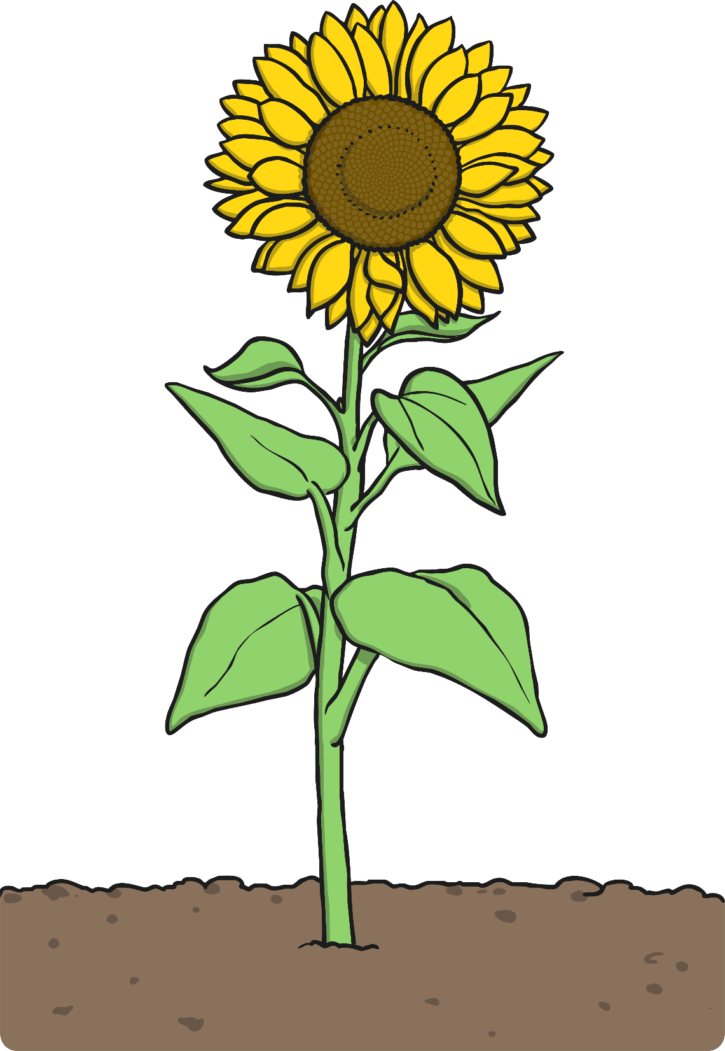
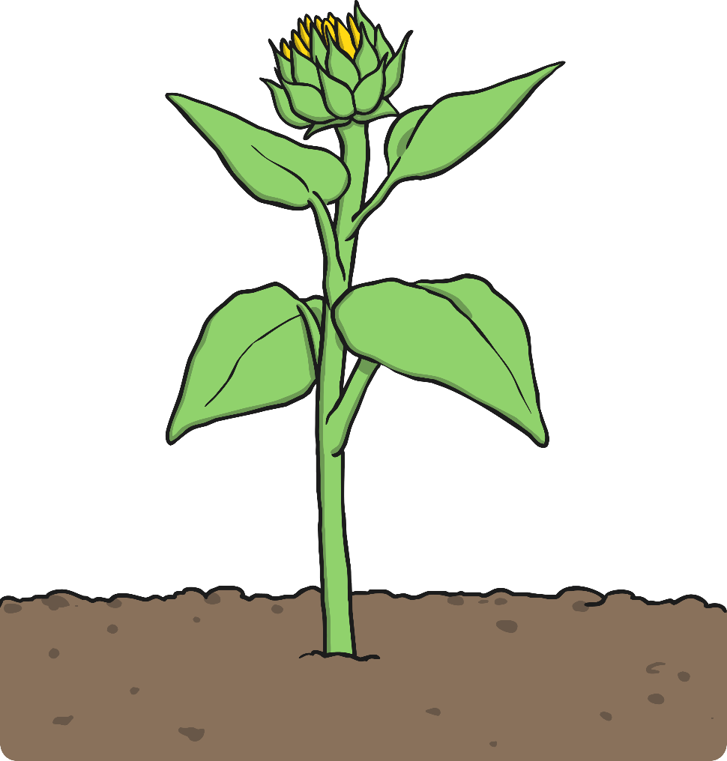
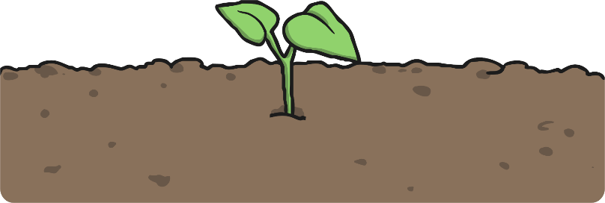
Growing and Flowering
Once the seed has germinated
the plant grows bigger and
then forms flowers.

Slide 6

Pollination
Pollination occurs when pollen from the anther is transferred to the stigma, often by an insect.

Slide 7
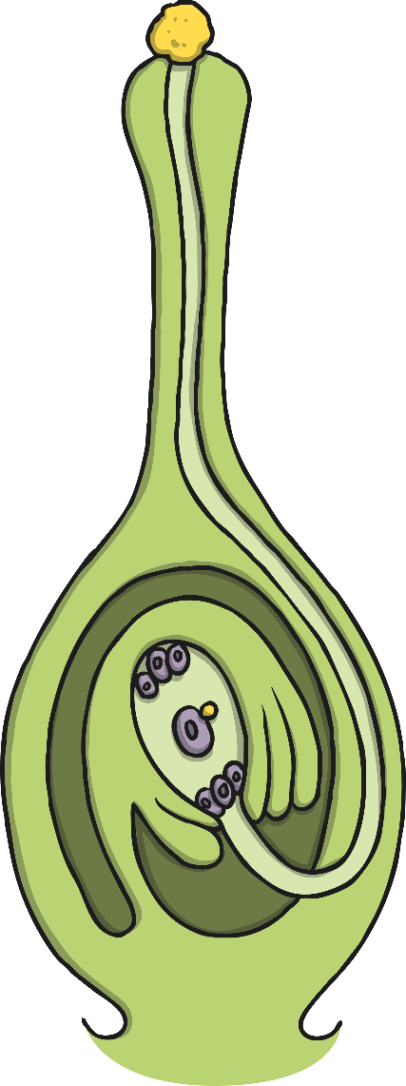
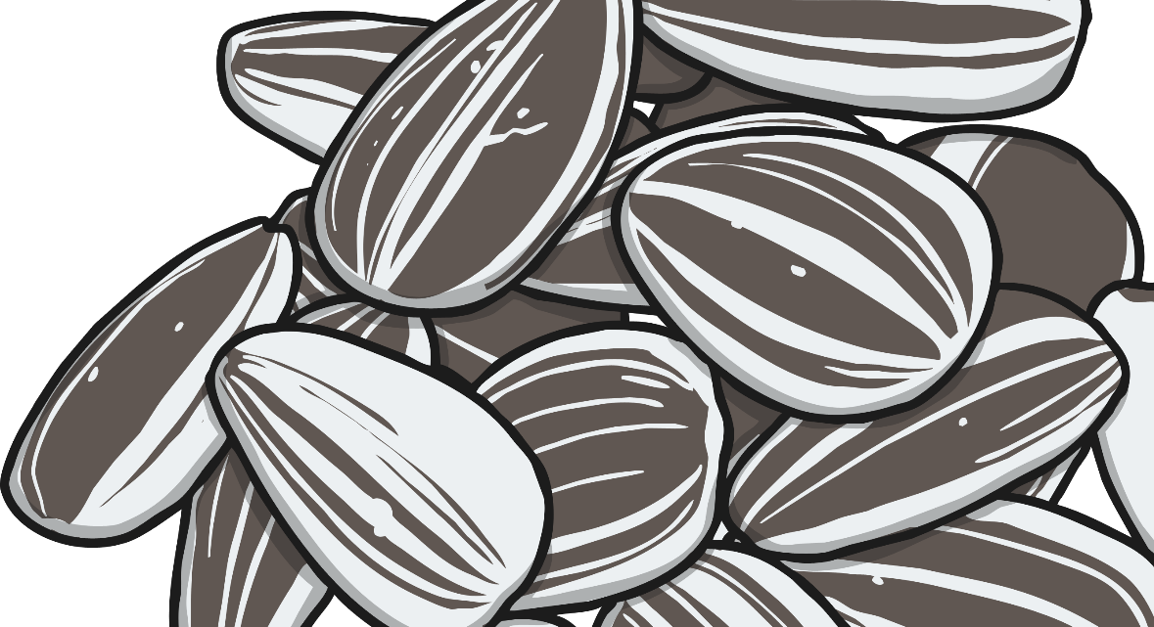
Fertilisation and Seed Formation
Fertilisation happens when the pollen travels from the
stigma down the style to the ovary.
The pollen joins with an ovule to form a seed.
The seed forms inside the ovary.

Slide 8
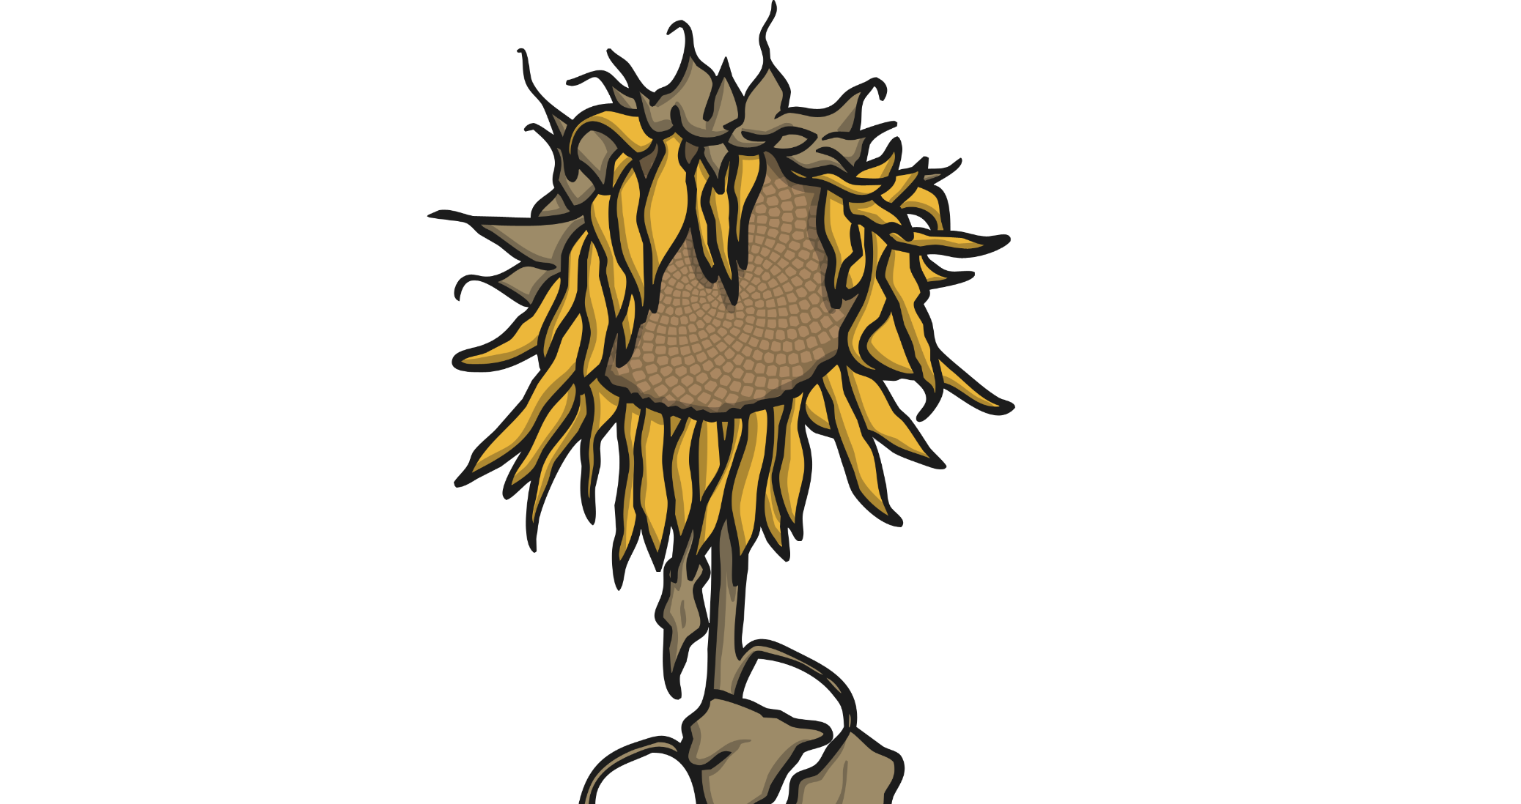
Seed Dispersal
Once the seeds are fully formed, the plant needs to disperse them.
This means that the plant needs to move or transport the seeds away from the parent plant in some way so that they don't all try to grow in the same place.
There are lots of different ways that seeds can be dispersed.

Slide 9
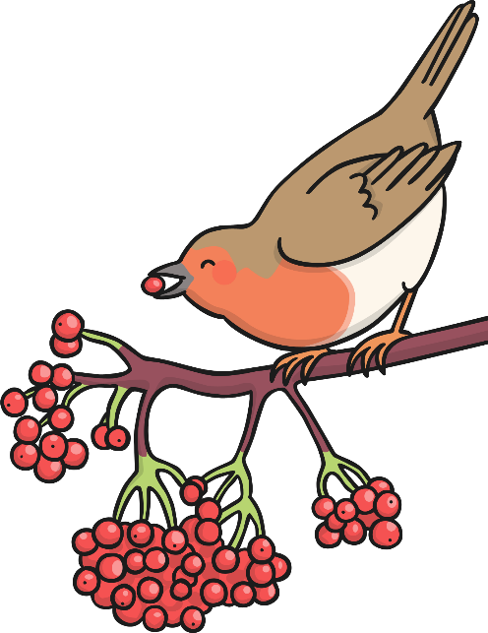
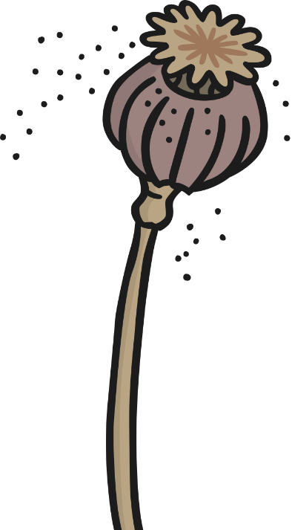
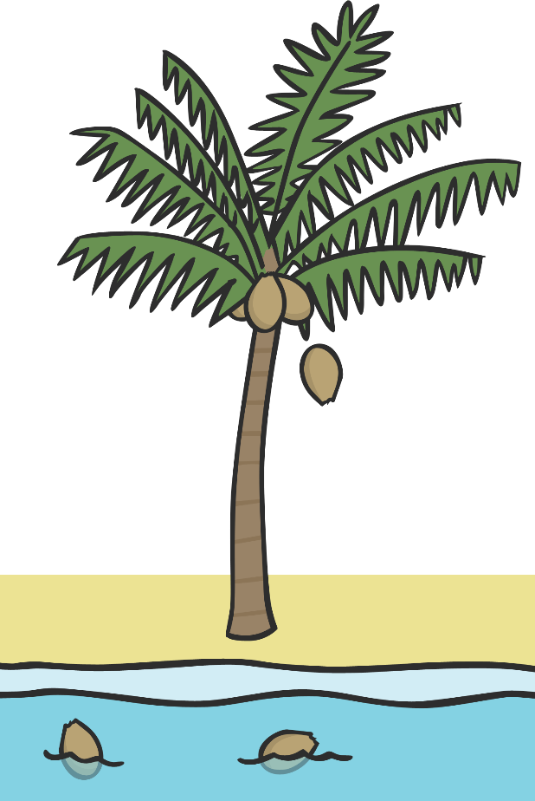
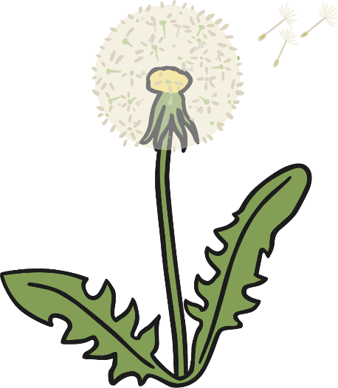


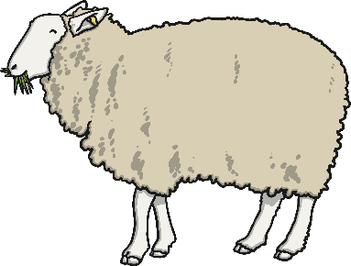

Seed Dispersal
Seeds can be dispersed by:
eating
the wind
shaking
water
dropping
bursting
carrying

Slide 10




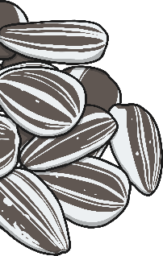

Germination
The seed starts to grow.
Seed Dispersal
Growing and Flowering
The fully formed seeds are moved away from the parent plant.
The plant grows bigger and forms a flower.
Fertilisation and Seed Formation
Pollination
Pollen from the anther lands on the stigma and travels down the style.
The pollen joins with an ovule and a seed starts to form.

Slide 11
Your task
You are going to complete the life cycle of a plant sheet.
There are different challenges for you to choose. Either mild, spicy or hot. Choose which one you would like to do.

