Slide 1
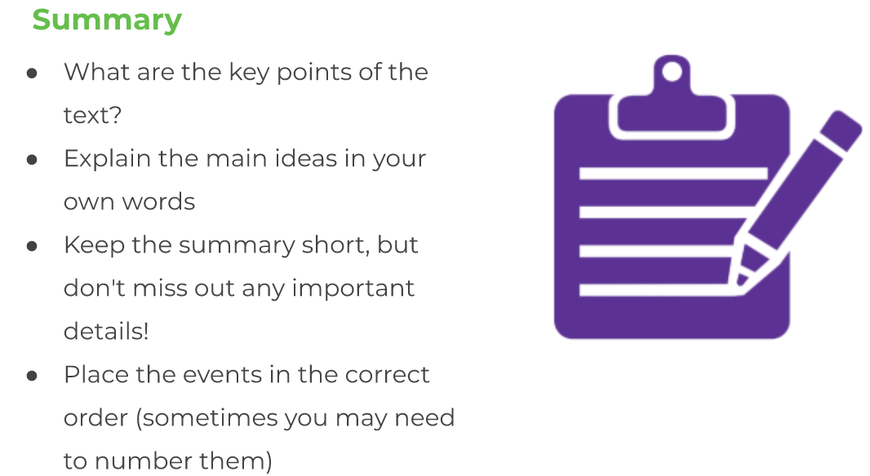
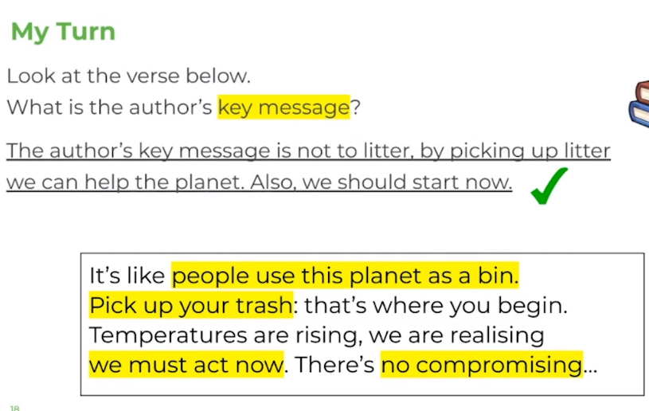
LO: To summarise a text.
Tuesday 23rd June
Today we are going to be focusing on summarising a text, using the ‘One Small Change’ persuasive rap.
To ‘summarise’ means to sum up a text and explain the key events that happened, the most important and relevant parts.

Slide 2
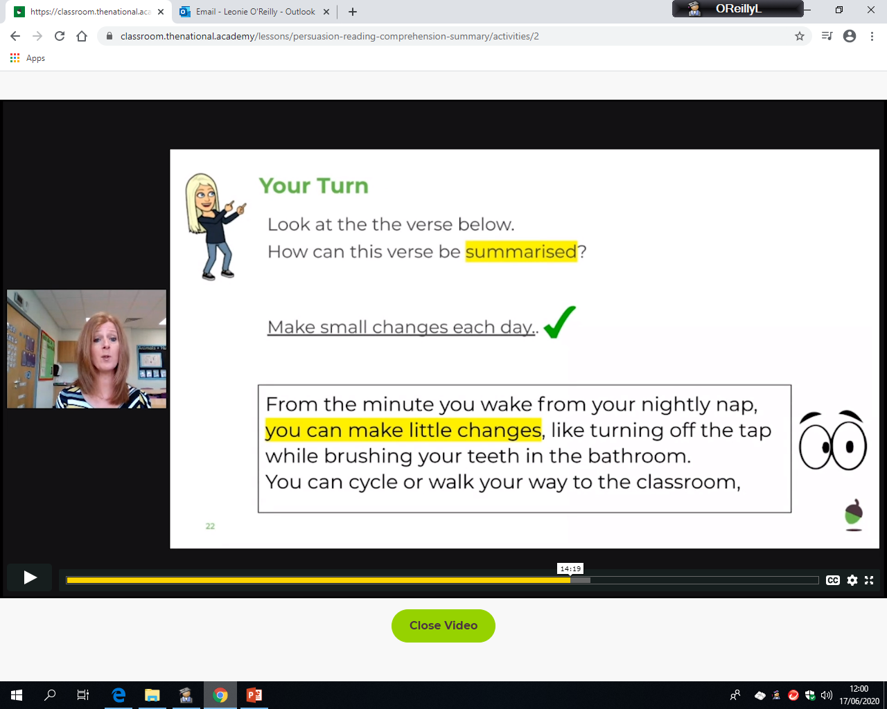
LO: To summarise a text.
Tuesday 23rd June
Have a look below at the process of summarising:
The question wants us to read the verse…
Our answer is a shorter version of what the verse is telling us, key points only…
Read the ‘One Small Change’ text again, then try some summary questions.

Slide 3
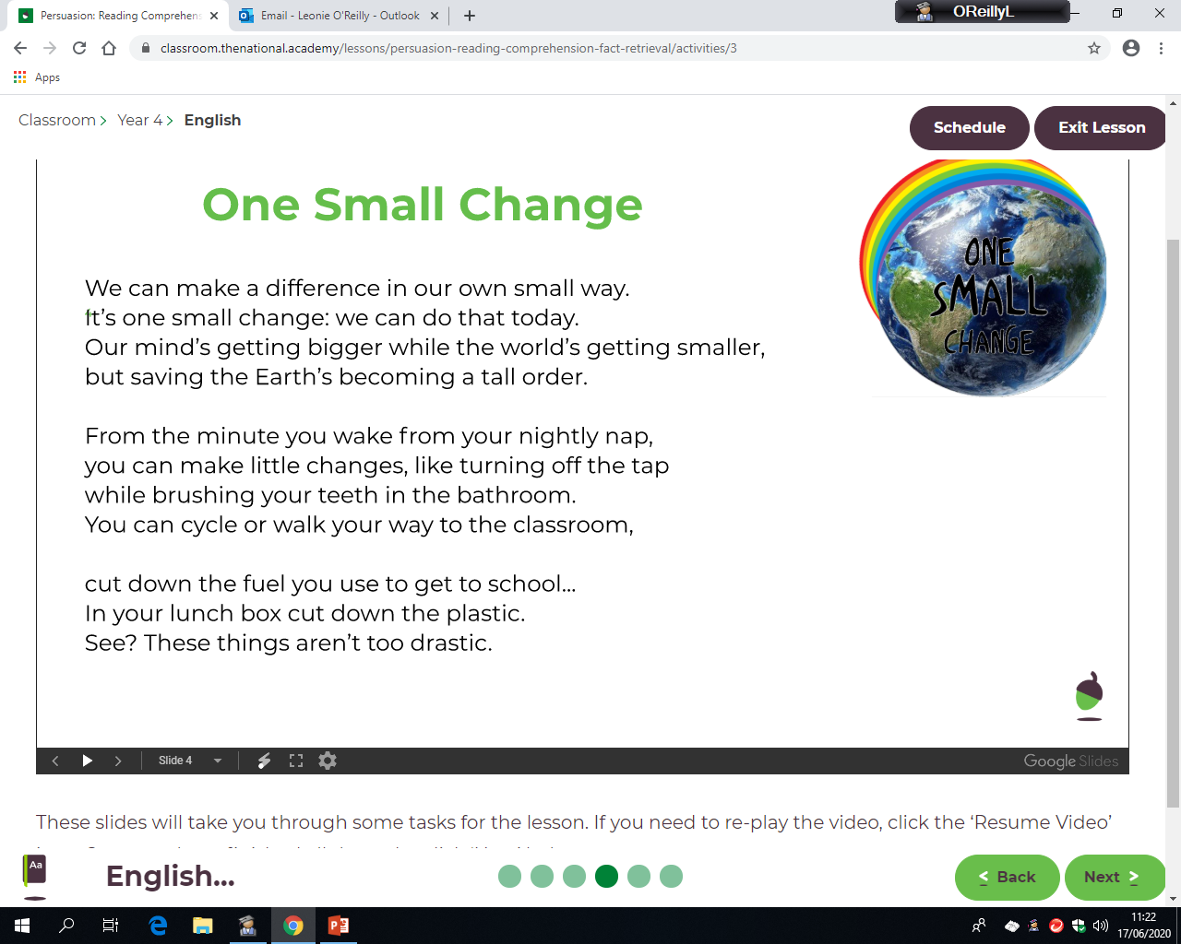
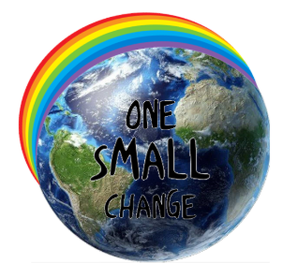
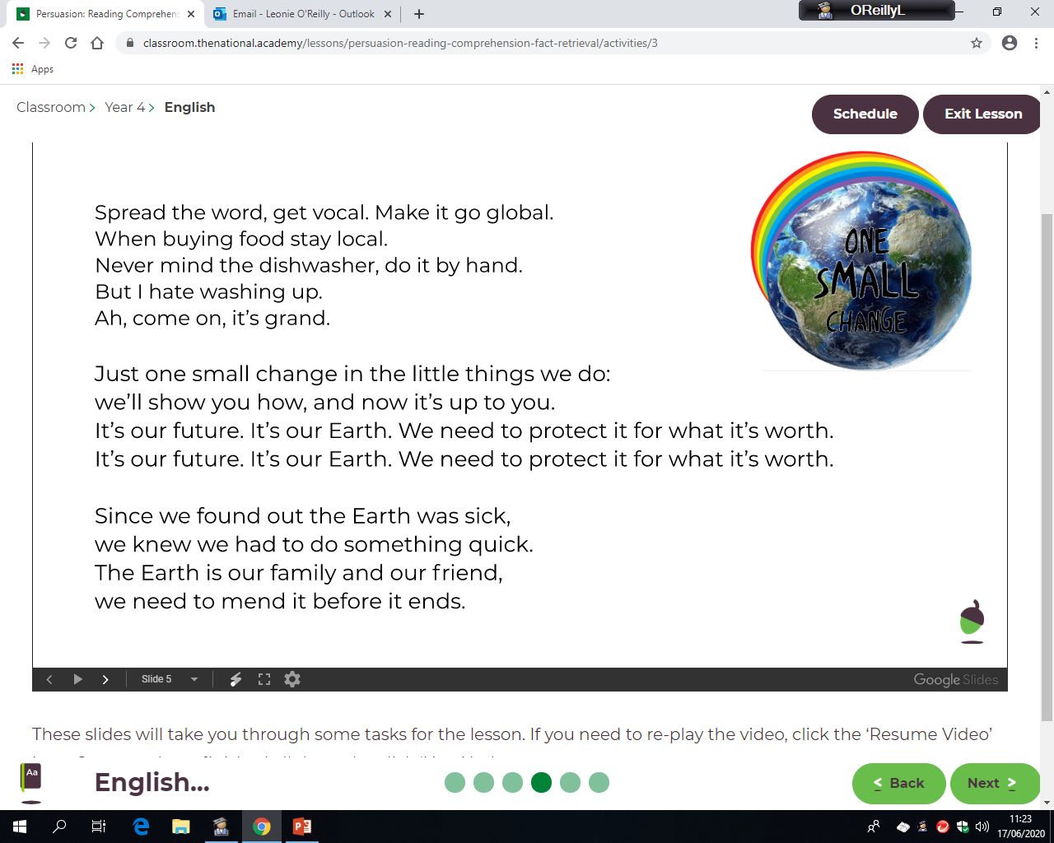


Slide 4
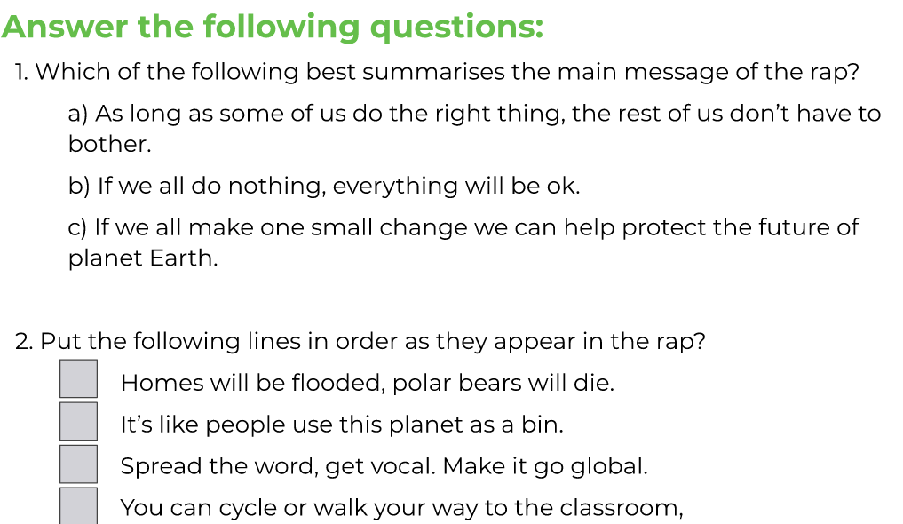
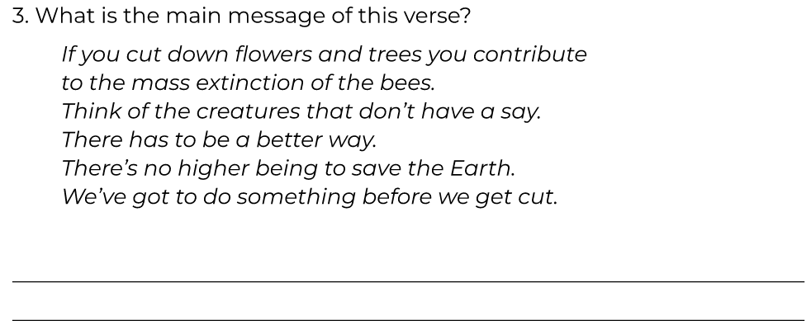
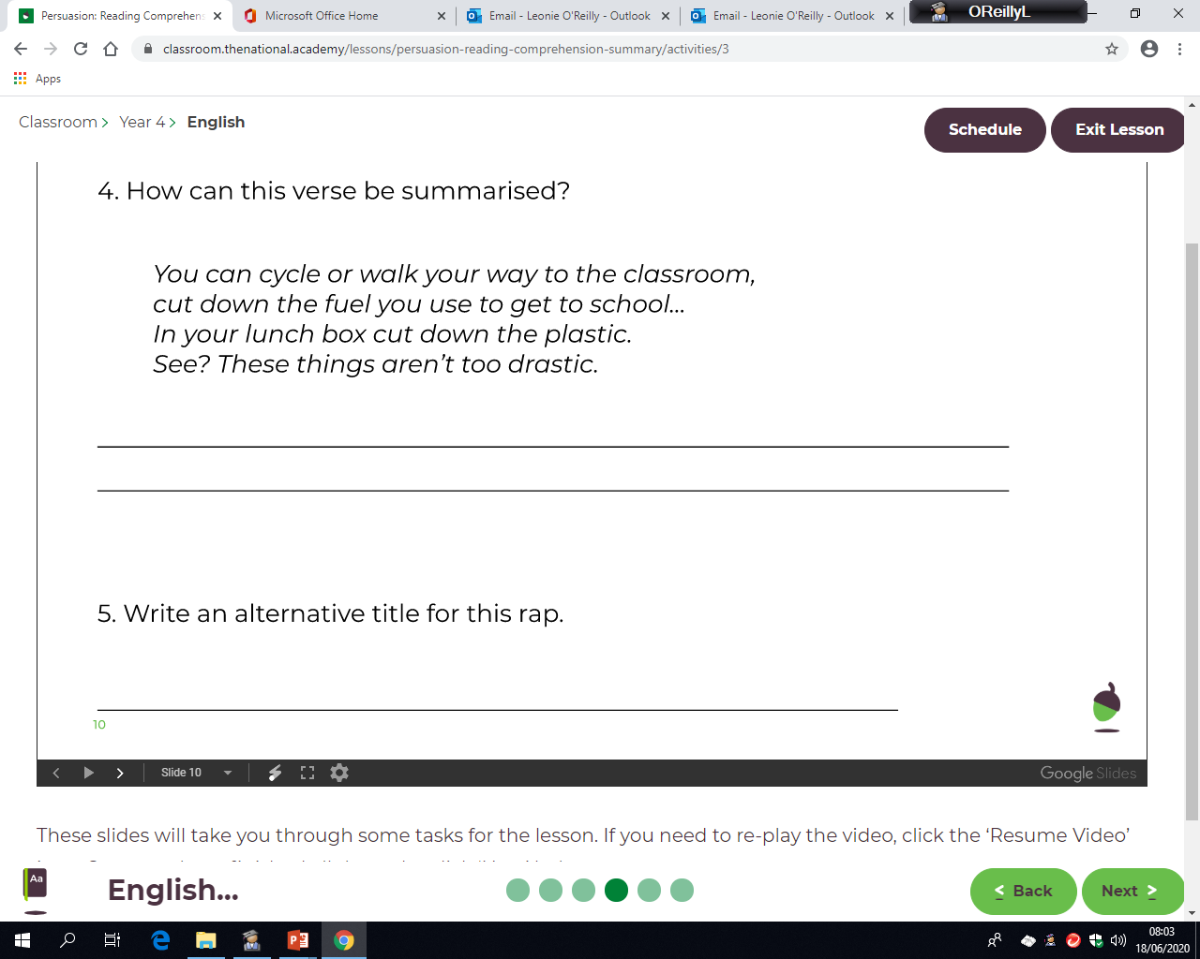
LO: To summarise a text.
Tuesday 23rd June

Slide 5
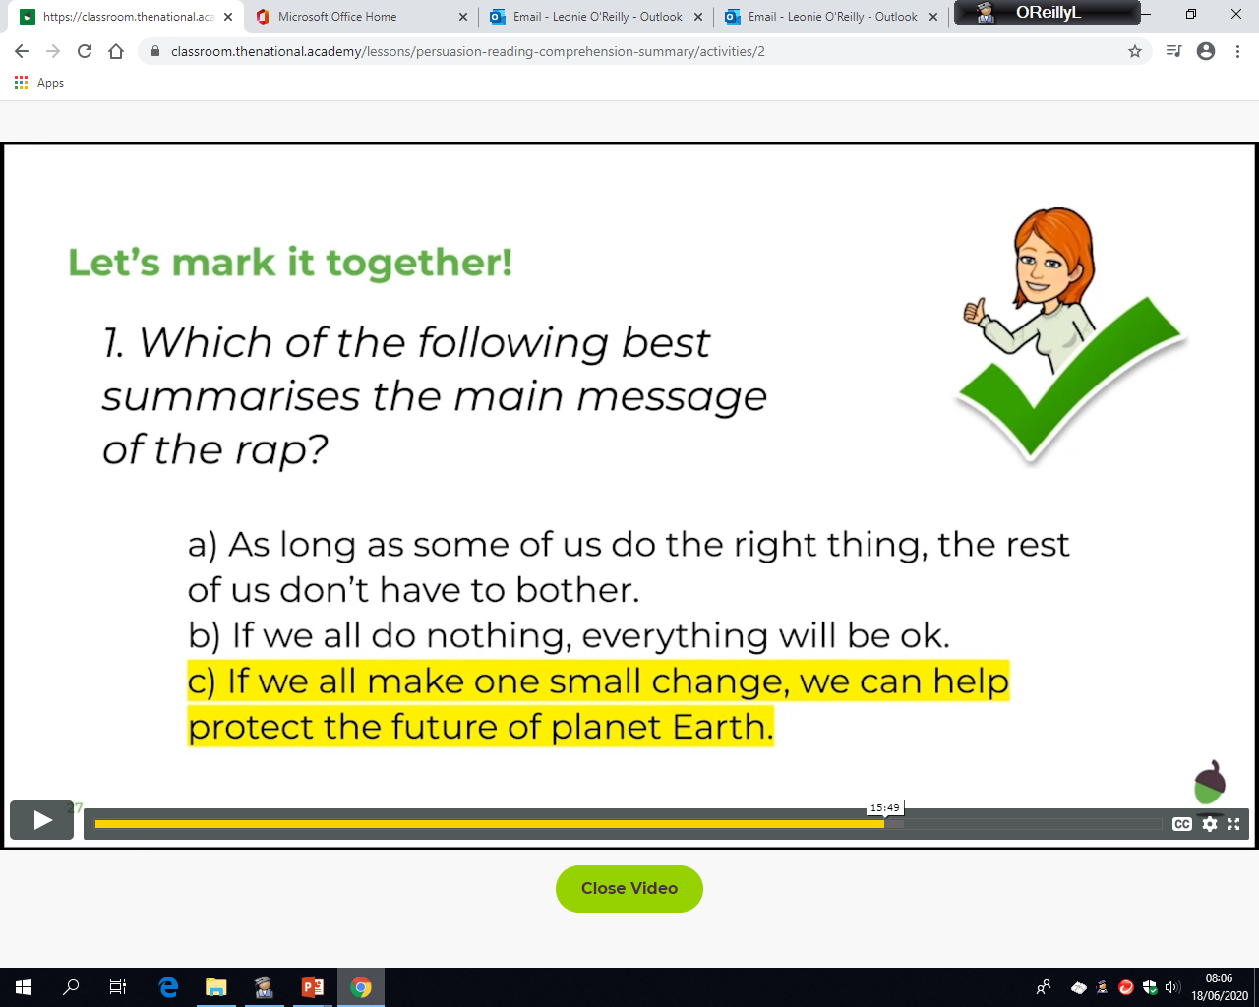
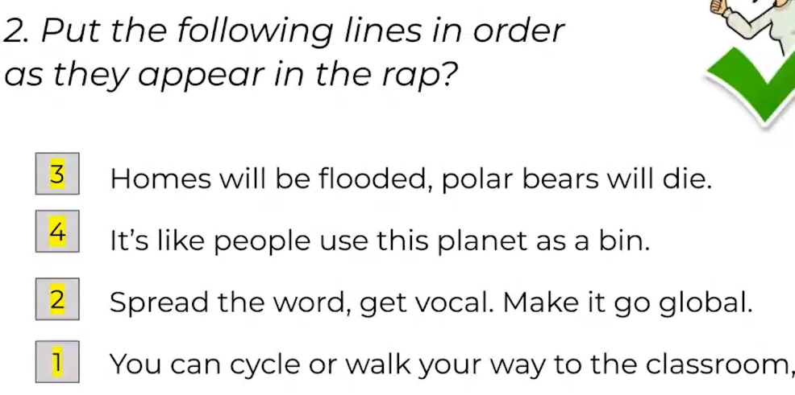
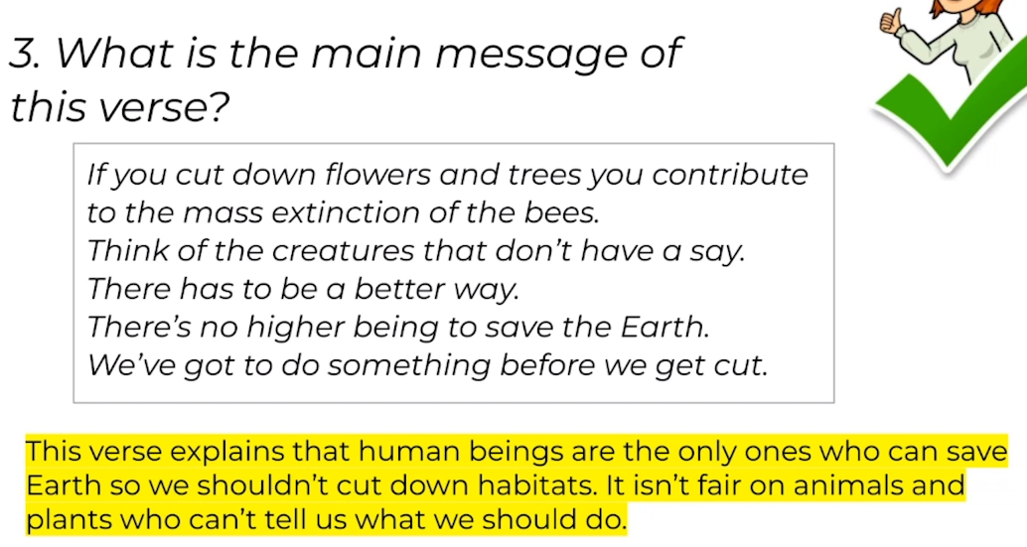
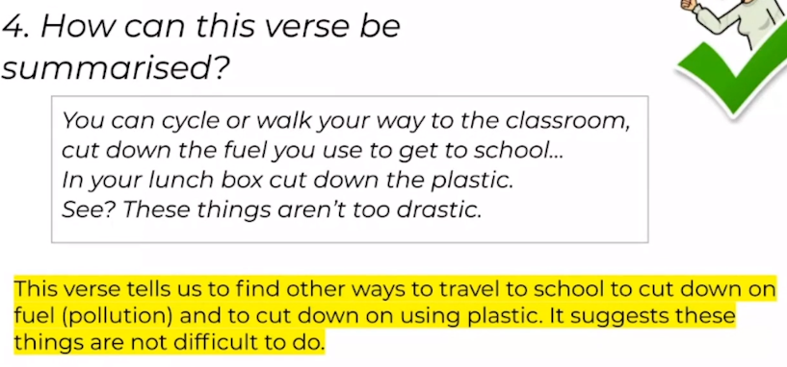
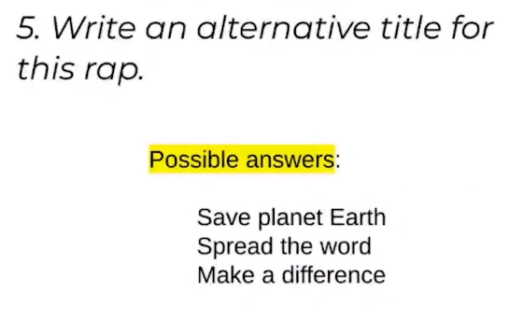
ANSWER SHEET
Tuesday 23rd June

