Slide 1
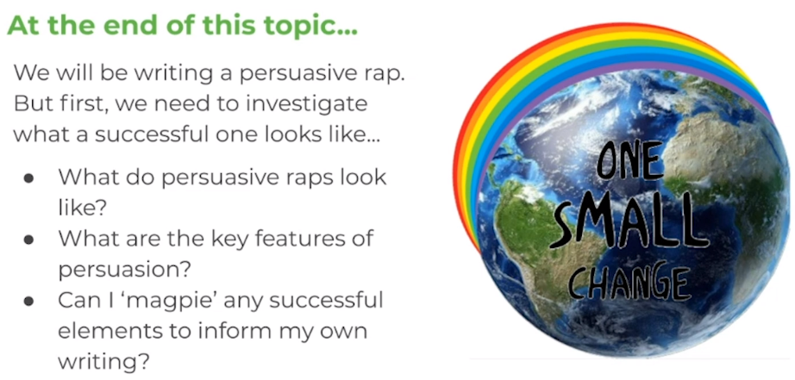
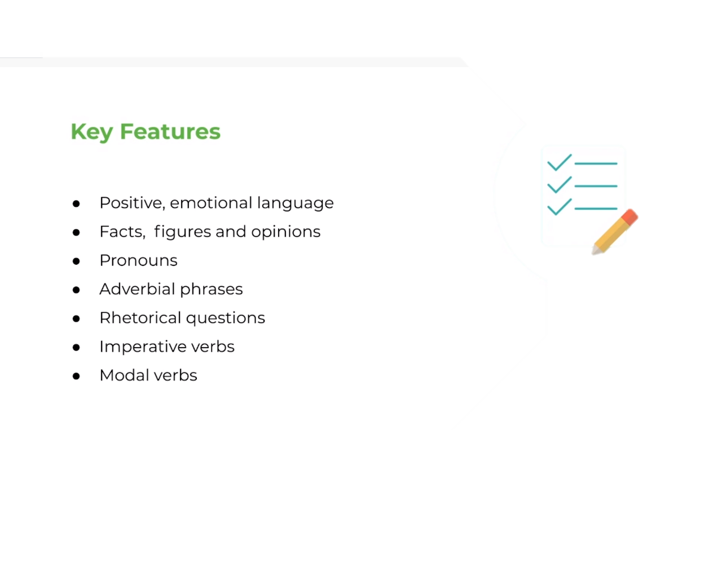
LO: To identify features of a persuasive rap
Wednesday 24th June
We will be writing our own persuasive rap about saving the planet, but first, we need to look at a WAGOLL and identify the key features of a persuasive rap.
Key features of a persuasive rap can be found below…
Many believe… / People think…
He/She/I/We/You/They/Us/Our/Their
(known as ‘bossy’ verbs) use/put/must/buy/join/come/educate
(Indicate likelihood/probability) should/shall would/will could/can

Slide 2
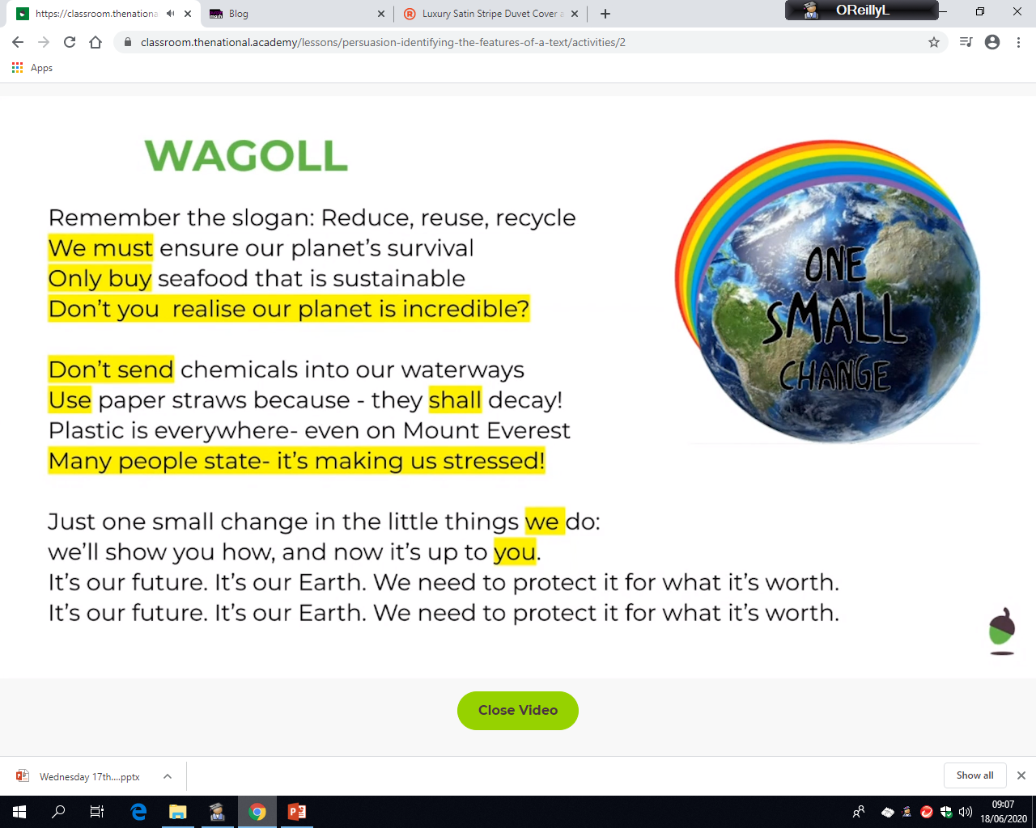
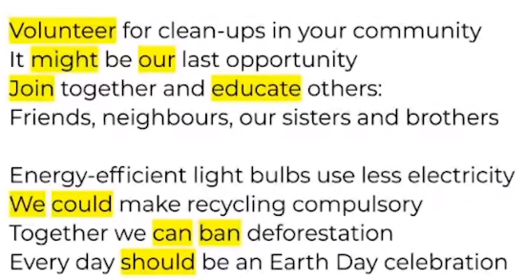
Wednesday 24th June
Before you look at the WAGOLL below, watch the video about modal verbs to remind yourself what they are.
https://www.bbc.co.uk/bitesize/topics/zwwp8mn/articles/zps4pbk
modal verb
imperative verb
rhetorical question
imperative verb
modal verb
facts, figures and opinions
emotional language
imperative verb
pronoun
imperative verb
modal verb
pronoun
imperative verb
modal verb
pronoun
Imperative verb
modal verb

Slide 3
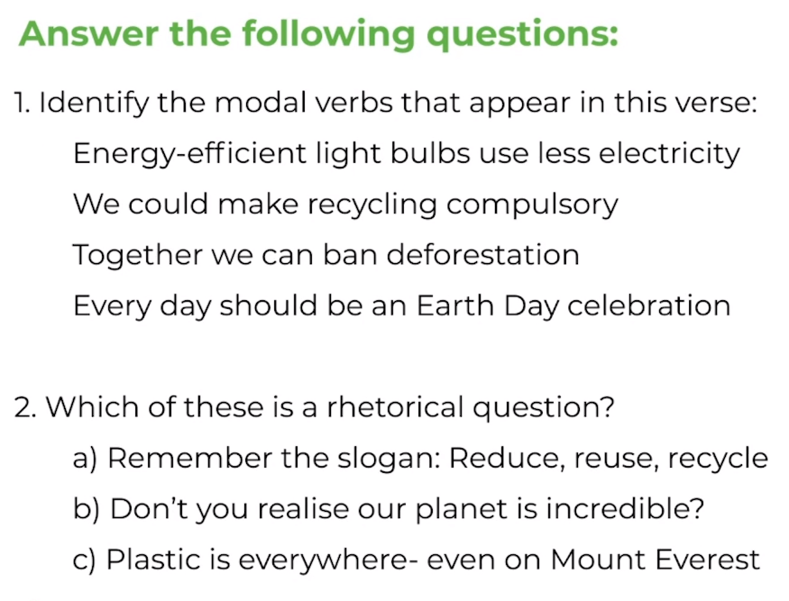
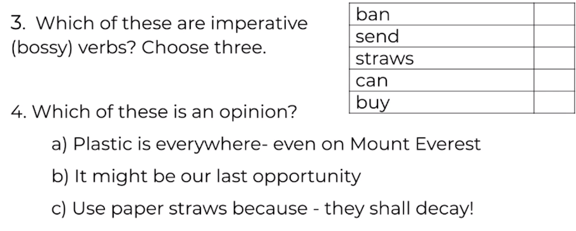
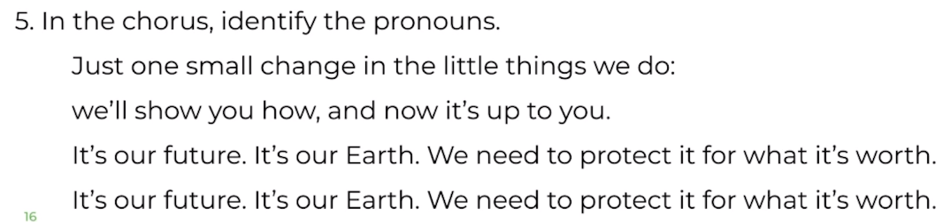
LO: To identify features of a persuasive rap
Wednesday 24th June

Slide 4
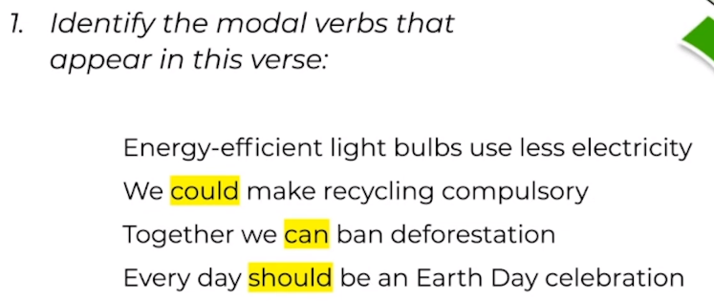
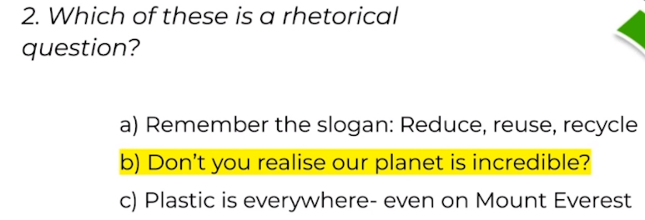
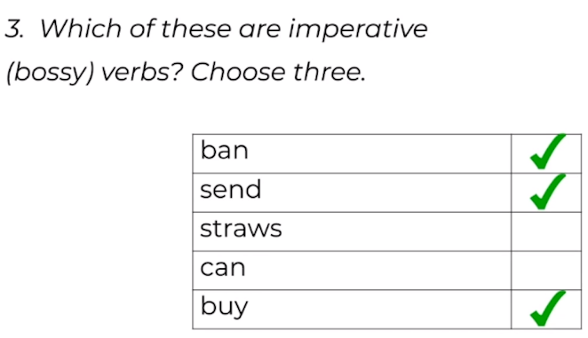
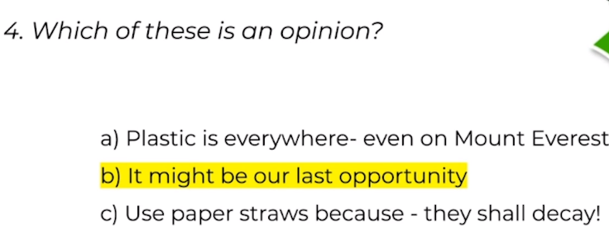
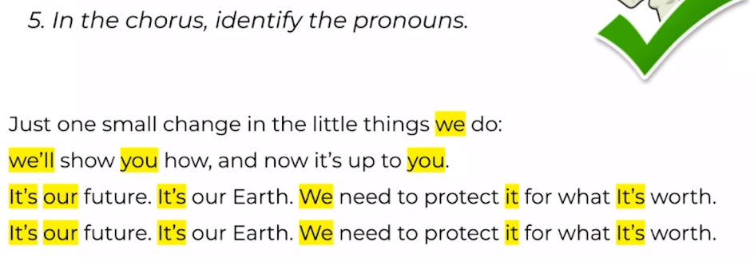
ANSWER SHEET
Wednesday 24th June

Slide 5
Needs water challenge
Wednesday 24th June
1) Why is ‘it might be our last opportunity’ an opinion and not a fact?
___________________________________________________
2) What is the imperative verb in the phrase “shut the door” and why?
___________________________________________________
3) Identify two rhyming couplets in the WAGOLL and write it down.
___________________________________________________
4) What definition best matches the word ‘sustainable’? Circle your answer.
To maintain the supply of
To get stains out of clothing
To use up all the supplies
5) Re-write the paragraph below and change the pronouns.
Katelyn had a really awful day at school so Katelyn decided to eat some chocolate biscuits when Katelyn got home. Katelyn’s Mum wondered what had happened.
___________________________________________________
___________________________________________________
___________________________________________________

Slide 6
Needs water ANSWERS
Wednesday 24th June
Why is ‘it might be our last opportunity’ an opinion and not a fact?
The modal verb ‘might’ shows that it is not certain
2) What is the imperative verb in the phrase “shut the door” and why?
Shut – it is an instruction
3) Identify two rhyming couplets in the WAGOLL and write it down.
Stressed/Everest - Others/Brothers - recycle/survival – waterway/decay - do/you - opportunity/community - deforestation/celebration
4) What definition best matches the word ‘sustainable’? Circle your answer.
To maintain the supply of
To get stains out of clothing
To use up all the supplies
5) Re-write the paragraph below and change the pronouns.
Katelyn had a really awful day at school so Katelyn decided to eat some chocolate biscuits when Katelyn got home. Katelyn’s Mum wondered what had happened.
Katelyn has a really awful day at school so she decided to eat some chocolate biscuits when she got home. Her mum wondered what had happened.

