Slide 1
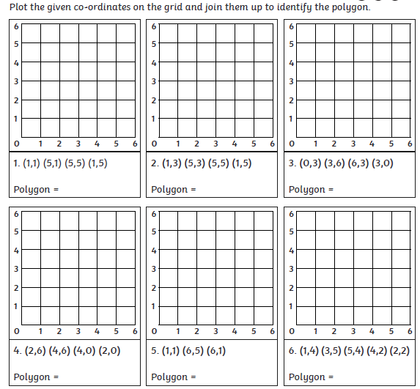
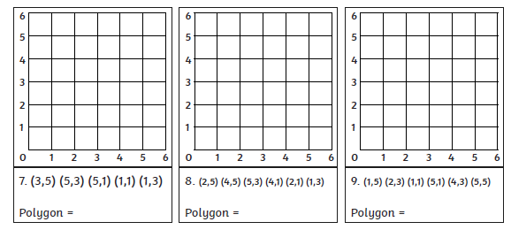
MILD
Wednesday 24th June
L.O. To draw polygons using co-ordinates given

Slide 2
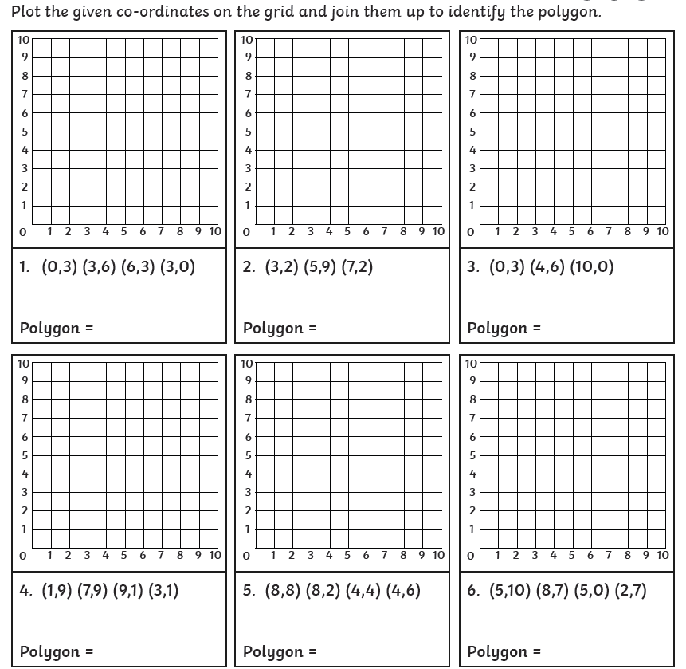
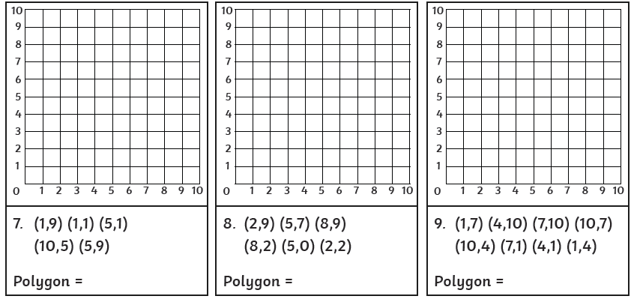
Wednesday 24th June
SPICY
L.O. To draw polygons using co-ordinates given

Slide 3
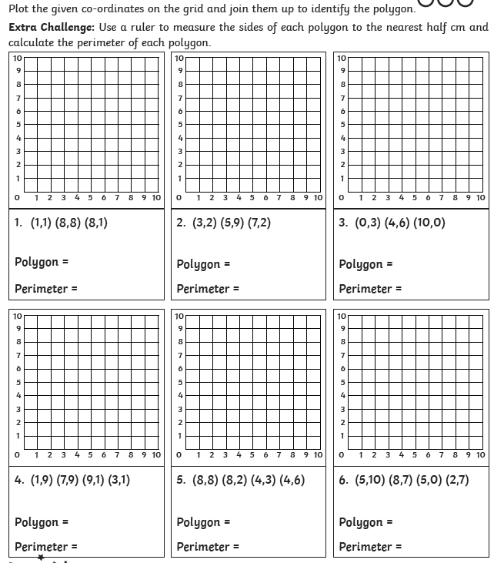
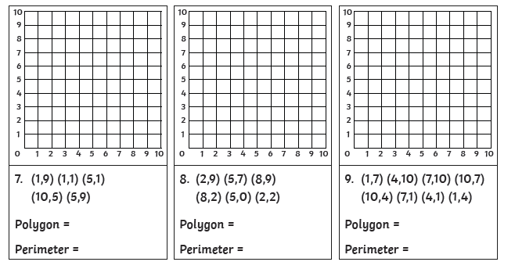
HOT
Wednesday 24th June
L.O. To draw polygons using co-ordinates given

Slide 4


