Slide 1
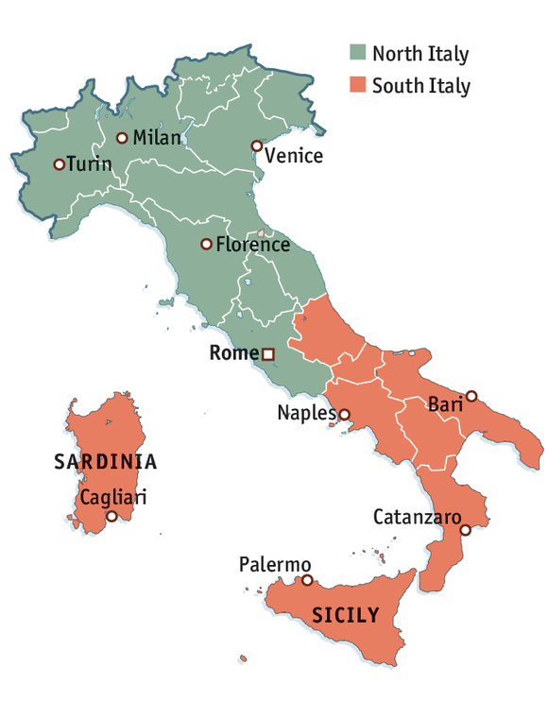
Wednesday 24th June
Why do people migrate?
Using all your past learning about Italy, what reasons would people prefer to live in Northern Italy?
What is migration?
To move from one place and go and live in another
Using all your past learning about Italy, what reasons would people prefer to live in Sothern Italy?

Slide 2
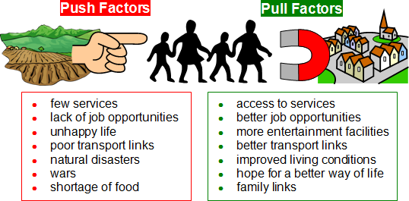
When thinking about migration, there are pull factors which are pulling into an area and push factors which are pushing you away from an area
How do these factors relate to Italy?

Slide 3
Push and pull factors for Southern and Northern Italy. Can you add to these lists?
Southern Italy
Northern Italy
+ Lots of space
+ Ancient tourist attractions
+ Beautiful landscapes
+ All year round nice weather
+ Scenic beaches
Hilly and mountains landscape
Far from urban markets and shops
Isolated
Poor quality soil
Lacks modern technology
+ Near to major industries
+ Many job opportunities
+ Fertile soil
+ Easy to borrow money for business
+ Higher quality of life
+ No droughts
+ Tourist attractions
+ Good transportation links
Lots of people to compete with
Pollution caused by mass industry
Expensive to live
Overcrowding in large cities

Slide 4
Wednesday 24th June
Why do people migrate?
Mild – Write a letter to your parents to persuade them to move to either Northern or Southern Italy. Think about which region you would rather live in and make sure you provide several clear reasons. Include 3 paragraphs:
Explain why you are writing your parents a letter and describe which part of Italy you want to move to
Give reasons for why you should move to this region, explain each one clearly with examples
Summarise your letter, reminding your parents what you want
Spicy – Design a leaflet to encourage people to migrate to either North or South of Italy. Use the template provided. Include different persuasive arguments on each part of your leaflet, thinking carefully about the language you are using and choosing the reasons you feel are most important.
Hot – Write a balanced argument about life in Northern and Southern Italy. Include 4 paragraphs:
An introduction to migration
Reasons why Northern Italy would make a better place to live
Reasons why Southern Italy would make a better place to live
Conclusion, stating your opinion about where you would rather live and why

