Slide 1

Hamlet
Monday 22nd/ Thursday 25th June English PowerPoint
To be or not to be? That is the question.

Slide 2
Monday 22nd/ Thursday 25th June English PowerPoint
LO: Write a diary entry from the viewpoint of either Hamlet or Claudius
Success criteria:
Written in the first person.
Adverbials of time to show sequence of events
Events described using past tense
Use of informal language and phrases
Adjectives to describe feelings
Use of questions to show character’s thought process
Use of key spellings (amateur, conscience, immediately, opportunity)
Select language that shows good awareness of the reader
Use a range of punctuation correctly

Slide 3
Let’s recap…
Monday 22nd/ Thursday 25th June English PowerPoint

Slide 4
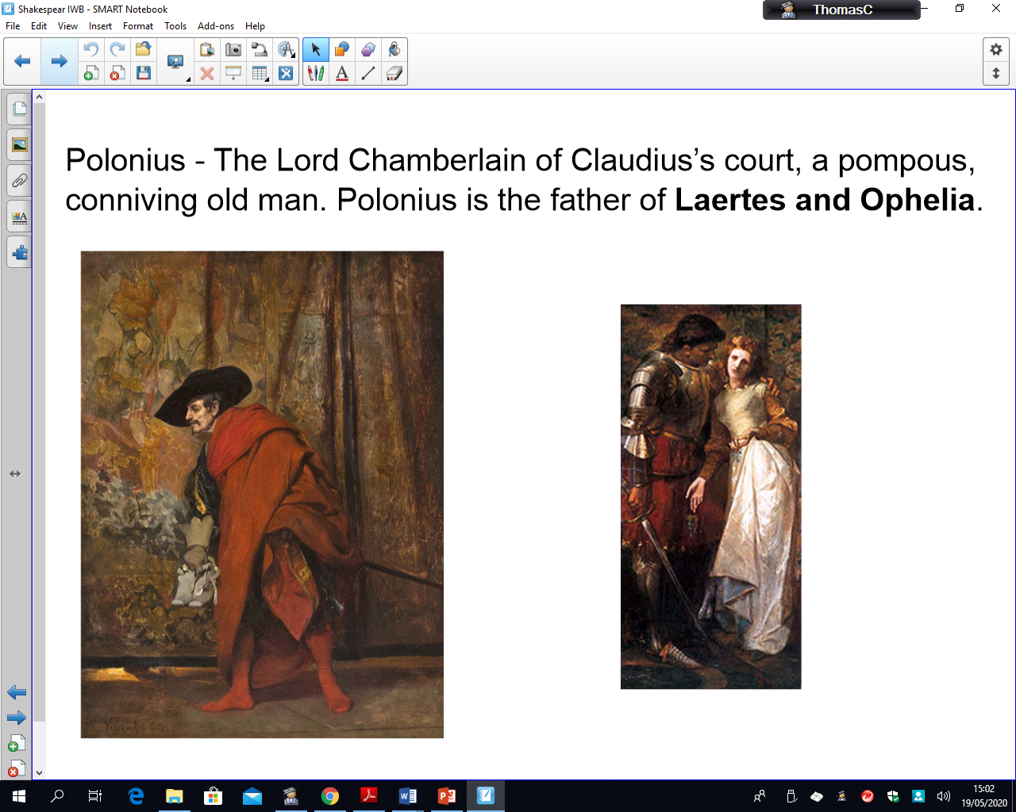
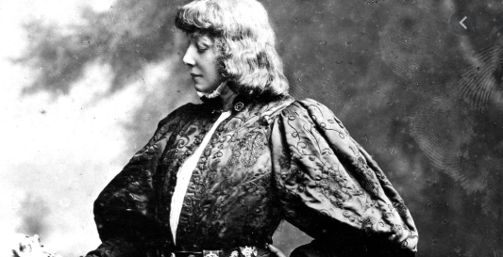
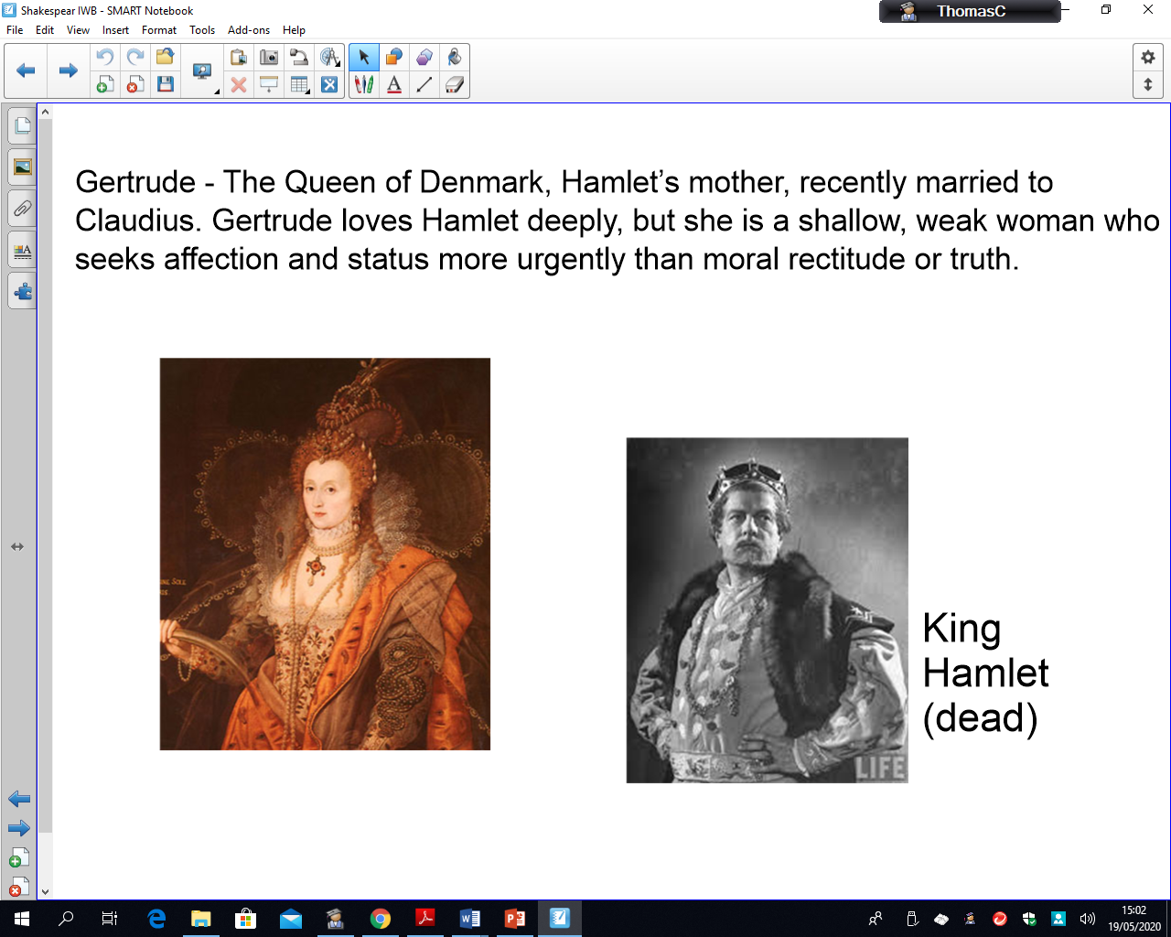
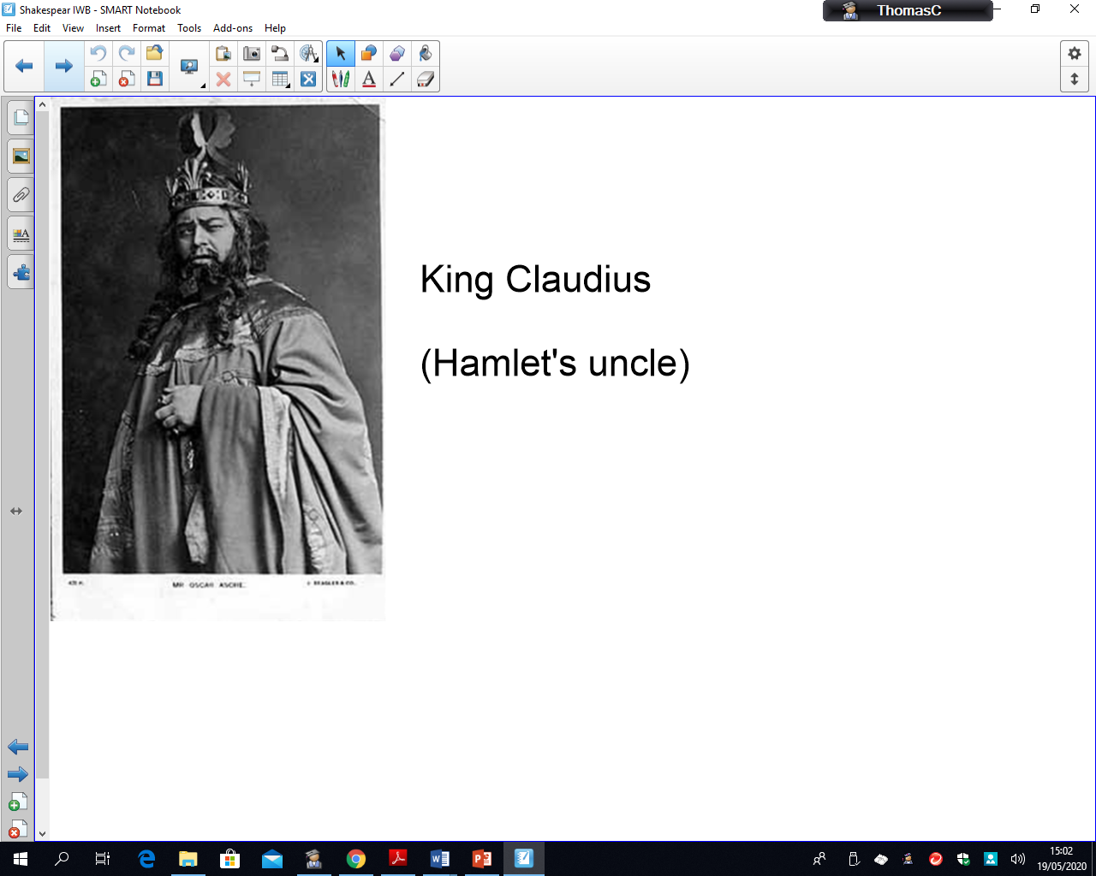
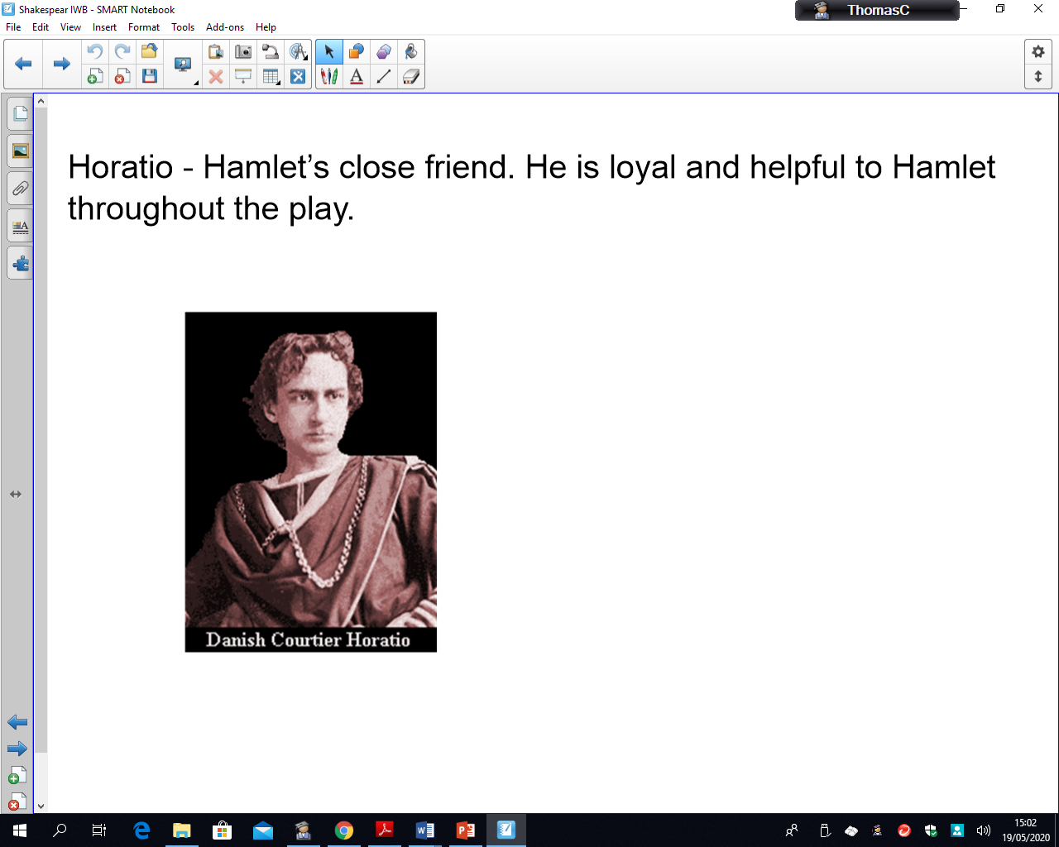
Who’s Who?
Monday 22nd/ Thursday 25th June English PowerPoint

Slide 5
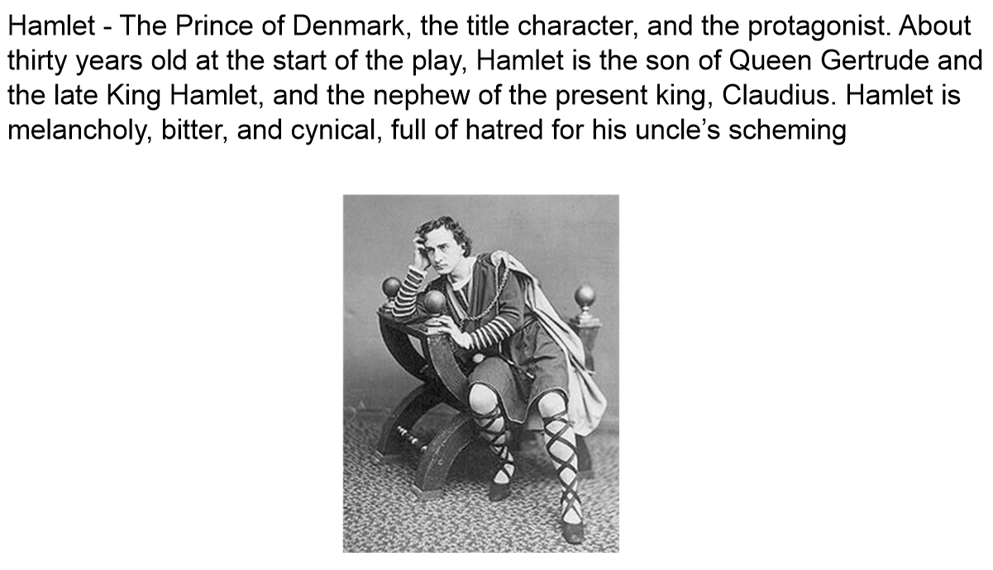
Monday 22nd/ Thursday 25th June English PowerPoint

Slide 6
Monday 22nd/ Thursday 25th June English PowerPoint

Slide 7
Monday 22nd/ Thursday 25th June English PowerPoint

Slide 8
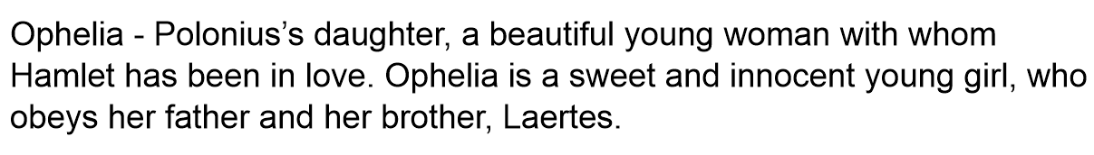
Monday 22nd/ Thursday 25th June English PowerPoint

Slide 9
Monday 22nd/ Thursday 25th June English PowerPoint

Slide 10
Monday 22nd/ Thursday 25th June English PowerPoint
LO: Write a diary entry from the viewpoint of either Hamlet or Claudius
Success criteria:
Written in the first person.
Adverbials of time to show sequence of events
Events described using past tense
Use of informal language and phrases
Adjectives to describe feelings
Use of questions to show character’s thought process
Use of key spellings (amateur, conscience, immediately, opportunity)
Select language that shows good awareness of the reader
Use a range of punctuation correctly
Teacher to model/share write opening to diary entry. Children have examples of diary entries on their tables to support as well as the success criteria.

Slide 11
Noun phrases | verbs | adverbs | Descriptive phrases
innocent father selfish old fiend royal throne as pale as a colourless cloud deadly actions innocent fellow fiendish truth traitor | slay avenge murdered revealing my secret expose my uncle’s guilt slumped poisoned wailed | hastily defiantly selfishly | Perchance I should’ve not murdered King Hamlet? Perchance I should have been a patient man? Perchance I should’ve not taken mine royal height for granted? The scarlet sheen will soon be drizzling down on him I was shocked into a silence of guilt… An evil traitor he is.

