Slide 1

Hamlet
Tuesday 23rd/ Friday 26th June English PowerPoint
To be or not to be? That is the question.

Slide 2
Tuesday 23rd/ Friday 26th June English PowerPoint
LO: Edit, improve and publish a diary entry from the viewpoint of either Hamlet or Claudius
Success criteria:
Written in the first person.
Adverbials of time to show sequence of events
Events described using past tense
Use of informal language and phrases
Adjectives to describe feelings
Use of questions to show character’s thought process
Use of key spellings (amateur, conscience, immediately, opportunity)
Select language that shows good awareness of the reader
Use a range of punctuation correctly

Slide 3
Let’s recap…
Tuesday 23rd/ Friday 26th June English PowerPoint

Slide 4
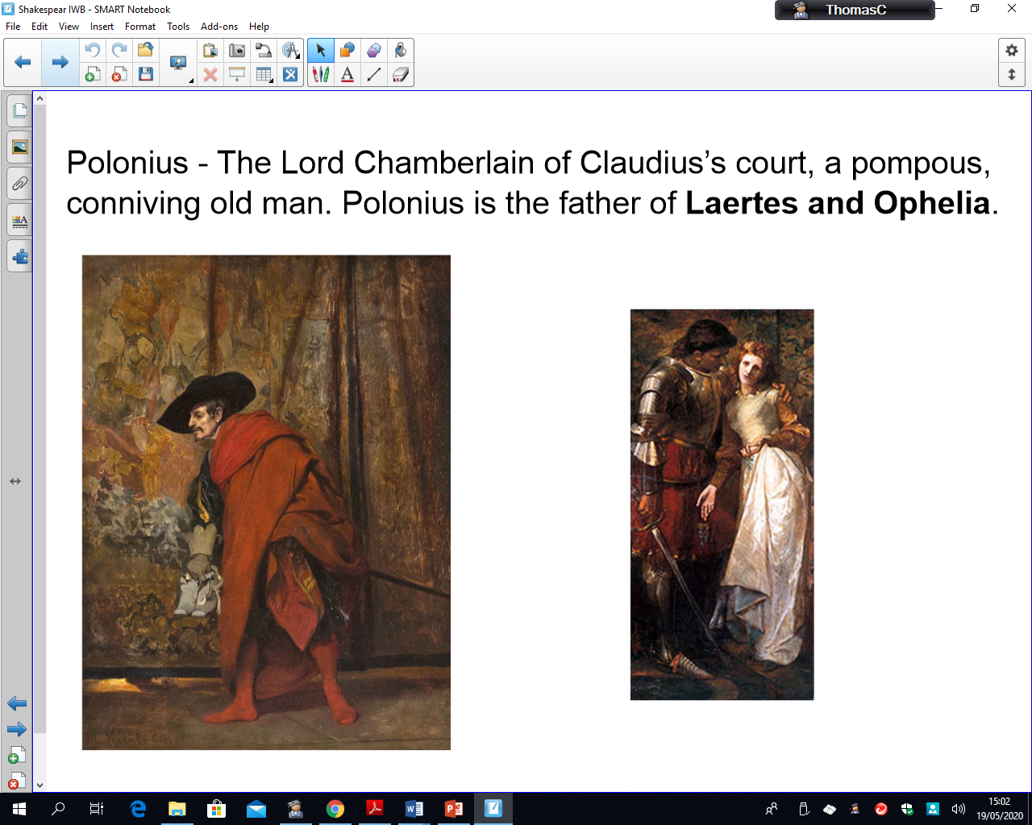
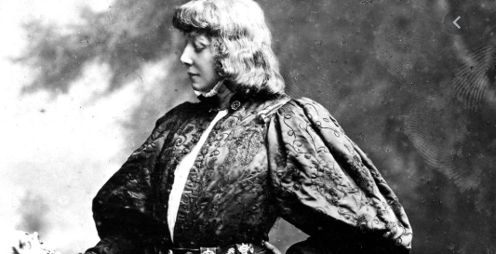
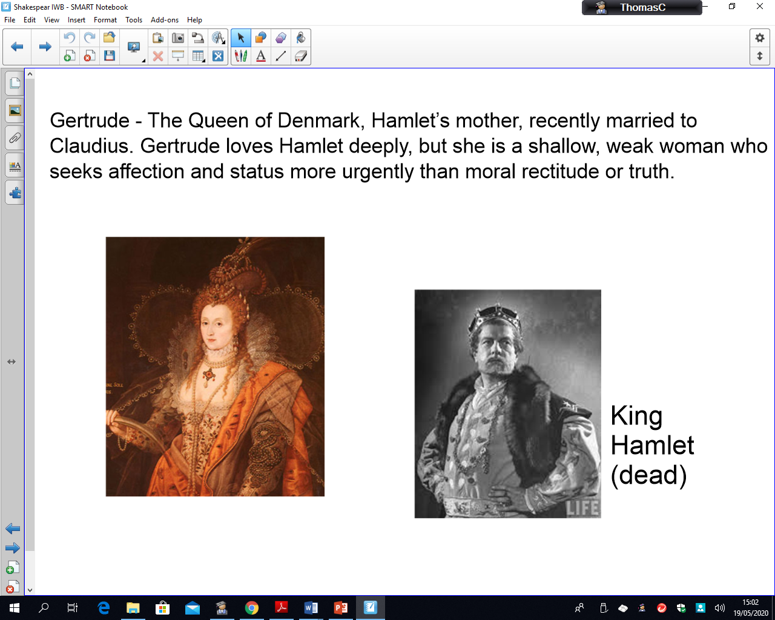
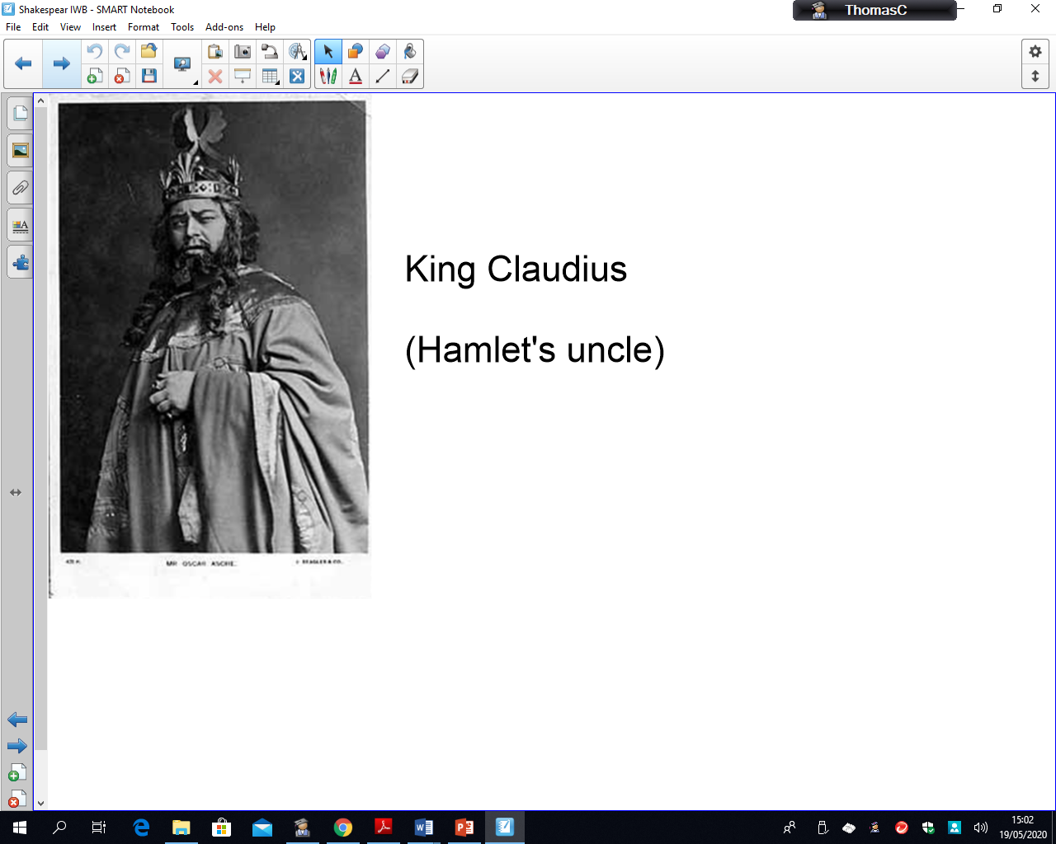
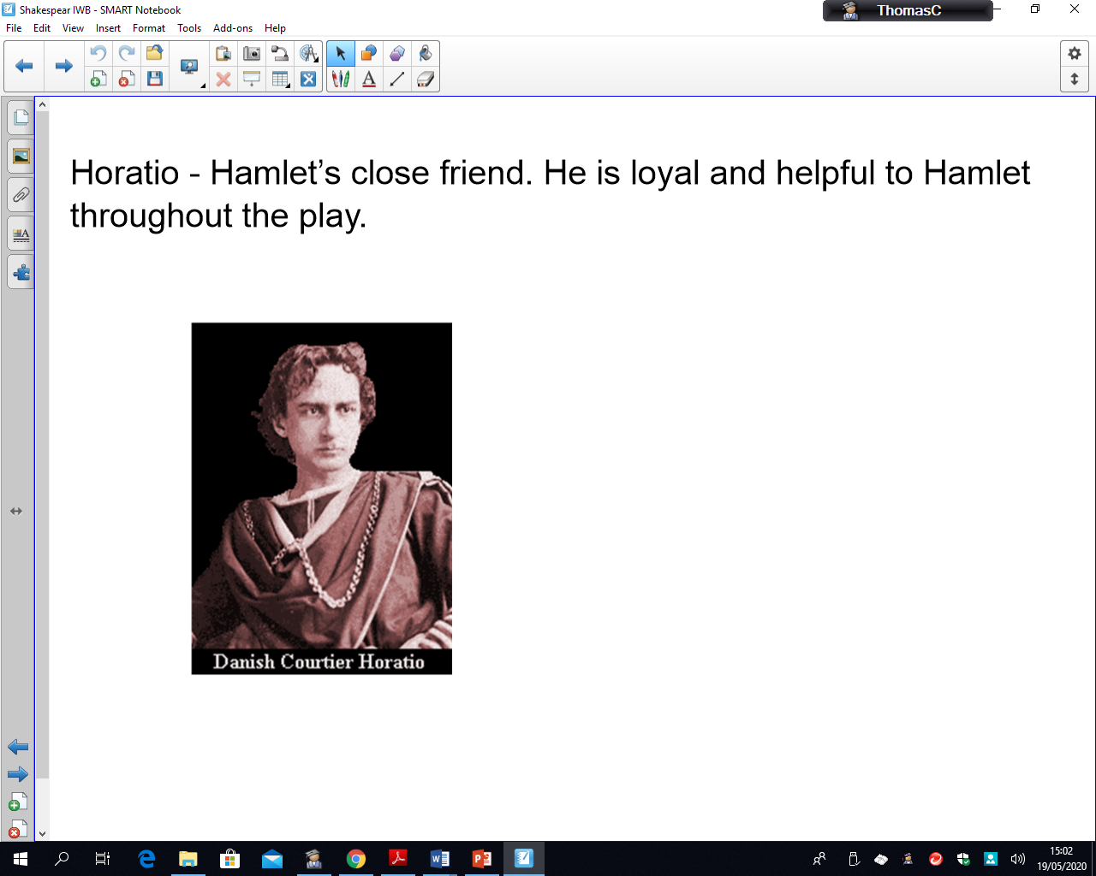
Who’s Who?
Tuesday 23rd/ Friday 26th June English PowerPoint

Slide 5
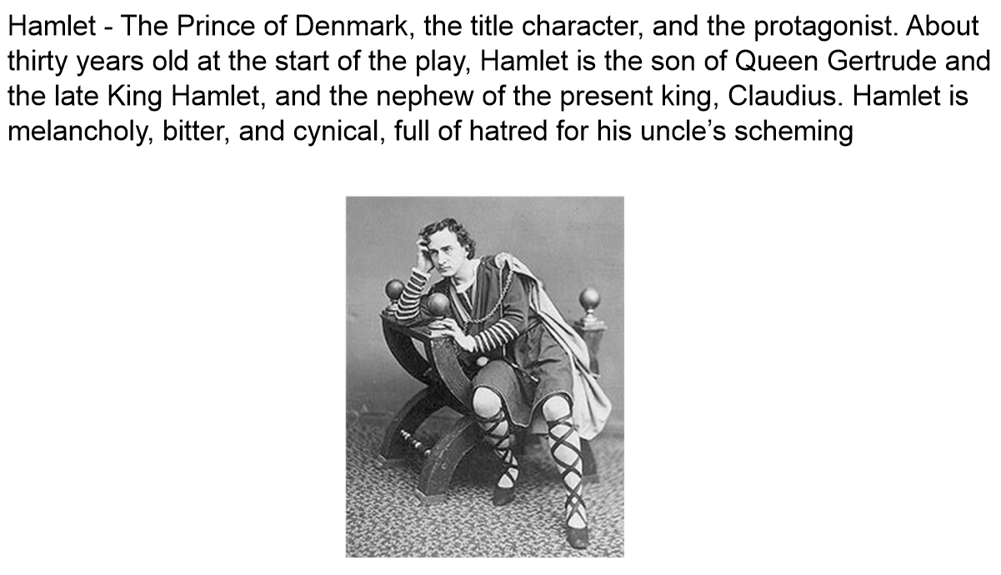
Tuesday 23rd/ Friday 26th June English PowerPoint

Slide 6
Tuesday 23rd/ Friday 26th June English PowerPoint

Slide 7
Tuesday 23rd/ Friday 26th June English PowerPoint

Slide 8
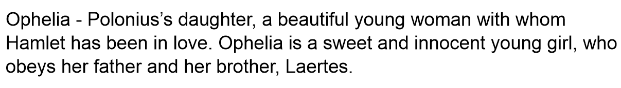
Tuesday 23rd/ Friday 26th June English PowerPoint

Slide 9
Tuesday 23rd/ Friday 26th June English PowerPoint

Slide 10
Tuesday 23rd/ Friday 26th June English PowerPoint
LO: Edit, improve and publish a diary entry from the viewpoint of either Hamlet or Claudius
Success criteria:
Written in the first person.
Adverbials of time to show sequence of events
Events described using past tense
Use of informal language and phrases
Adjectives to describe feelings
Use of questions to show character’s thought process
Use of key spellings (amateur, conscience, immediately, opportunity)
Select language that shows good awareness of the reader
Use a range of punctuation correctly
Have a couple examples of children’s writing scanned in and model editing and improving using success criteria. Children then edit and improve their own writing and publish if time.

Slide 11


