Slide 1
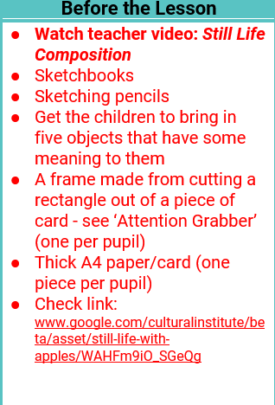
Teacher slide
Monday 22nd /Thursday 25th June – Art
https://www.kapowprimary.com/
See lesson plan for username and password
Once logged in, go to: subjects/ art-design/ upper-key-stage-2/ year-6/ still-life

Slide 2
LO: To sketch ideas for a still life study
Monday 22nd /Thursday 25th June – Art
Success Criteria
I can draw with attention to form line and layout
I can draw observing with care
I know that my sketches are not the finished article and I can do several attempts

Slide 3
Monday 22nd /Thursday 25th June – Art
You were asked to bring in five objects that mean a lot to you and which represent important memories.
Today you will be arranging these in order to draw them as a still life study.
Let’s look at some examples of still life sketches and paintings and discuss as a class what we notice about these compositions…

Slide 4
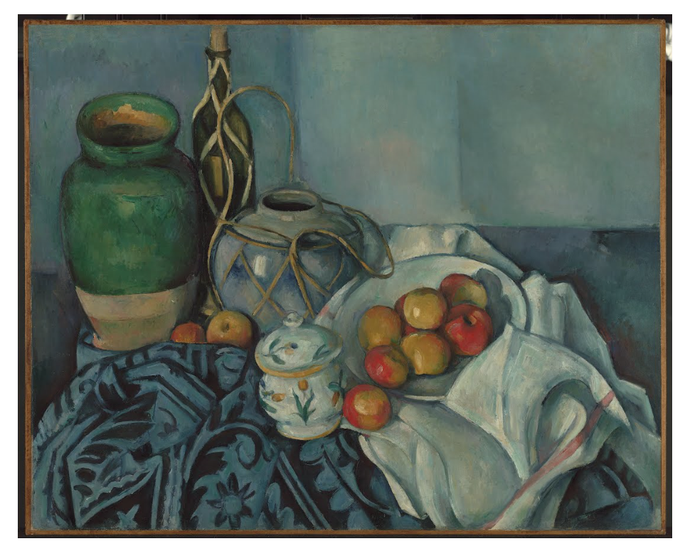
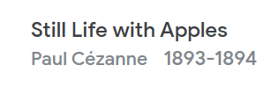
Monday 22nd /Thursday 25th June – Art
https://artsandculture.google.com/asset/still-life-with-apples/WAHFm9iO_SGeQg
Key Questions
Look for the direction of the lines that make up each shape - what direction does each lie in?
Where does the object lie in the frame?
What can you see half way across or down the frame?

Slide 5
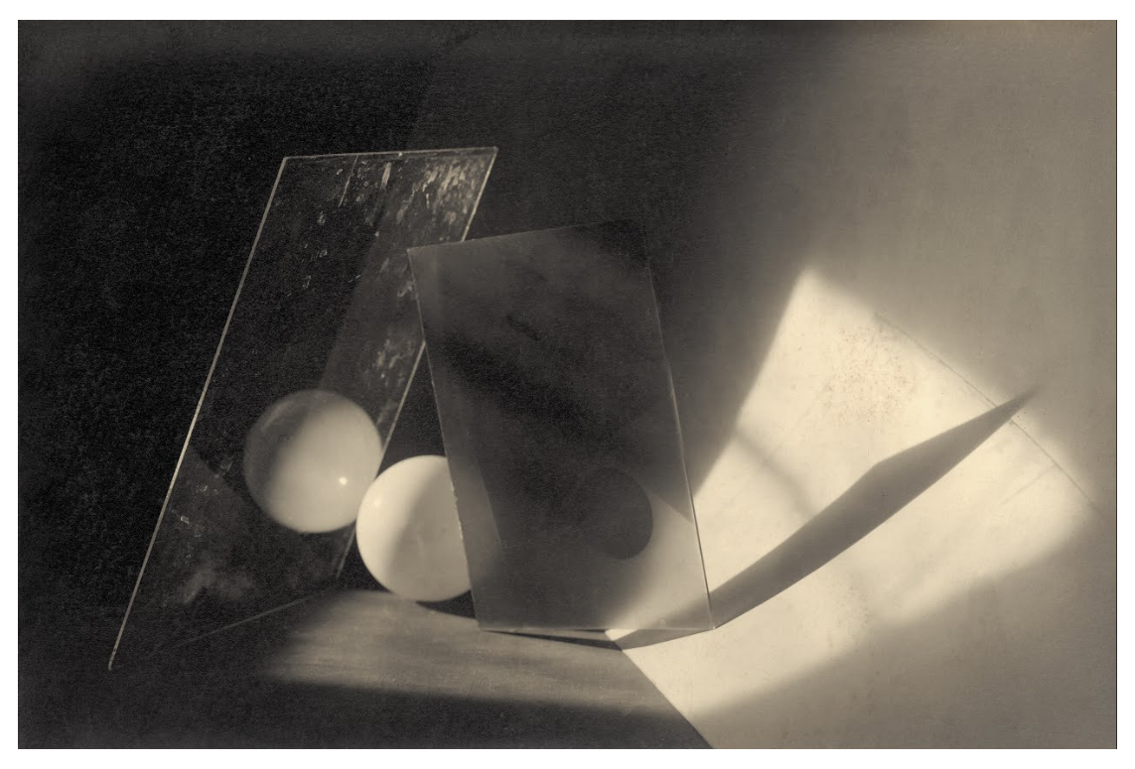
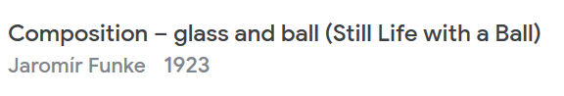
Monday 22nd /Thursday 25th June – Art
https://artsandculture.google.com/asset/composition-–-glass-and-ball-still-life-with-a-ball/XwF8YLw4igKZ-g
Key Questions
Look for the direction of the lines that make up each shape - what direction does each lie in?
Where does the object lie in the frame?
What can you see half way across or down the frame?

Slide 6
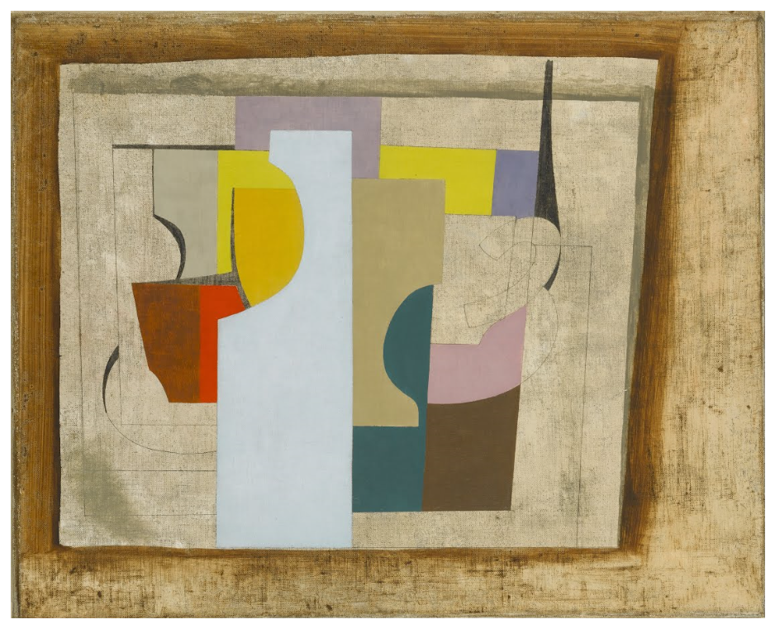
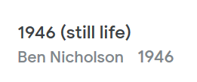
Monday 22nd /Thursday 25th June – Art
https://artsandculture.google.com/asset/1946-still-life/XQHzqzrXWcNxEw
Key Questions
Look for the direction of the lines that make up each shape - what direction does each lie in?
Where does the object lie in the frame?
What can you see half way across or down the frame?

Slide 7

Before moving on…
Monday 22nd /Thursday 25th June – Art
Make a paper or card frame by cutting a rectangle out of a piece of card to be used later in the lesson.

Slide 8
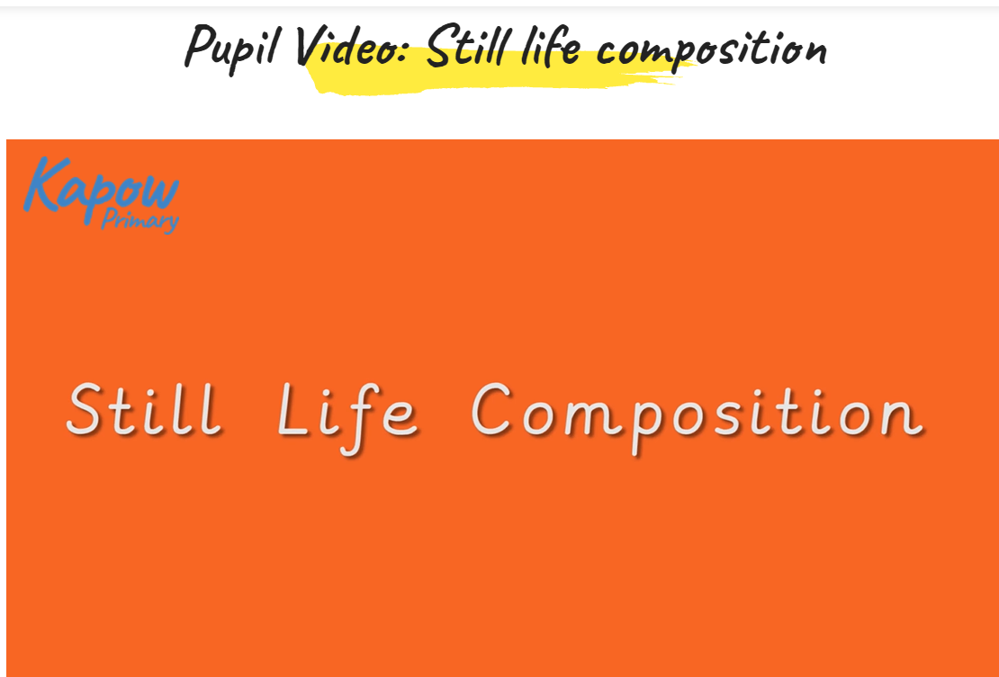
Watch Pupil Video…
Monday 22nd /Thursday 25th June – Art

Slide 9
Let’s get started…
Monday 22nd /Thursday 25th June – Art
Group your objects in an arrangement.
You should ensure that:
the objects can all be seen
the objects all overlap slightly, making them appear as one body
no single object entirely dominates the composition

Slide 10
Monday 22nd /Thursday 25th June – Art
Once you are happy with how your still life arrangement looks, you can start with some preparatory sketches, using your frame to help create boundaries for your composition so you can see how it would look on a page. You should mark out the key shapes of the objects and try sketching them from different angles.
You can have several attempts at this, rearranging the objects in the layout as desired.
Once you’ve finished your sketches, you should draw your final composition on a piece of thick A4 paper or card

