Slide 1
Living things

Slide 2

Who discovered classification?

Slide 3
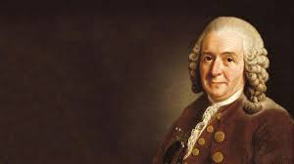
Carl Linnaeus
https://www.tigtagworld.com/clil/film/carl-linnaeus-PRM00688/

Slide 4
Carl Linnaeus
‘God created, Linnaeus organised’
These are the bold words of 18th century Swedish scientist Carl Linnaeus. Linnaeus was a confident young man who wanted to make a name for himself in botany (plant science). He was particularly fascinated by the great variety of plants in the world and sought to find a way of organising them.

Slide 5
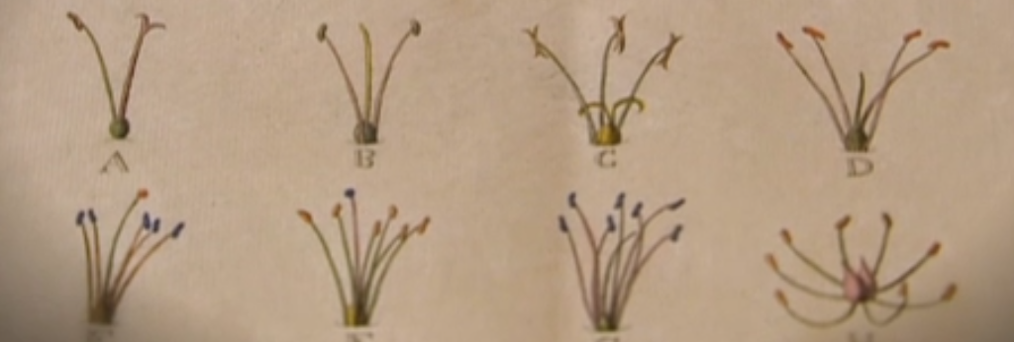
Carl Linnaeus
One day he thought he noticed something that no one else had: he thought that plants could be organised into groups according to the number of male and female reproductive organs they had. He noticed that the flowers of some plants had two male parts, while others had more than 20. So Linnaeus created a classification system based on this physical characteristic.

Slide 6
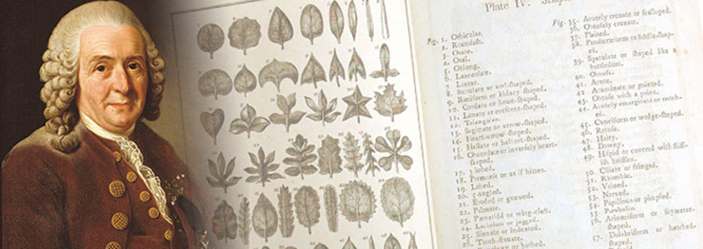
Carl Linnaeus
He was devastated when other scientists pointed out that his method was not accurate – flowers of the same plant could have different numbers of reproductive organs. Undeterred, he refined his system, grouping plants by other physical characteristics, such as leaf shape and seed type. We still use his improved system to classify living things today.

Slide 7
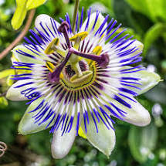
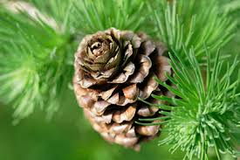
Plants
Plants can be divided into two main groups:
non-flowering and flowering plants.
Flowering plants include all other plants, including most trees, grasses and shrubs. They have flowers that produce pollen. Some flowers are adapted to attract insects for pollination, but other flowers use wind or water for pollination. Once pollinated, a flower will develop into a seed.
Non-flowering plants include conifers, ferns and mosses. Conifers have cones that produce pollen and seeds in the same way as flowers. They are wind-pollinated. Ferns and Mosses do not produce seeds – they reproduce by making spores that can grow into new plants.

Slide 8
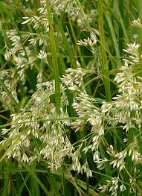
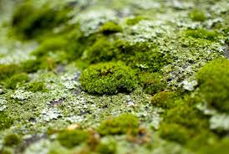
Plants
It might not be obvious which parts are the flowers in some flowering plants. For example, the flowers in grasses are small and green, rather than the brightly coloured parts that we normally think of as flowers.
Moss is commonly found amongst grass, in damp, shady places, in soil and on hard surfaces such as rocks, tiles and brickwork. Ferns also like moist, fairly dark areas and are often found in woodlands.

Slide 9
Task – Classify leaves
Leaf keys
Collect a range of different leaves from the school grounds or use the leaf sheet provided. Then, create a classification key to help identify them.
(Remember that Carl Linnaeus classified his plants by leaf shape.)

