Slide 1
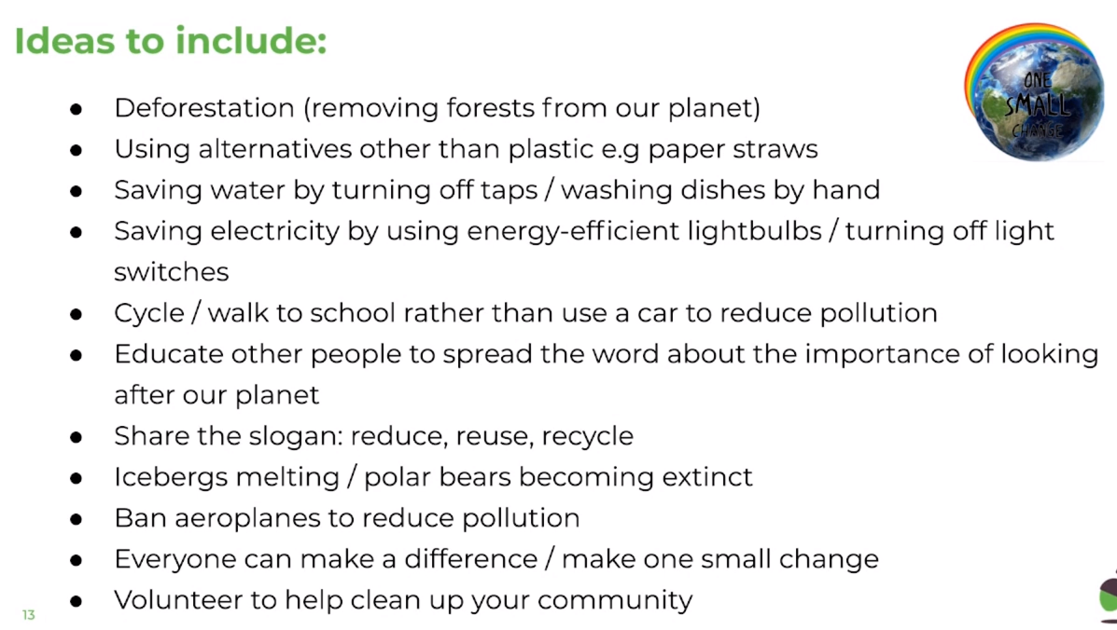
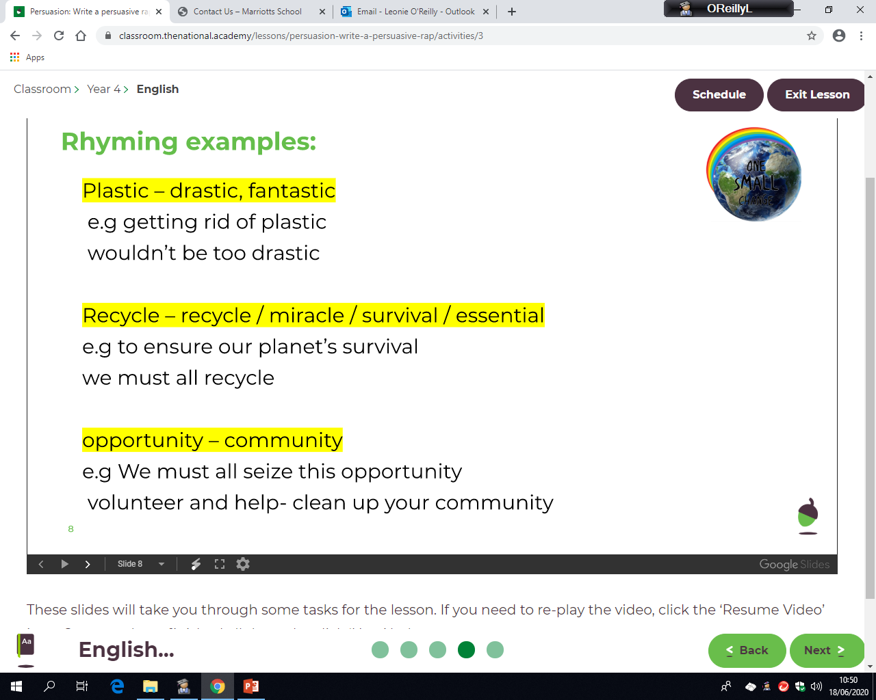
LO: To plan a persuasive rap.
Thursday 25th June
It’s now time to start planning your persuasive rap about saving the planet. Firstly, watch the video that a primary school created about saving the planet and make one small change.
https://www.youtube.com/watch?v=kuR7VN_Q06g&feature=emb_title

Slide 2
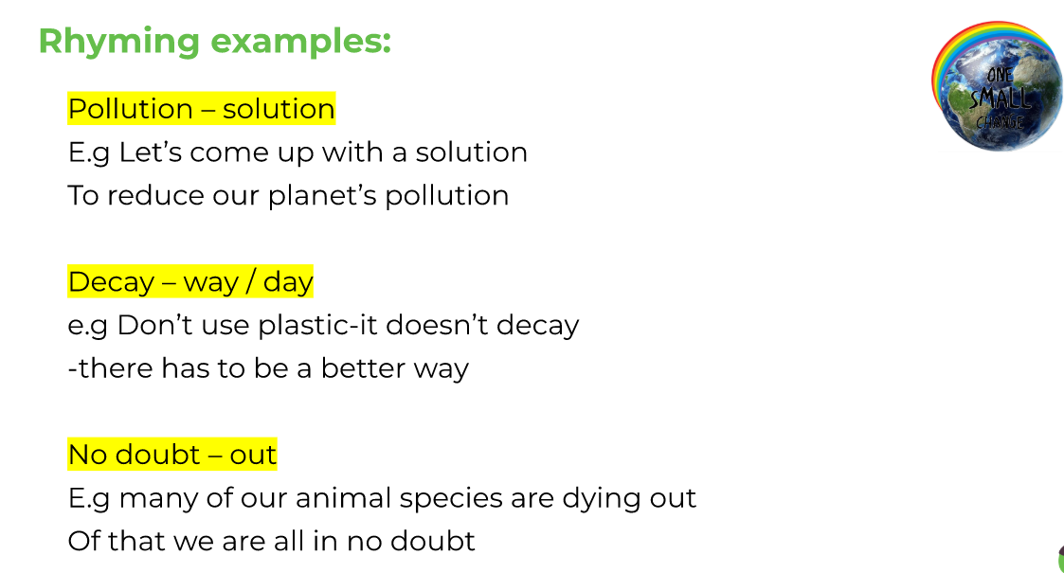
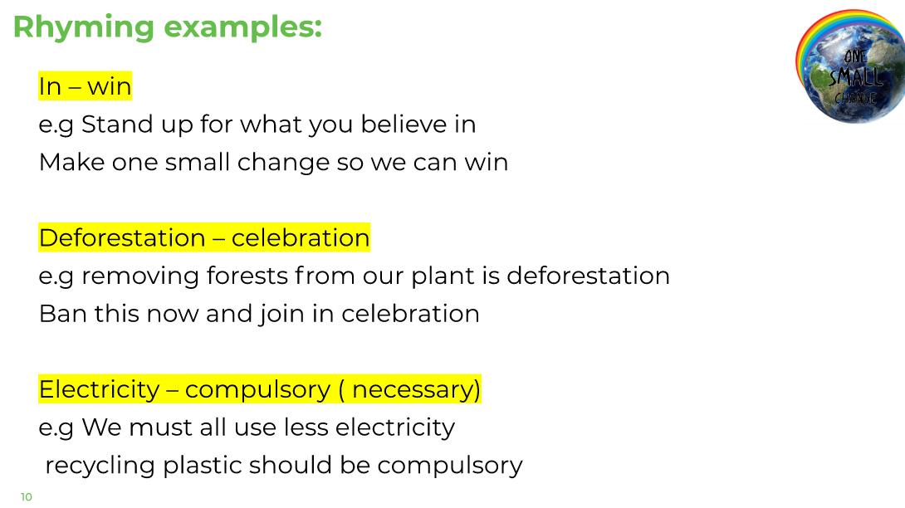
LO: To plan a persuasive rap.
Thursday 25th June

Slide 3
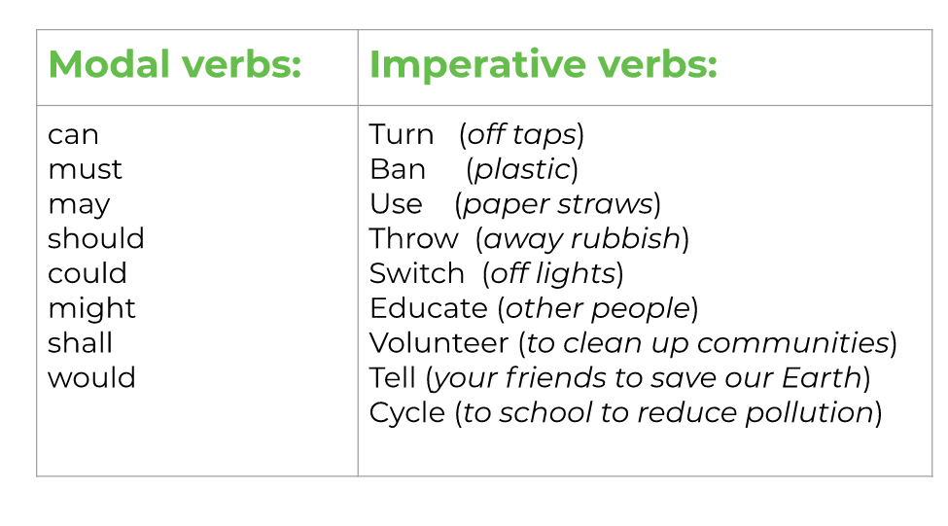
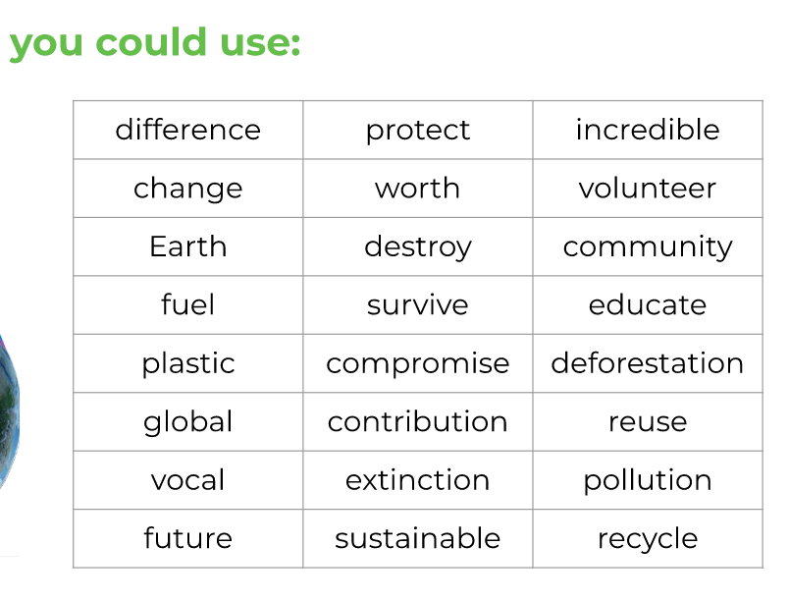
LO: To plan a persuasive rap.
Thursday 25th June

Slide 4
LO: To plan a persuasive rap.
Thursday 25th June
It’s time to start drafting some ideas on your planning sheet to use in your writing tomorrow.
Rhetorical Questions - E.G Can you help us save The Earth? | Imperative Verbs – Ordering the reader E.G Stop wasting/Start helping
Modal verbs - | Alliteration –
Rhyming couplets - | Opinions to include - E.G The planet might never be the same again
Ideas to include, what will be your key important points about saving the planet?

