Slide 1
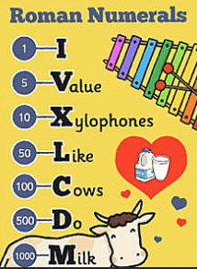
Friday 26th June
Help Sheet
You could use the mnemonic above or adapt this one to make one of your own

