Slide 1
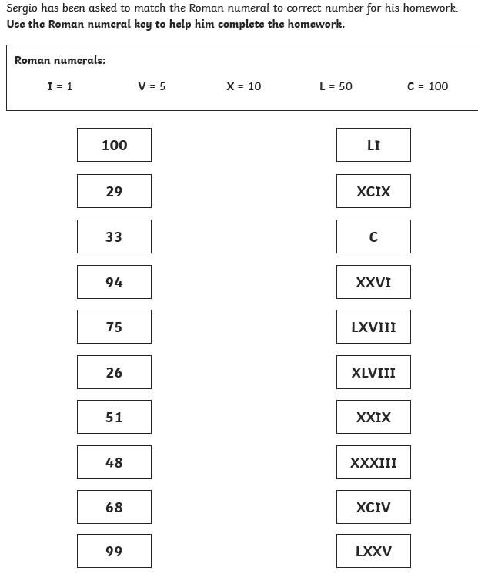
Friday 26th June
MILD
LO: to read Roman numerals

Slide 2
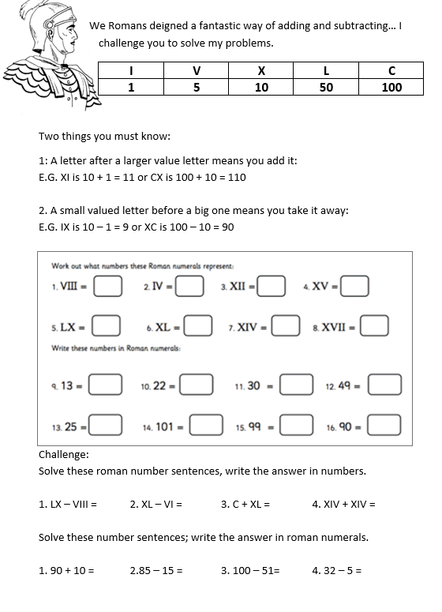
Friday 26th June
SPICY
LO: to read Roman numerals

Slide 3
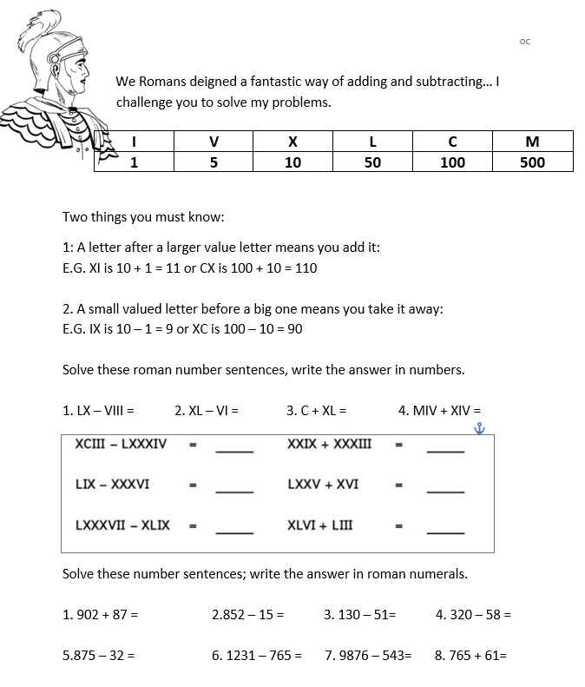
Friday 26th June
HOT
LO: to read Roman numerals

Slide 4
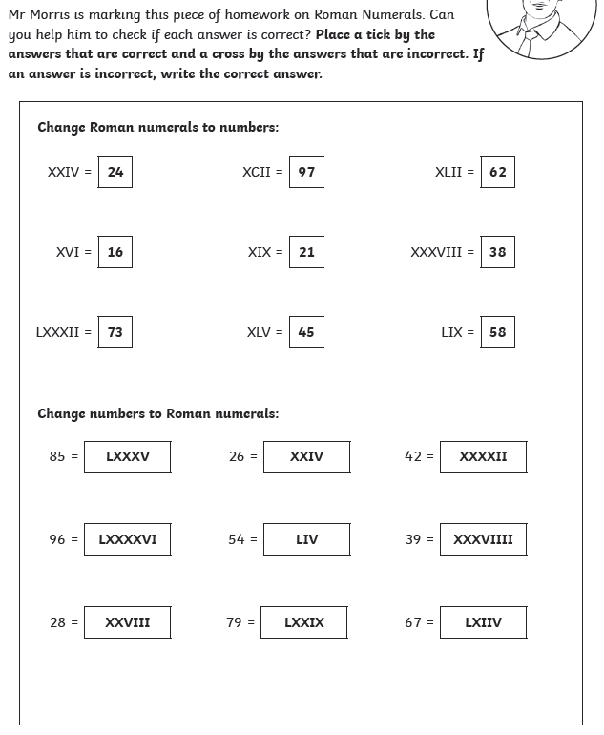
Friday 26th June
NEEDS WATER
LO: to read Roman numerals

