Slide 1

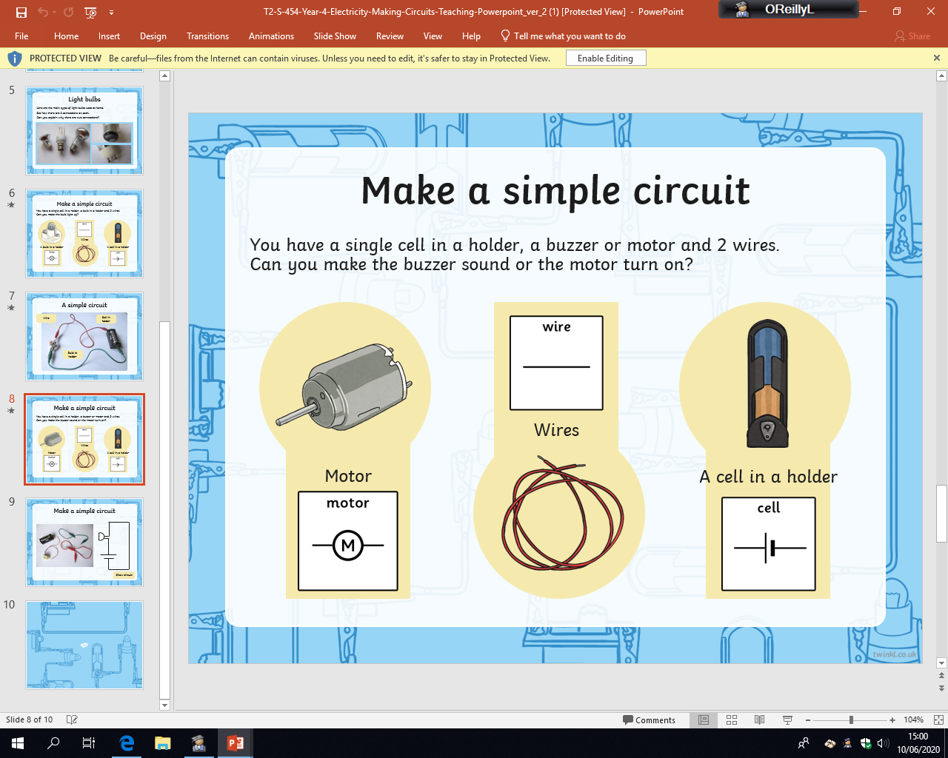

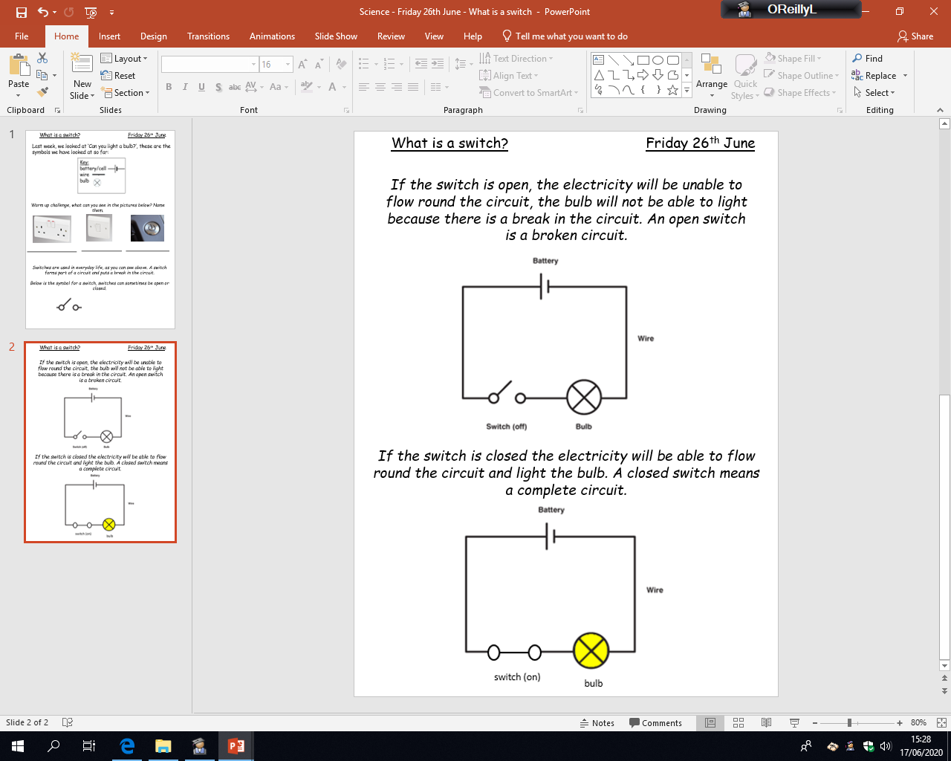

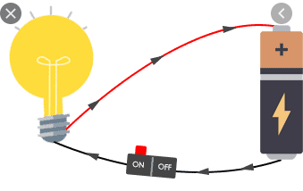
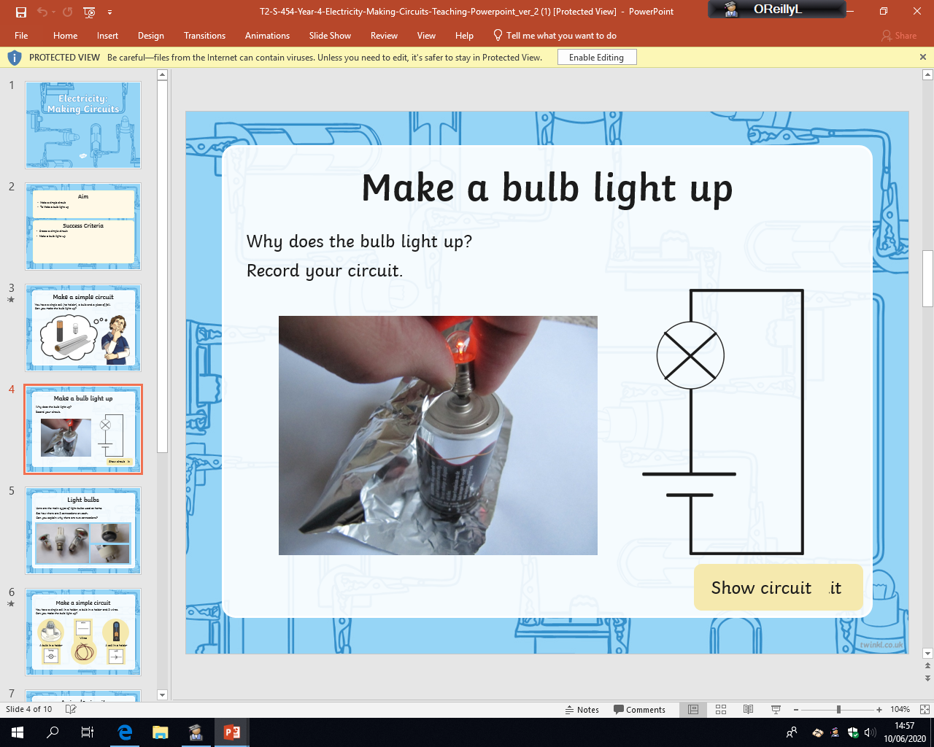

Friday 26th June
Mild
What is a switch?
Decide if the circuits below are complete or broken, explain why.
Below is a simple everyday circuit, containing a bulb, battery and switch. The bulb is lit up because the switch is closed (therefore it is on). The circuit is complete.
Is it a complete circuit? Yes/No
Is it a complete circuit? Yes/No
Is it a complete circuit? Yes/No
Is it a complete circuit? Yes/No
Key:
battery/cell
wire
Bulb
switch
Is it a complete circuit? Yes/No
Is it a complete circuit? Yes/No
Is it a complete circuit? Yes/No
Is it a complete circuit? Yes/No

Slide 2

Friday 26th June
Spicy
What is a switch?
Decide if the circuits below are complete or broken, explain your reason for your answer.
Colour the complete circuit bulbs yellow to show there is power when you are finished.
Below is a simple everyday circuit, containing a bulb, battery and switch. The bulb is lit up because the switch is closed (therefore it is on). The circuit is complete.
___________
___________
___________
___________
___________
___________
___________
___________
___________
___________
___________
___________
Key:
battery/cell
wire
Bulb
switch
___________
___________
___________
___________
___________
___________
___________
___________
___________
___________
___________
___________

Slide 3

Friday 26th June
Hot
What is a switch?
Decide if the circuits below are complete or broken, explain your reason for your answer. Then, on the back of the sheet explain how the broken circuits need fixing. Colour the complete circuit bulbs yellow to show there is power when you are finished.
Below is a simple everyday circuit, containing a bulb, battery and switch. The bulb is lit up because the switch is closed (therefore it is on). The circuit is complete.
___________
___________
___________
___________
___________
___________
___________
___________
___________
___________
___________
___________
Key:
battery/cell
wire
Bulb
switch
___________
___________
___________
___________
___________
___________
___________
___________
___________
___________
___________
___________

