Slide 1
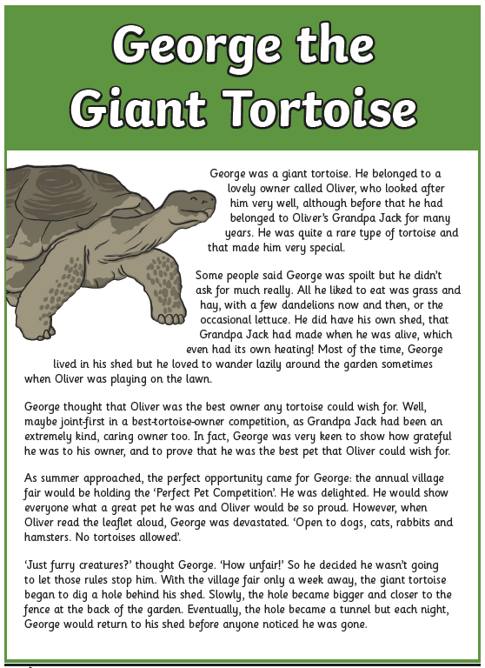
Monday 29th June
LO: to understand how paragraphs are used
Read this text, thinking carefully about how and why each paragraph has been used.

Slide 2
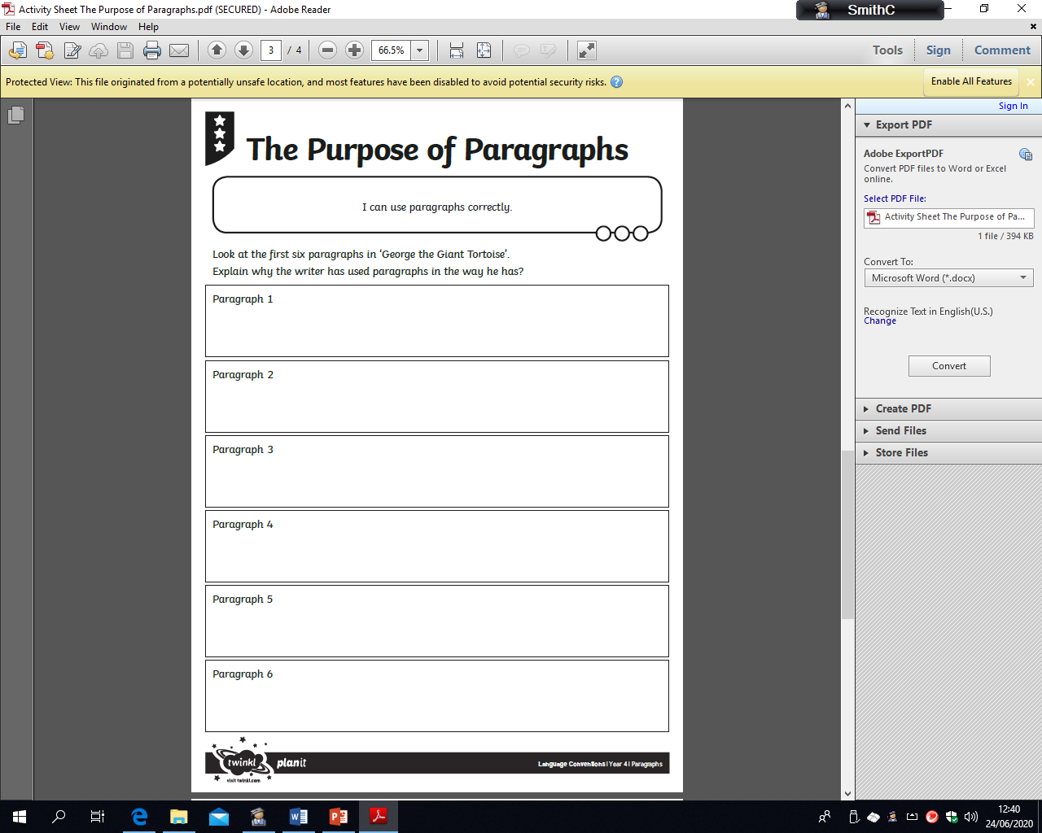
Monday 29th June
LO: to understand how paragraphs are used
Paragraphs can be used to:
introduce new characters
introduce a new speaker or new dialogue
introduce a new theme/ idea or thought
to show a change of time
Look at the paragraphs in ‘George the Giant Tortoise’.
Explain why the writer has used paragraphs in the way he has?

Slide 3
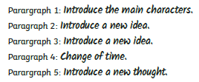
Monday 29th June
LO: to understand how paragraphs are used
ANSWERS

