Slide 1
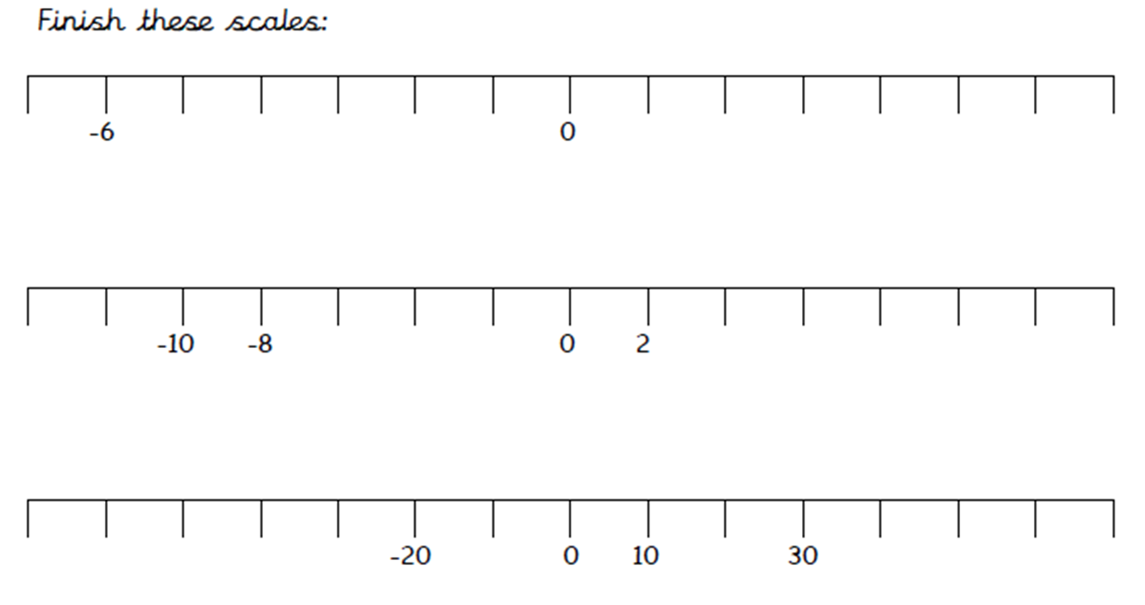
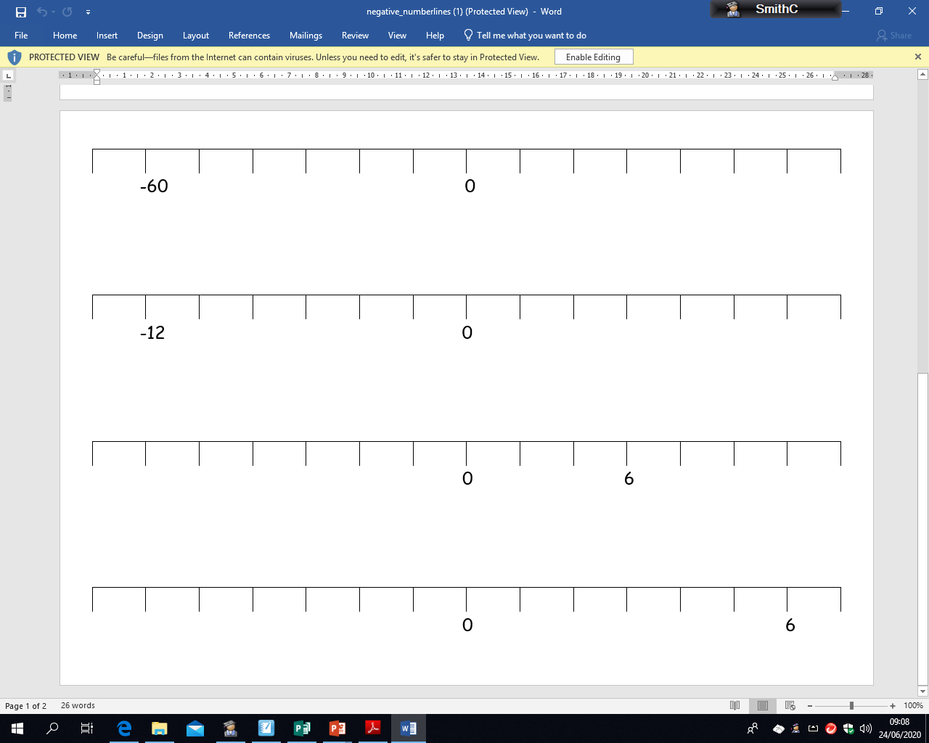
MILD
Monday 29th June
LO: to complete number lines past zero
Using the numbers provided, calculate what the intervals on each scale are going up and down in then complete the missing numbers.
-1
2
6
20
-10
-4
6

Slide 2
SPICY
Monday 29th June
LO: to complete number lines past zero
Using the numbers provided, calculate what the intervals on each scale are going up and down in then complete the missing numbers.

Slide 3
HOT
Monday 29th June
LO: to complete number lines past zero
Using the numbers provided, calculate what the intervals on each scale are going up and down in then complete the missing numbers.
Now decide what you want your intervals to increase or decrease by and create your own number lines. Can you use different intervals to those used above?

