Slide 1
Tuesday 30th June 2020
LO: To tell the time
SC:
*past the hour
*time in words
*hands drawn

Slide 2
Recap!
How many days in a year?
Leap year?
Days in September?
Days in April?

Slide 3

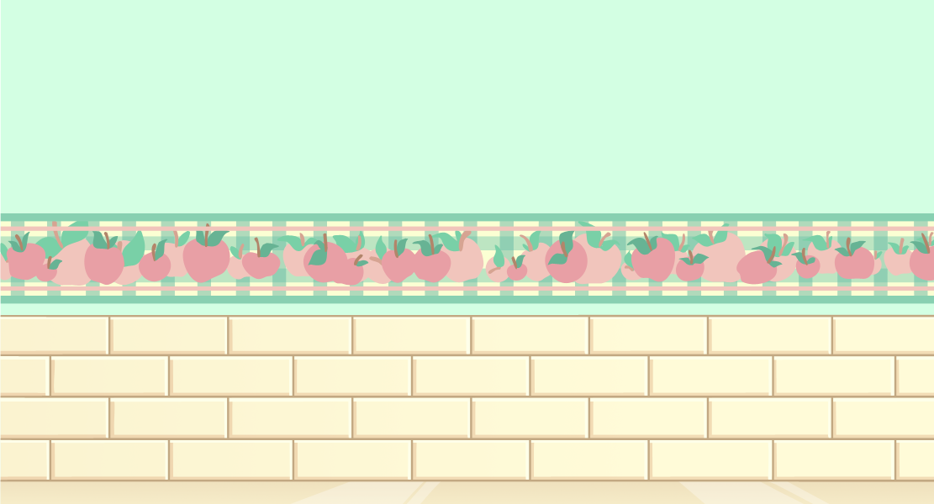
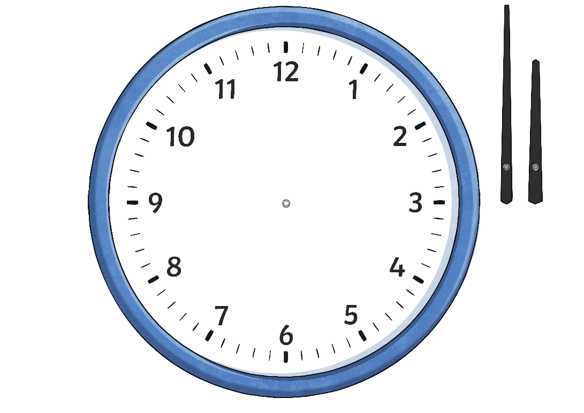
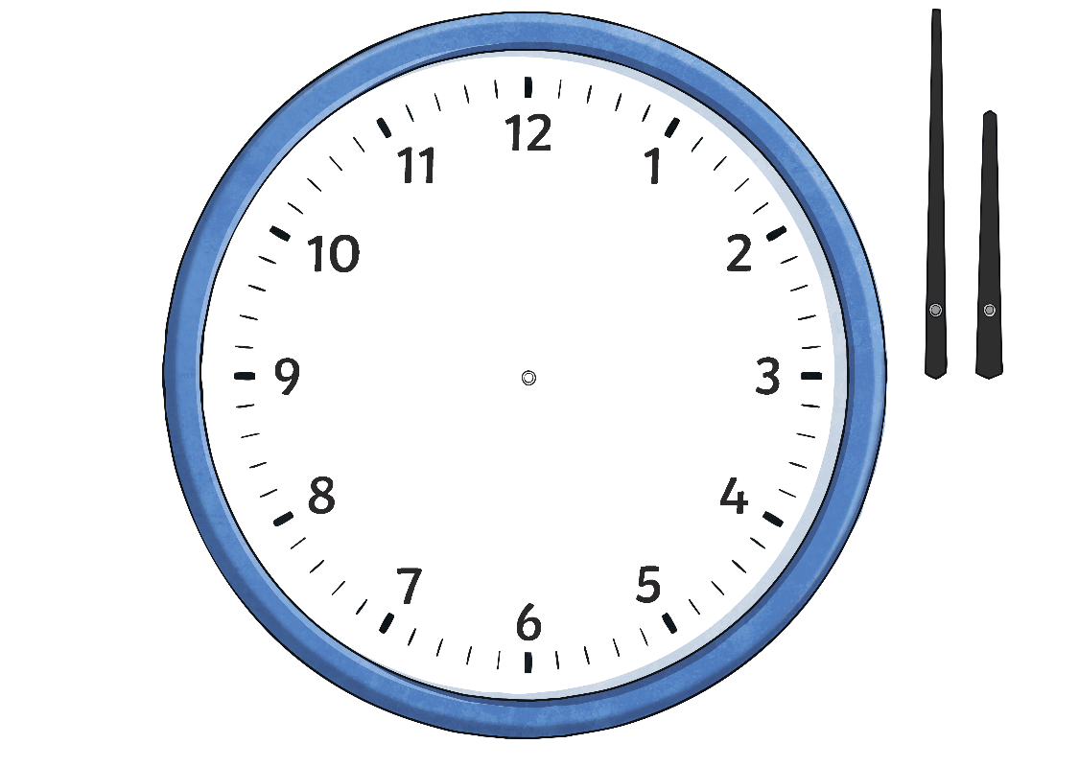
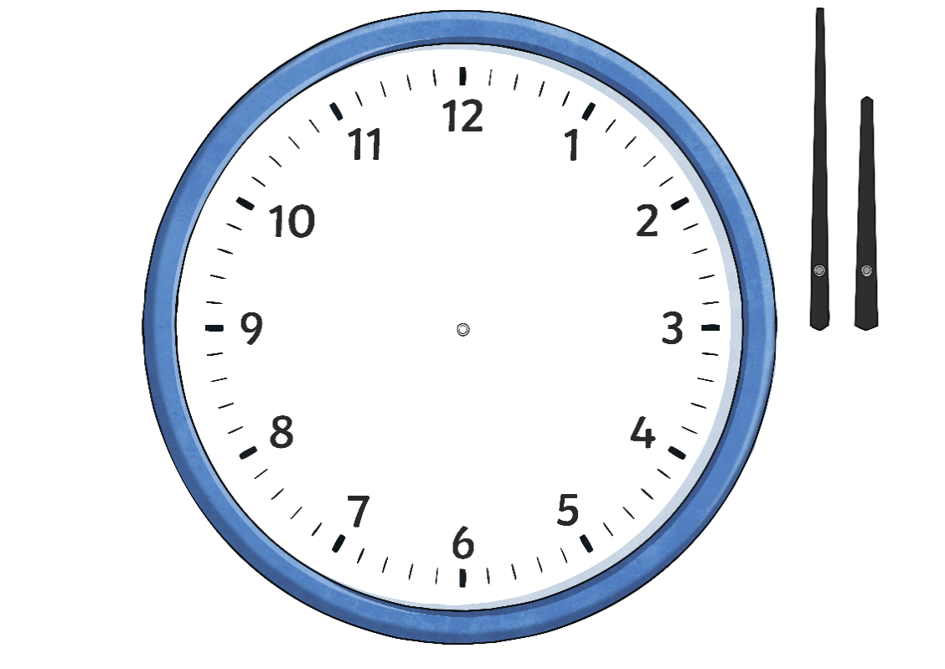
Minute Past the Hour
5 past
10 past
15 minutes past
(quarter past)
We can tell the time to the nearest minute by counting clockwise round the clock in fives, then counting on in single minutes until we reach the exact time.
20 past
25 past
30 minutes past
(half past)

Slide 4
Minute Past the Hour
Count clockwise in multiples of five, then count on in single minutes.
The big hand is
at 2 minutes after the 2. 10 minutes plus 2 minutes = 12 minutes past the hour.
12 minutes past 6

Slide 5
Minute Past the Hour
Count clockwise in multiples of five, then count on in single minutes.
The big hand is
at 3 minutes after the 4. 20 minutes plus 3 minutes = 23 minutes past the hour.
23 minutes past 10

Slide 6
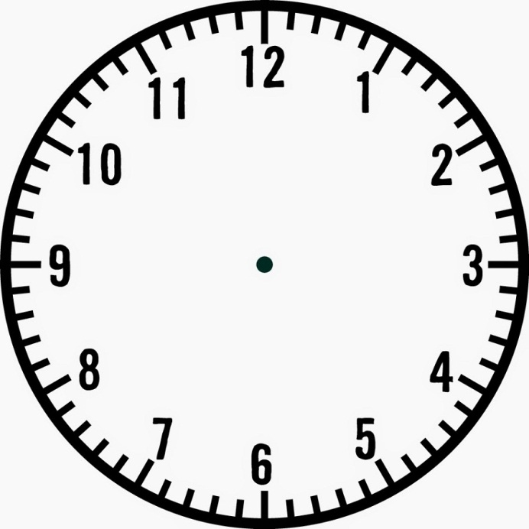
TO
PAST

Slide 7

Write down the times on these clocks:

Slide 8
Show me:
10 past 2
5 past 6
12 past 8
Quarter past 7

Slide 9
Wednesday 1st July 2020
LO: To tell the time

Slide 10
TO
PAST

Slide 11
Show me:
10 past 2
5 past 6
12 past 8
Quarter past 7

Slide 12


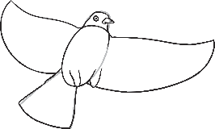
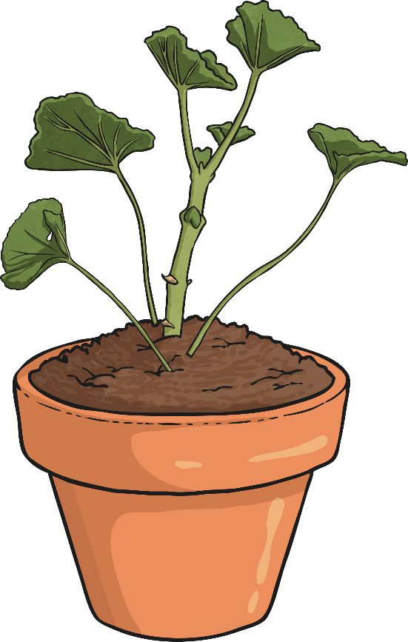
Minutes to the Hour
We already know how to tell the time past the hour to the nearest minute.
time flies
5 to
10 to
15 minutes to
(quarter to)
We can tell the time to the hour to the nearest minute by counting round the clock in fives anticlockwise, then counting on in single minutes until we reach the exact time.
20 to
25 to

Slide 13

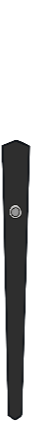
Minutes to the Hour
Count in multiples of five, anticlockwise, then count on in single minutes.
time flies
The big hand is
2 minutes before the 11. 5 plus 2 =
7 minutes to the hour.
7 minutes to 6

Slide 14
Minutes to the Hour
Count in multiples of five, anticlockwise, then count on in single minutes.
time flies
The big hand is
4 minutes before the 9. 15 plus 4 = 19 minutes to the hour.
19 minutes to 11

Slide 15
Minutes to the Hour
Count in multiples of five, anticlockwise, then count on in single minutes.
time flies
The big hand is
1 minute before the 7. 25 plus 1 =
26 minutes to the hour.
26 minutes to 2

Slide 16
Write down the times on these clocks:

Slide 17
TO
PAST

Slide 18
Show me:
10 to 2
5 to 6
12 to 8
Quarter to 7

Slide 19
Thursday 2nd July 2020
LO: To tell the time

Slide 20
Show me:
10 minutes to 2
5 minutes to 6
12 minutes past 8
Quarter past 7

Slide 21

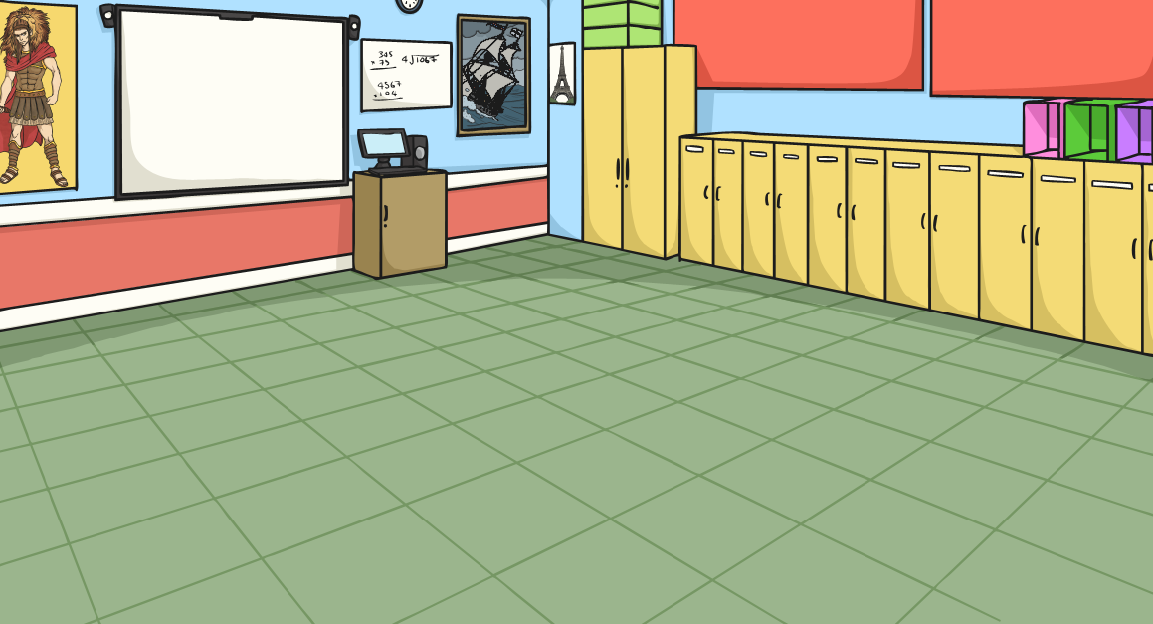
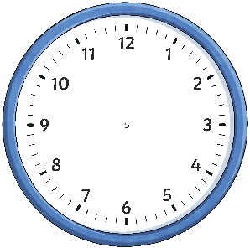
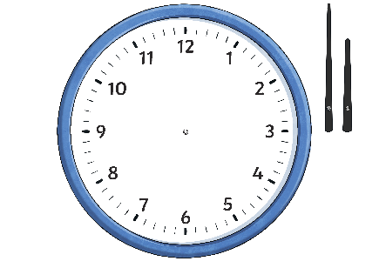
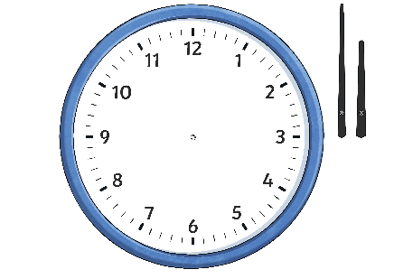
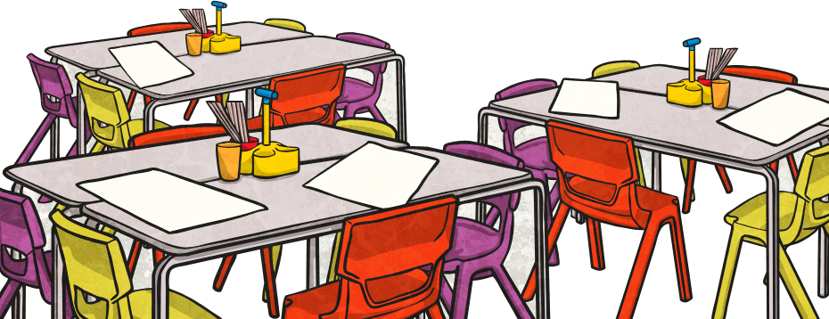
O’Clock, Half Past,
Quarter Past, Quarter To
Click on the times to reveal the answers.
5 o’clock
Half Past
7
Quarter Past 1
Quarter
To 11
Half Past 10
Quarter
To 3
Quarter Past 10
6 o’clock
Quarter Past 7
Half Past 11
Quarter
To 2
3 o’clock

Slide 22
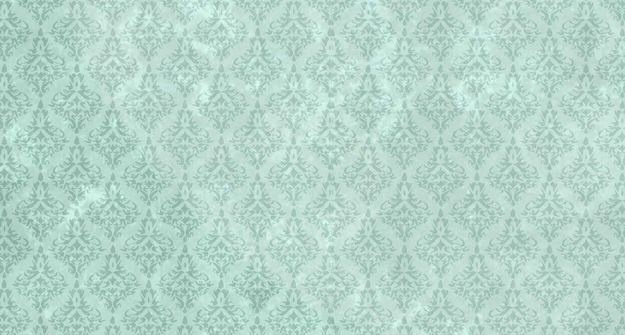
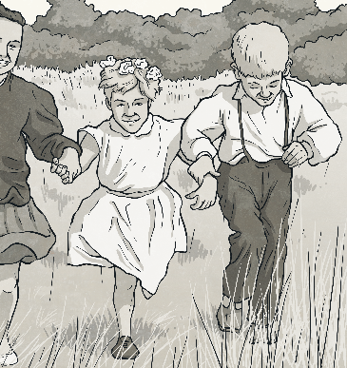

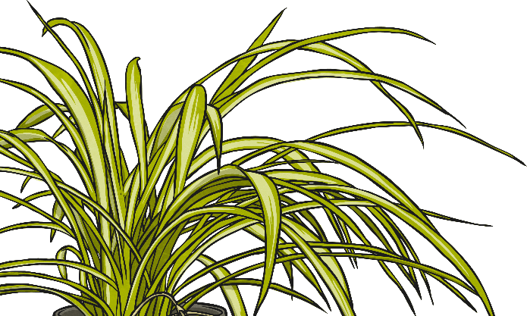
Telling the Time Past the Hour
Starting at 12, we count clockwise round the clock to tell us
minutes past the hour.
5 past
10 past
15 minutes past
(quarter past)
20 past
25 past
30 minutes past
(half past)

Slide 23
Telling the Time Past the Hour
What time is it?
5 past
hide hint
hint
10 past
15 minutes past
(quarter past)
20 past
25 past
5 past 5
30 minutes past
(half past)

Slide 24
Telling the Time Past the Hour
What time is it?
5 past
hide hint
hint
10 past
15 minutes past
(quarter past)
20 past
25 past
10 past 9
30 minutes past
(half past)

Slide 25
Telling the Time Past the Hour
What time is it?
5 past
hide hint
hint
10 past
15 minutes past
(quarter past)
20 past
15 minutes past 11
(quarter
past 11)
25 past
30 minutes past
(half past)

Slide 26
Telling the Time Past the Hour
What time is it?
5 past
hide hint
hint
10 past
15 minutes past
(quarter past)
20 past
25 past
20 past 2
30 minutes past
(half past)

Slide 27
Telling the Time Past the Hour
What time is it?
5 past
hide hint
hint
10 past
15 minutes past
(quarter past)
20 past
25 past 12
25 past
30 minutes past
(half past)

Slide 28
Friday 3rd July 2020
LO: To tell the time

