Slide 1
Tuesday 20th June
LO: adding and subtracting with negative numbers

Slide 2
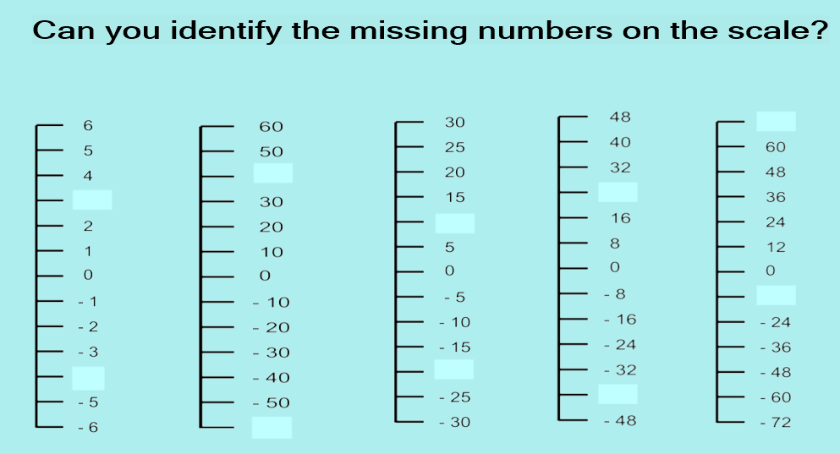

Slide 4
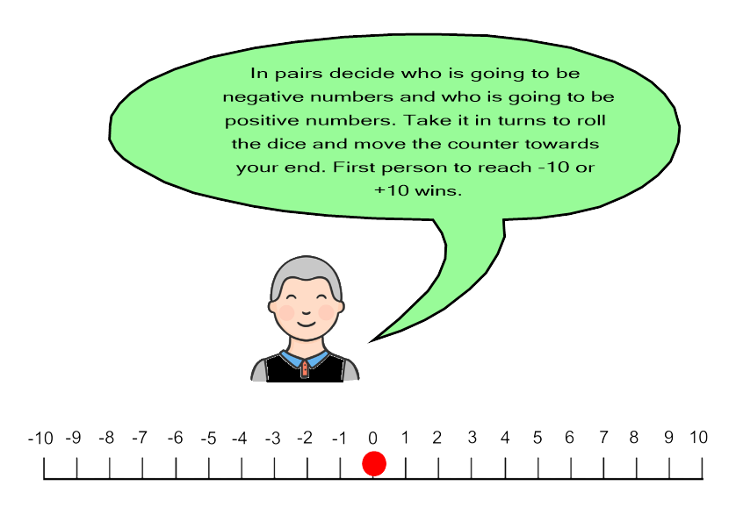
GAME – you can play this game if there is someone in your house available to play with you. If not, move onto the next slide.
You will need:
2 small counters
1 dice
The number line

Slide 5
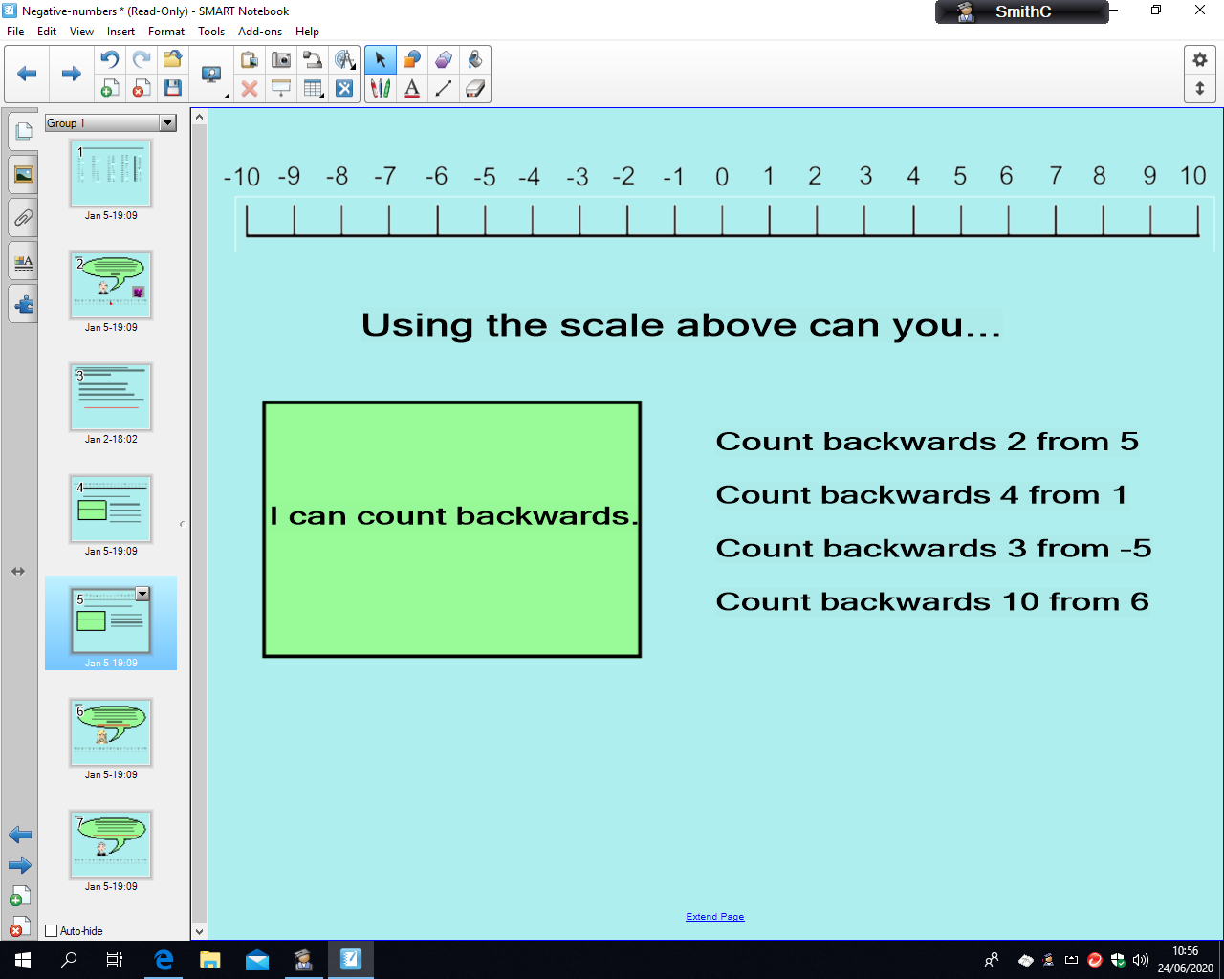
Count backwards 2 from 5
Count backwards 4 from 1
Count backwards 3 from -5
Count backwards 10 from 6

Slide 6
Count backwards 2 from 5
Count backwards 4 from 1
Count backwards 3 from -5
Count backwards 10 from 6

Slide 7
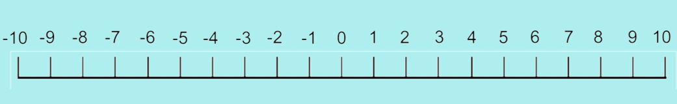
Count forwards 3 from 2
Count forwards 6 from -4
Count forwards 3 from -5
Count forwards 7 from -2

Slide 8
Count forwards 3 from 2
Count forwards 6 from -4
Count forwards 7 from -2
Count forwards 3 from -5

Slide 9
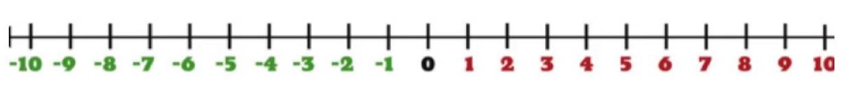
Put these in order from the smallest number to the greatest
-6, 6, 0, 4, -3, -7
2) 20, -15, -25, 0, 6, -5, 10, -11
3) -24, 5, -50, 18, 34, -2, 85
4) 0, 12, -55, 30, -16, -41, 28, -84

Slide 10
Put these in order from the smallest number to the greatest
-6, 6, 0, 4, -3, -7

Slide 11
Put these in order from the smallest number to the greatest
2) 20, -15, -25, 0, 6, -5, 10, -11

Slide 12
Put these in order from the smallest number to the greatest
3) -24, 5, -50, 18, 34, -2, 85

Slide 13
Put these in order from the smallest number to the greatest
4) 0, 12, -55, 30, -16, -41, 28, -84

