Slide 1
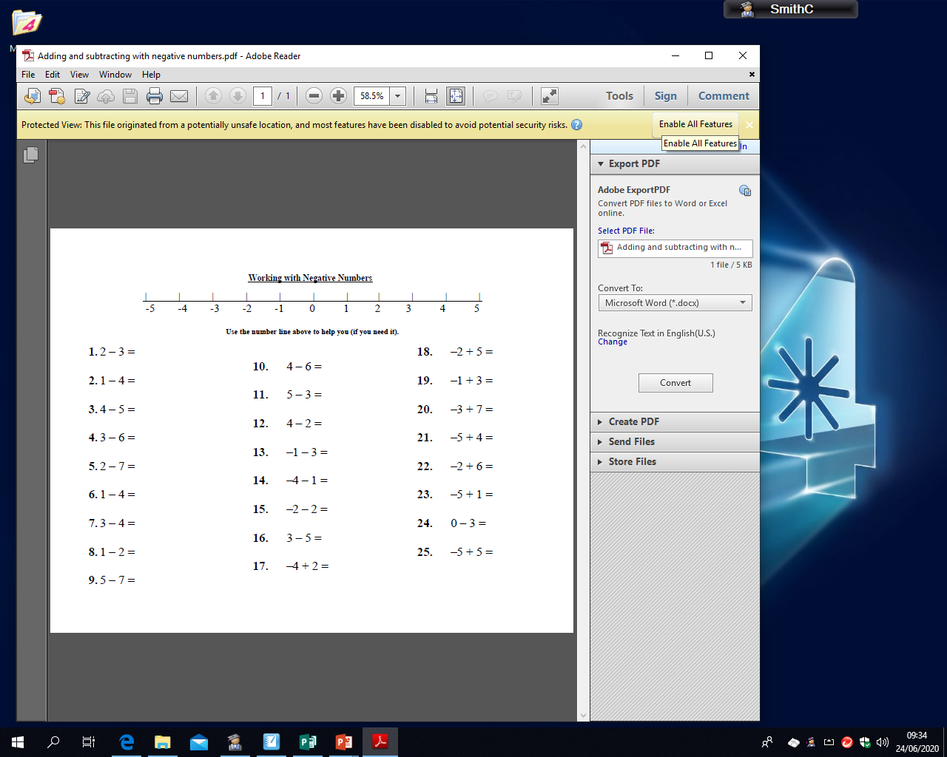
MILD
Tuesday 30th June
LO: adding and subtracting with negative numbers
Use the number line above to help you solve or double check your answers

Slide 2
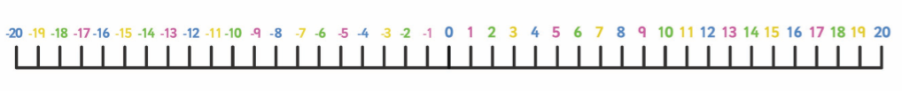
SPICY
Tuesday 30th June
LO: adding and subtracting with negative numbers
Use the number line above to help you solve or double check your answers
10 – 10
5 – 10
5 – 20
15 – 30
10 – 20
20 – 35
20 – 10
15 – 20
12 – 15
8 – 10
4 – 7
13 – 21
2 – 14
7 – 20
4 – 16
16. -12 + 12
17. -20 + 20
18. -20 + 30
19. -15 + 25
20. -10 + 14
21. -5 + 23
22. -18 + 31
23. -19 + 30
24. -13 + 16
25. -2 + 16
26. -7 + 23
27. -14 + 7
28. -11 + 9
29. -18 + 17
30. -6 + 14

Slide 3
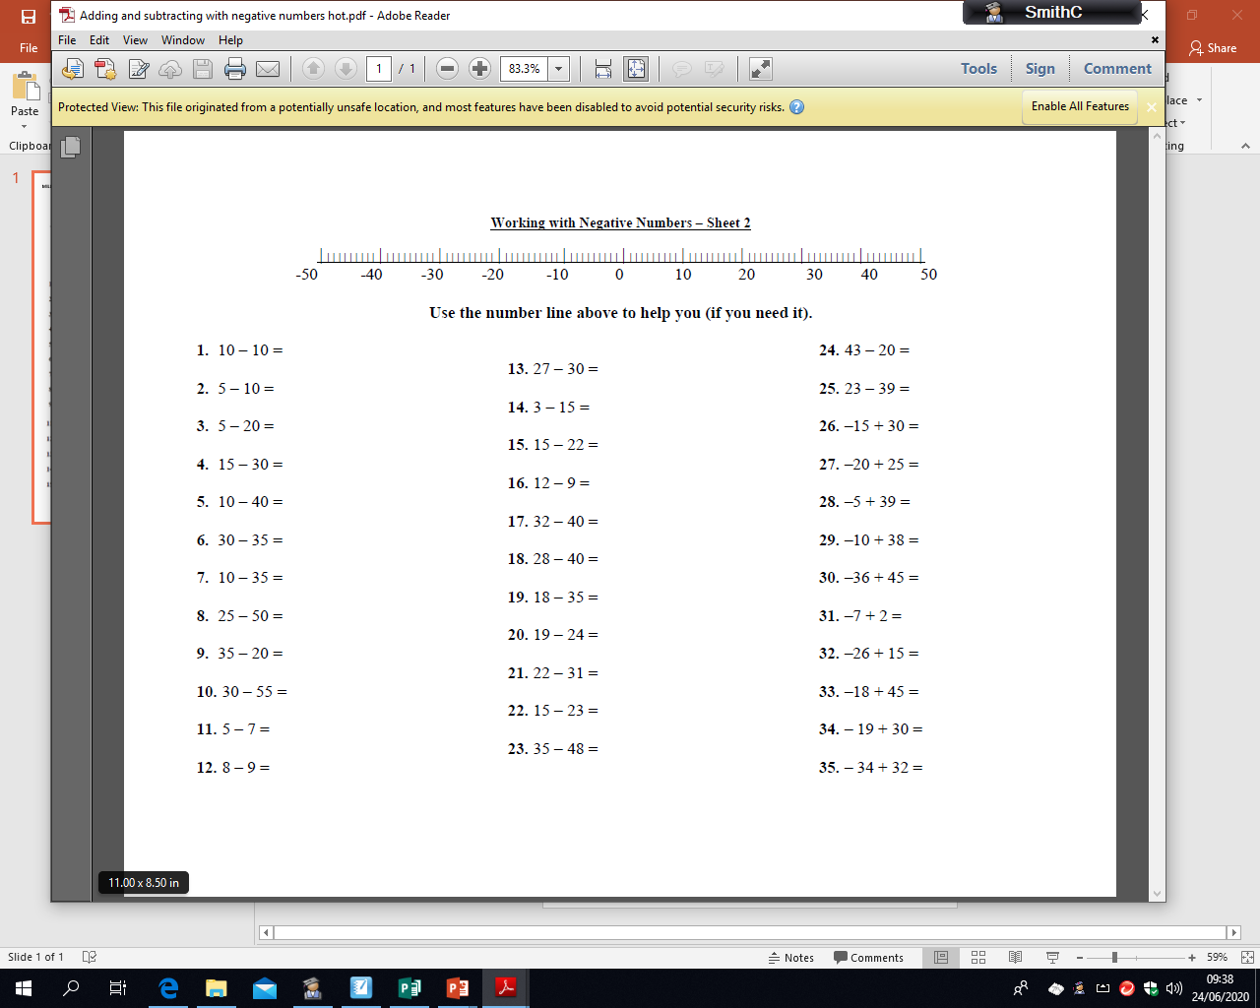
HOT
Tuesday 30th June
LO: adding and subtracting with negative numbers
Use the number line above to help you solve or double check your answers

