Slide 1
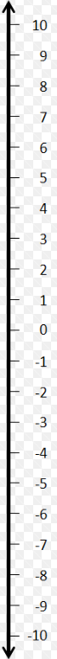
MILD
Wednesday 1st July
LO: using negative numbers with temperature
Circle the lower temperature (use the number line to help you):
6 or 10
8 or -8
-2 or -3
-1 or 3
-4 or 3
6 or -8
7) 0 or -4
8) -7 or 7
9) -1 or 0
10) 6 or -8
11) 3 or -5
12) 2 or - 4
Circle the higher temperature (use the number line to help you):
2 or -3
-7 or 0
0 or 3
-4 or 5
-3 or 6
-3 or 2
7) -9 or 8
8) -10 or 10
9) 0 or -6
10) 7 or -8
11) 5 or -6
12) 8 or -9

Slide 2
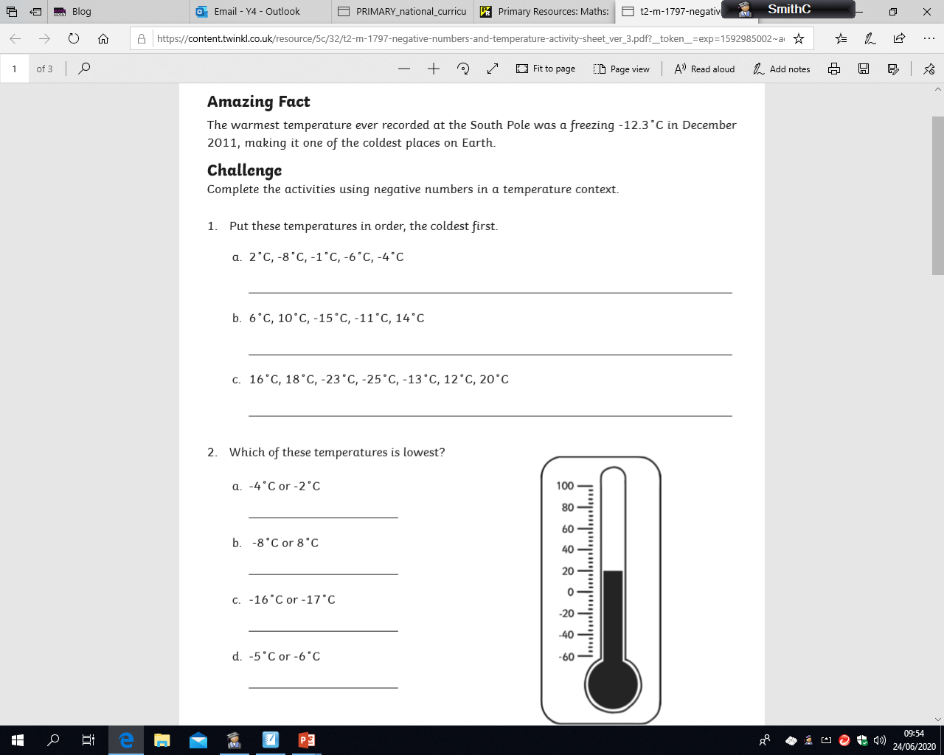
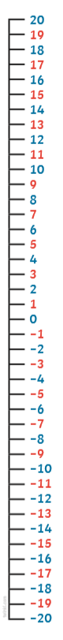
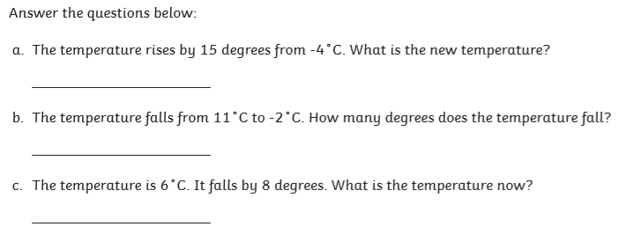
SPICY
Wednesday 1st July
LO: using negative numbers with temperature

Slide 3
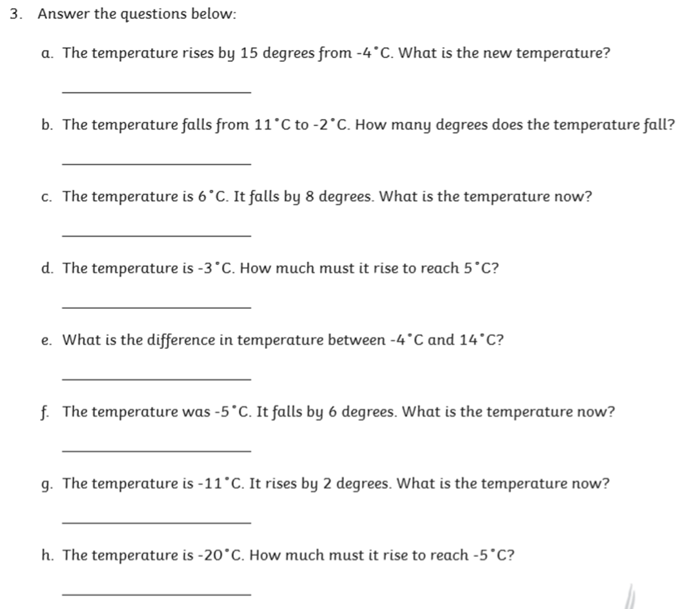
HOT
Wednesday 1st July
LO: using negative numbers with temperature

Slide 4
NEEDS WATER
Wednesday 1st July
LO: using negative numbers with temperature
After completing mild, spicy or hot you could try this challenge…
Research and create a information poster on:
Which places are colder
How scientists based at he South Pole survive the cold
When, and for how long, the South Pole gets sunshine
Where the hottest p[lace on Earth is

