Slide 1
Italy
Wednesday 1st July
LO: to promote tourism to an area
What are the Alps?
The Alps are a large mountain range in the middle of Europe. They are spread over eight countries:
France
Monaco
Italy
Switzerland
Liechtenstein
Austria
Germany
Slovenia
The Alps formed when two large tectonic plates slowly collided, pushing up the ground over tens of millions of years, creating some of the highest peaks in Europe. The highest mountain in the Alps is Mont Blanc.
What is it like in the Alps?
The weather in the Alps is affected by different temperatures of air coming from the north, west and south. These conditions create five different types of climate, depending on height - the higher up the mountains, the colder it gets.
The tops of the mountains are covered in snow and glaciers. Different types of animals and plants live in the different climate zones and some are not found anywhere else in the world.
Many rivers have their source in the Alps. Melting snow and ice in spring and summer supply water to the rivers and lakes at the foot of the mountains. Dams have also been built to hold this water in order to create hydroelectric power for nearby towns and cities.
Tourism is the main industry in the Alps. Around 30 million people visit the Alps each year, enjoying activities such as:
skiing and snowboarding
walking
sightseeing
trail running
mountain biking
paragliding

Slide 2
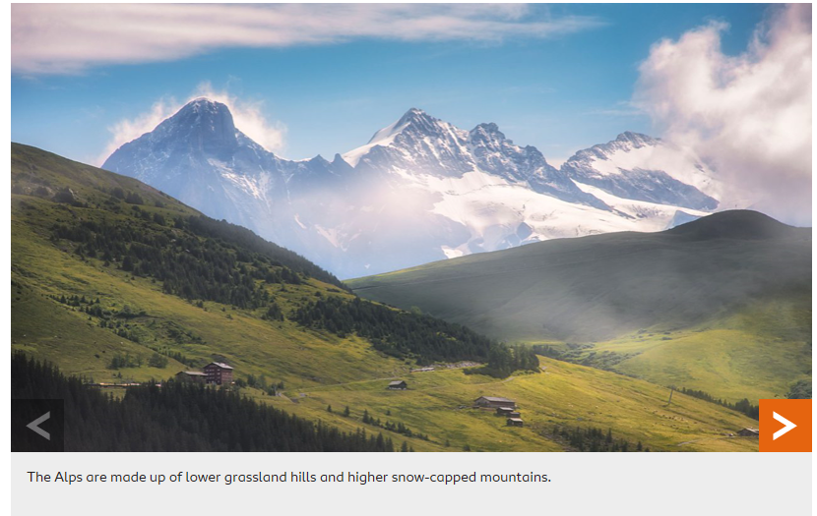
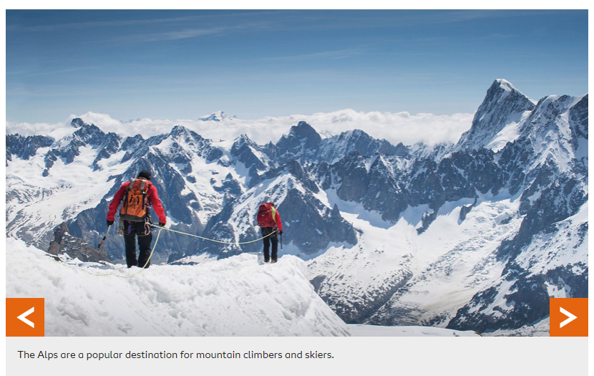
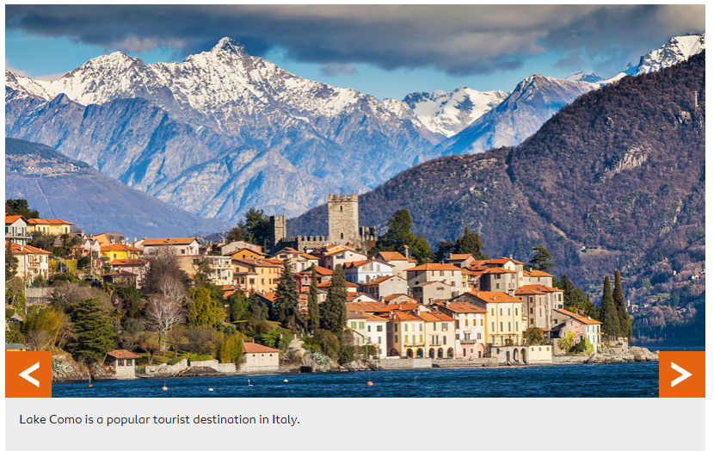
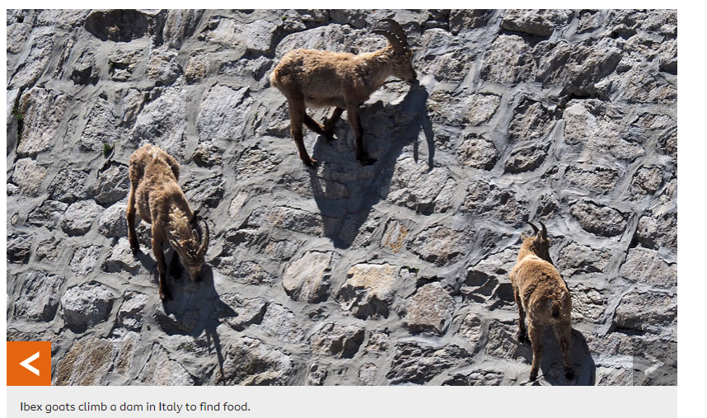
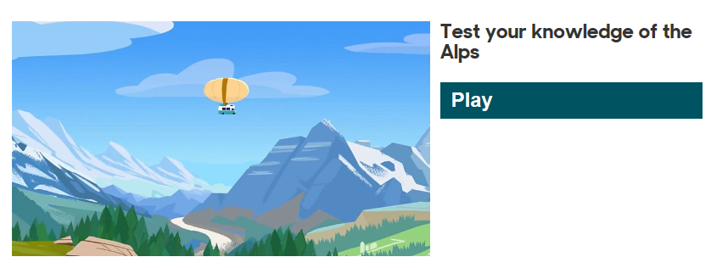
If you can go to:
https://www.bbc.co.uk/bitesize/topics/z3fycdm/articles/zb3ywty
There are 2 great videos on this page all about the Alps – watch them both.
Scroll all the way to the bottom and play the quiz…

Slide 3
Wednesday 1st July
LO: to promote tourism to an area
Your Task:
You have been appointed to work for the Alps tourism board.
Your aim is to increase the number of guests visiting the Alps over the coming 6 (mild) or 12 months (spicy & hot).
Write an action plan for each month explaining what you intend to do which will increase tourism to the area. Remember you will need to add variety and think about appealing to different types of people and people of different ages and genders. Consider what makes the Alps unique, the different uses of the area, the types of activities available, the time of year and what other regions might have to offer.
Now choose one of your plans from the 12 you have written and complete it. E.g. design a poster, make an informative leaflet, complete a TV advert, design an advert for a magazine, write a newspaper article.

Slide 4
Help sheet
LO: to promote tourism to an area
Design a poster to encourage teenagers/young adults to come snow boarding in the Alps
Create an informative leaflet for keen bikers and runners explaining the unique experience of biking/running through the Alps
Invent a catchy slogan
Possible actions
Design a comic strip to be put into a newspaper for adrenaline enthusiasts
Produce a TV advertisement appealing to families, show a range of activities to keep children busy and relaxation options for adults
Write a short article for circulation to all travel magazines aimed at showing off the beauty of the Alps to older people who may want to walk, sight see or just enjoy the views
Complete an interview with people who have stayed on the Alps and use their quotes on future advertising

Slide 5
MILD
LO: to promote tourism to an area
MONTH | ACTION | TARGET AUDIENCE
July
August
September
October
November
December

Slide 6
SPICY/HOT
LO: to promote tourism to an area
MONTH | ACTION | TARGET AUDIENCE
January
February
March
April
May
June
July
August
September
October
November
December

