Slide 2



Diving into Mastery Guidance for Educators
Each activity sheet is split into three sections, diving, deeper and deepest, which are represented by the following icons:
These carefully designed activities take your children through a learning journey, initially ensuring they are fluent with the key concept being taught; then applying this to a range of reasoning and problem-solving activities.
These sheets might not necessarily be used in a linear way. Some children might begin at the ‘Deeper’ section and in fact, others may ‘dive straight in’ to the ‘Deepest’ section if they have already mastered the skill and are applying this to show their depth of understanding.
Diving
Deeper
Deepest

Slide 3
Aim
Divide numbers up to 4 digits by a two-digit whole number using the formal written method of long division, and interpret remainders as whole number remainders, fractions, or by rounding, as appropriate for the context.

Slide 4
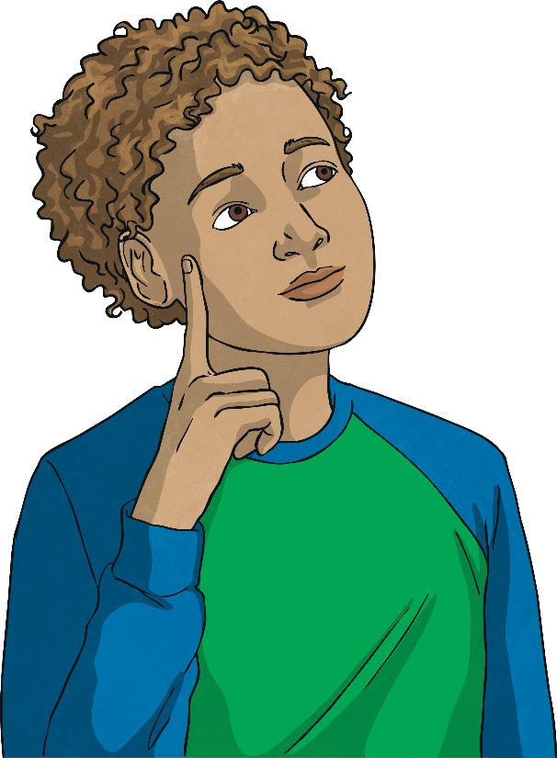
Long Division 1
Diving
Write down the next four multiples of the divisor and use the multiples to help you solve the long division calculation.
1 | 3 | 4 | 5 | 5
0
3
5
13
26
39
52
65

Slide 5
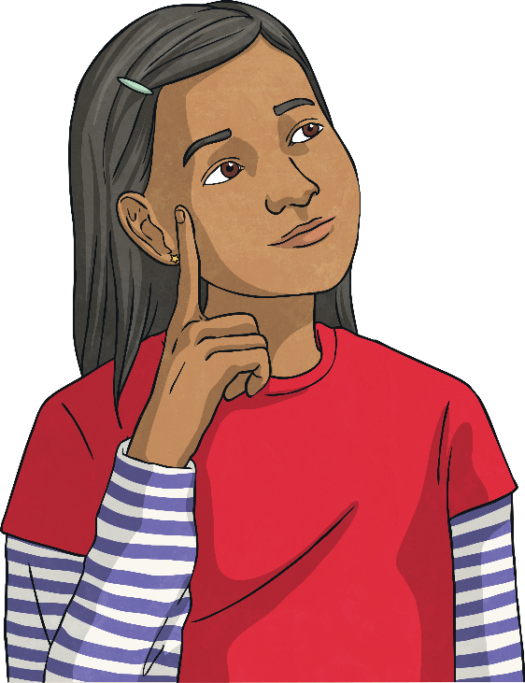
Long Division 1
Diving
Write down the next four multiples of the divisor and use the multiples to help you solve the long division calculation.
1 | 9 | 9 | 8 | 8
0
5
2
19
38
57
76
95

Slide 6

Long Division 1
Diving
A teacher is buying new pencils for
his class.
He needs to buy 384 pencils.
The pencils come packed in boxes of 16.
How many boxes of pencils will he need to buy?
0
2
4
The teacher accidently orders the wrong pencils.
He receives 432 pencils
in 24 boxes.
How many pencils were in each of the boxes that he accidently ordered?
0
1
8
1
6
3
8
4
2
4
4
3
2

Slide 7


Long Division 1
Deeper
A school uniform factory have been asked to make 868 jumpers for Twinkl Academy. They plan to make all of the jumpers in 2 weeks.
To fulfil its order, Miss Sweater calculates how many jumpers they will need to make each day using this calculation:
1 | 4 | 8 | 6 | 8
0
6
0
0
6
2
14
28
42
56
70
Explain why Miss Sweater is incorrect. How would you correct her mistake?
Miss Sweater is incorrect because she has either incorrectly divided the hundreds and tens by fourteen, or she has carried the 8 ones down, which cannot be divided by fourteen to give a whole number. The correct calculation and answer would be 62 jumpers each day.

Slide 8
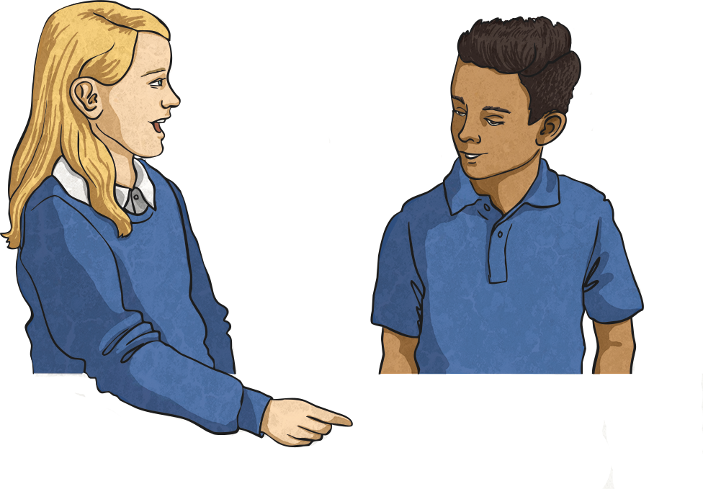
Long Division 1
Deeper
Two children are solving this long division calculation: 109 ÷ 17
I think that listing the multiples and then using these multiples to divide the number is the best way to solve this problem.
I think that the best way to solve this is to use repeated subtraction until I have no remainders left.
Jessie
Liam
Do you agree with either child’s method?
What is the most efficient way to solve the problem?
Both methods will work but Jessie’s method is more efficient as she should be able to solve the problem in fewer steps.

Slide 9


Long Division 1
Deepest
Can you work out the missing numbers in this calculation using the clues?
A ÷ B = 14
A
350
364
378
392
B
25
26
27
28
A is between 350 and 400.
B is a two-digit number.
Hint… Why not start by thinking
about which multiples of
14 will be close to 350?

Slide 10


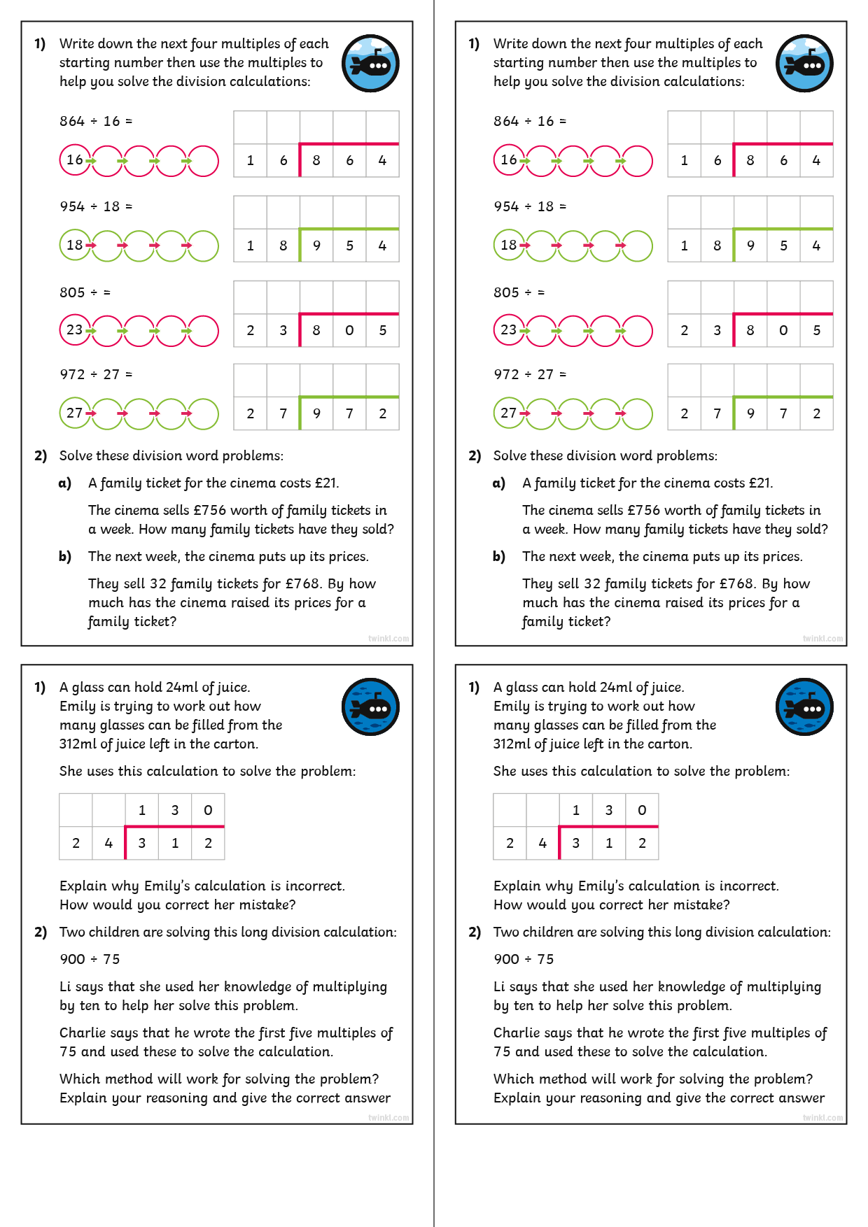
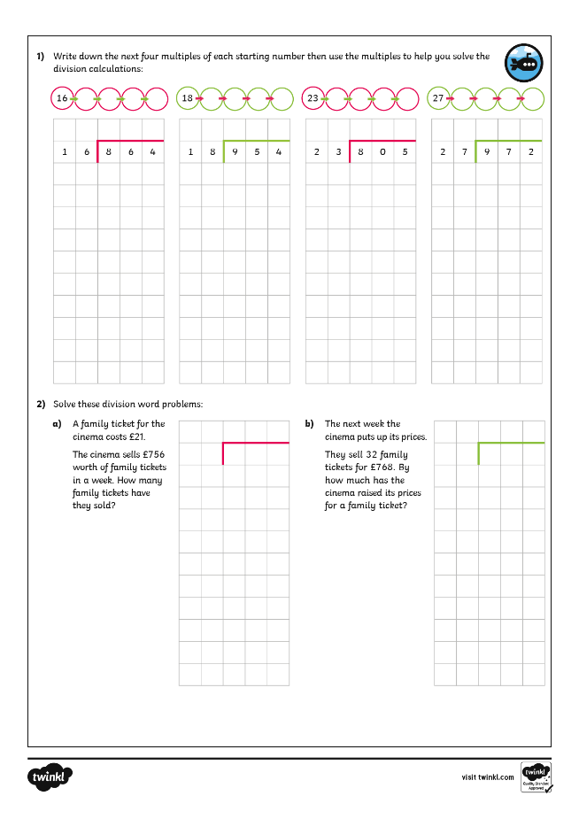
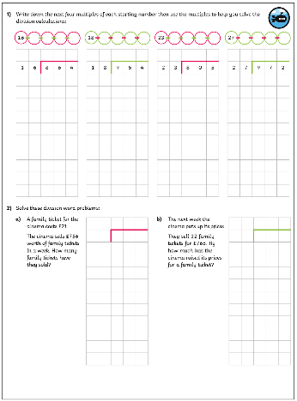
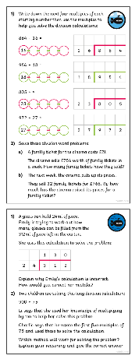
Long Division 1
Dive in by completing your own activity!

Slide 11
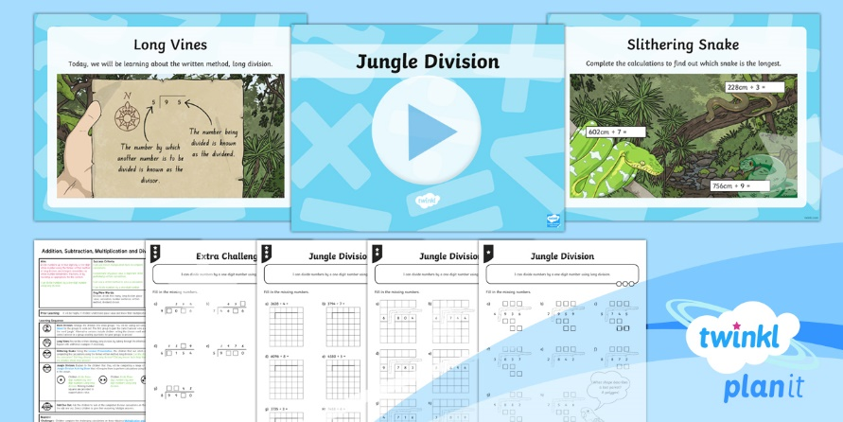
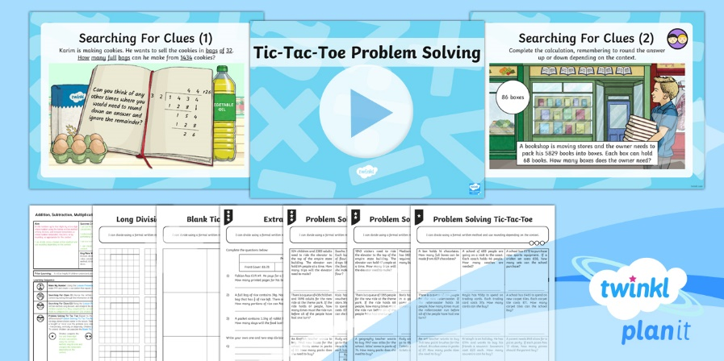

Need Planning to Complement this Resource?
National Curriculum Aim
Divide numbers up to 4 digits by a two-digit whole number using the formal written method of long division, and interpret remainders as whole number remainders, fractions, or by rounding, as appropriate for the context.
For more planning resources to support this aim, click here.
Twinkl PlanIt is our award-winning scheme of work
with over 4000 resources.

