Slide 1
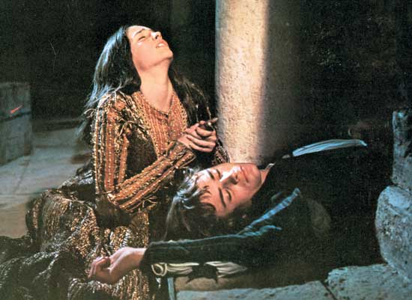
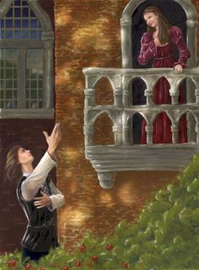

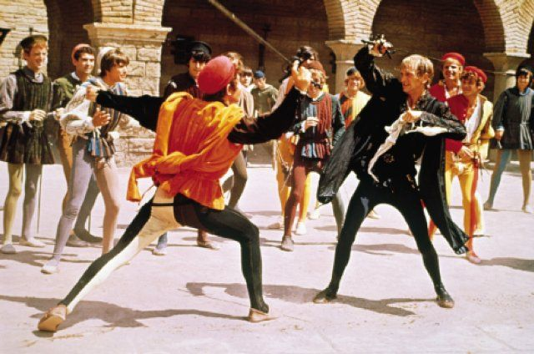
Romeo and Juliet
What do you know about the story ‘Romeo and Juliet’?

Slide 2
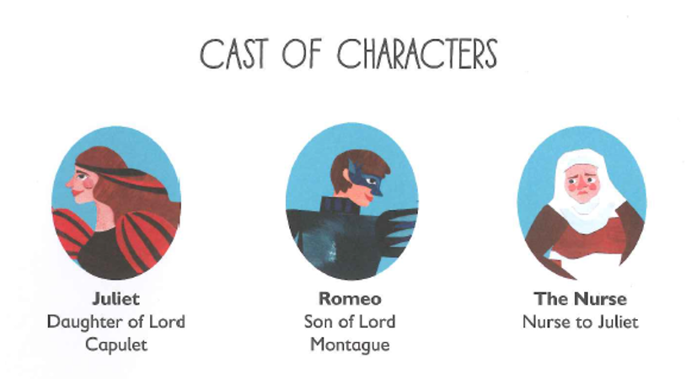
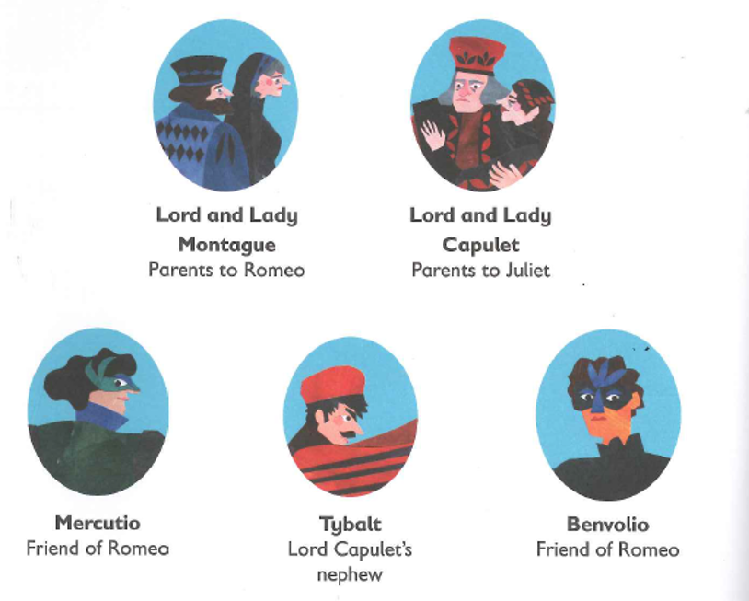
Romeo and Juliet Summary
An age-old vendetta between two powerful families erupts into bloodshed.
A group of masked Montagues risk further conflict by gatecrashing a Capulet party.
A young lovesick Romeo Montague falls instantly in love with Juliet Capulet, who is due to marry her father’s choice, the County Paris.
With the help of Juliet’s nurse, the women arrange for the couple to marry the next day, but Romeo’s attempt to halt a street fight leads to the death of Juliet’s own cousin, Tybalt, for which Romeo is banished.
In a desperate attempt to be reunited with Romeo, Juliet follows the Friar’s plot and fakes her own death.
The message fails to reach Romeo, and believing Juliet dead, he takes his life in her tomb.
Juliet wakes to find Romeo’s corpse beside her and kills herself.
The grieving family agree to end their feud.

Slide 3
LO: Analyse how dialogue helps to portray character
Mild – read and highlight dialogue, paying particular attention to the punctuation. Explain how to correctly punctuate dialogue.
Spicy – highlight dialogue, verbs, adverbs and actions surrounding the dialogue. Explain what this tells you about the character.
Hot – Explore the rest of the text for dialogue and analyse its impact on character portrayal.

Slide 4
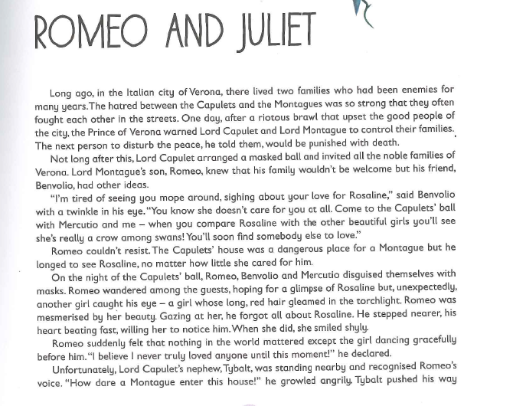


Slide 5
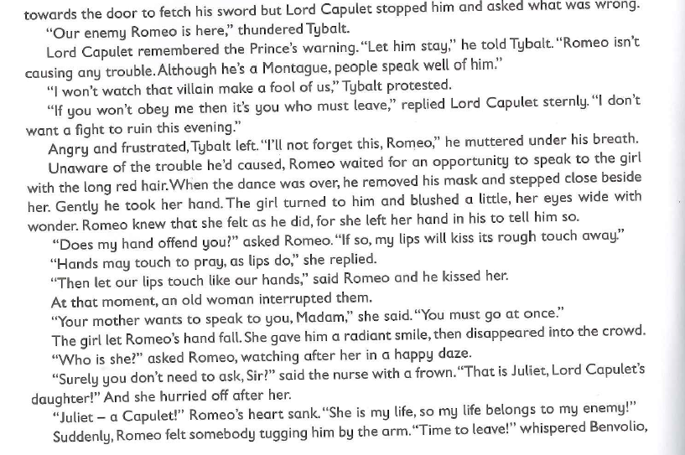
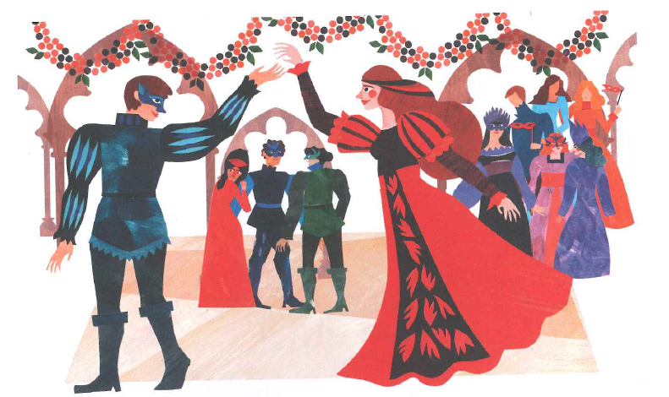

Slide 6
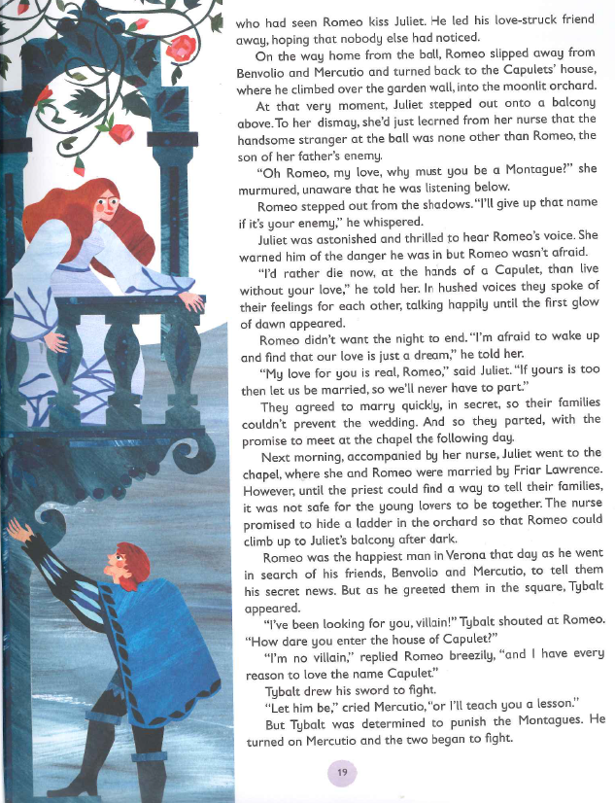

Slide 7
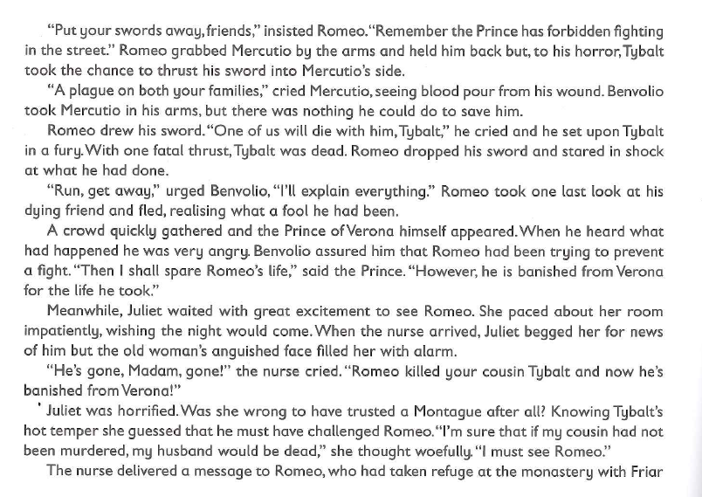
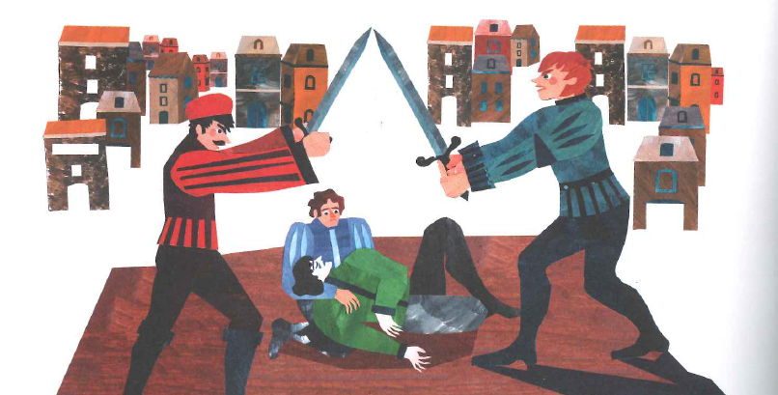

Slide 8
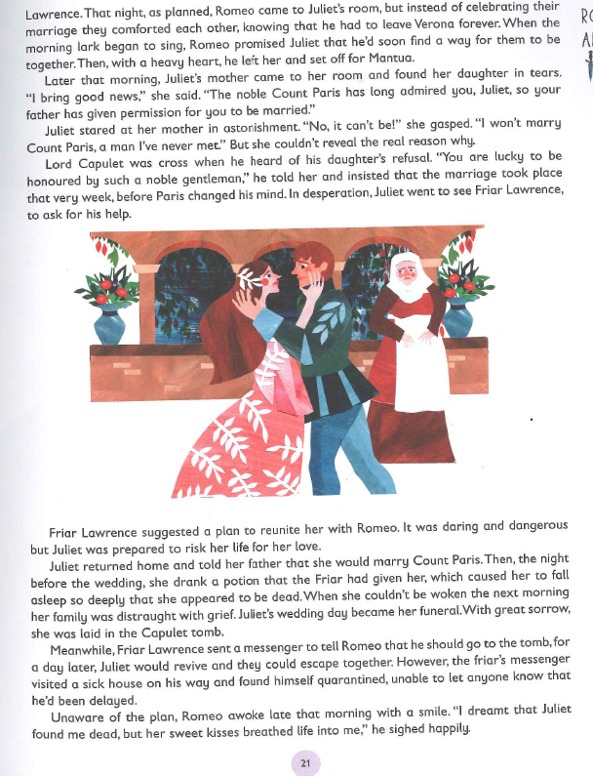

Slide 9
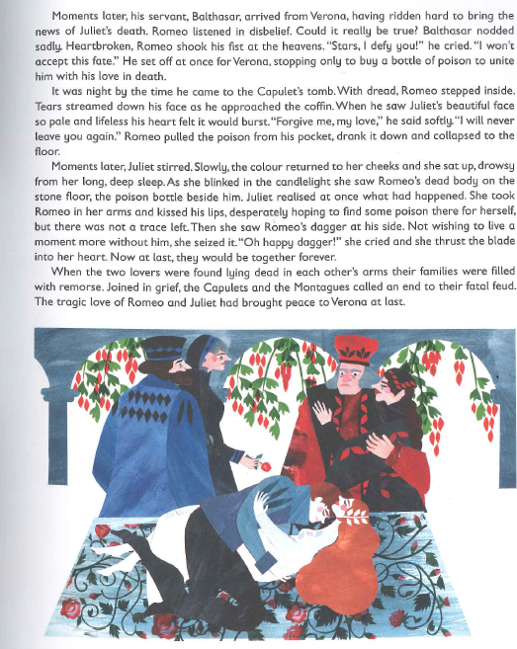
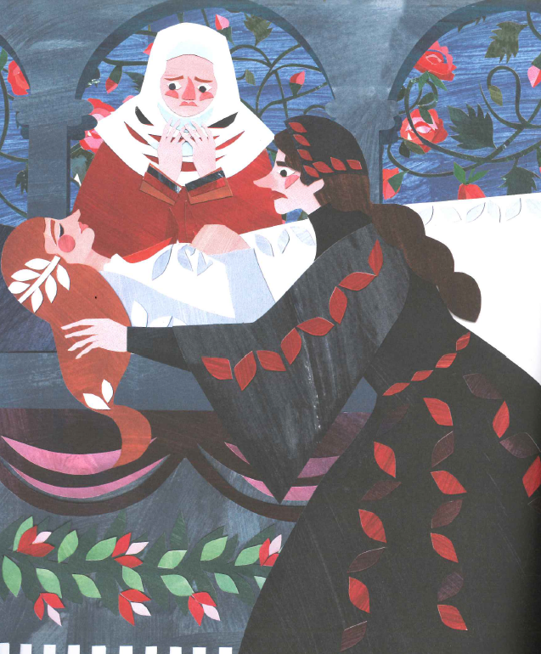

Slide 10
LO: Analyse how dialogue helps to portray character
Dialogue | Portrayal of character
“I’m tired of seeing you mope around, sighing about your love for Rosaline,” said Benvolio with a twinkle in his eye. “You know she doesn’t care for you at all. Come to the Capulet’s ball with Mercutio and me – when you compare Rosaline to the other beautiful girls you’ll see she’s really a crow among swans!” You’ll soon find somebody else to love.”
Romeo suddenly felt that nothing in the world mattered except the girl dancing gracefully before him. “I believe I never truly loved anyone until this moment!” he declared. Unfortunately, Lord Capulet’s nephew, Tybalt, was standing nearby and recognised Romeo’s voice. “How dare a Montague enter this house!” he growled angrily.
“Our enemy Romeo is here,” thundered Tybalt.
Lord Capulet remembered the Prince’s warning. “Let him stay,” he told Tybalt. “Romeo isn’t causing any trouble. Although he’s a Montague, people speak well of him.” “I won’t watch that villain make a fool of us,” Tybalt protested. “If you won’t obey me then it’s you who must leave,” replied Lord Capulet sternly. “I don’t want a fight to ruin this evening.”
Angry and frustrated, Tybalt left. “I’ll not forget this, Romeo,” he muttered under his breath

Slide 11
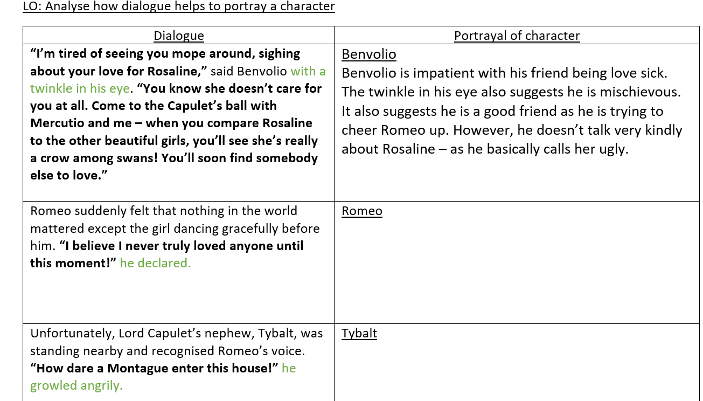

Slide 12

https://www.youtube.com/watch?v=E1zHhOHTdm8

Slide 13
End of unit outcome: retell the story of Romeo and Juliet
Success Criteria
Describe characters, settings and atmosphere
Integrate dialogue to convey character and move action forward
Ensure writing flows
Use a range of punctuation
Select vocabulary carefully to reflect the Shakespearean style of writing

