Slide 1
LO: To draw a still life study in charcoal
Monday 29th June/ Thursday 2nd July
Success criteria:
I can use charcoal and chalk to show light and shadow
I can create a piece of abstract art
I can create clear lines and shapes

Slide 2
Monday 29th June/ Thursday 2nd July
Take a look back at the still life sketches in your sketchbooks.

Slide 3
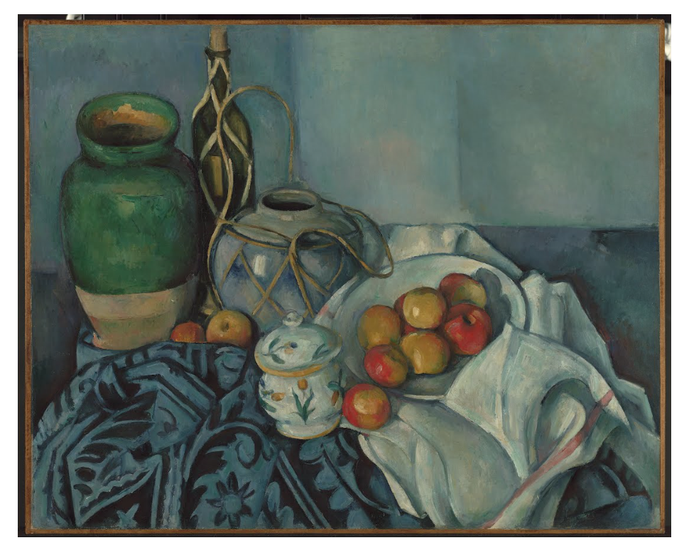
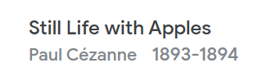
Monday 29th June/ Thursday 2nd July
The Cezanne is in oils and precisely uses the form and colour of each shape. The composition is such that the lines of each item flow into each other.
Key Questions
Which direction do the lines go in on each shape?
Which side is the light stronger on?
What simple shapes can you reduce this object to?

Slide 4
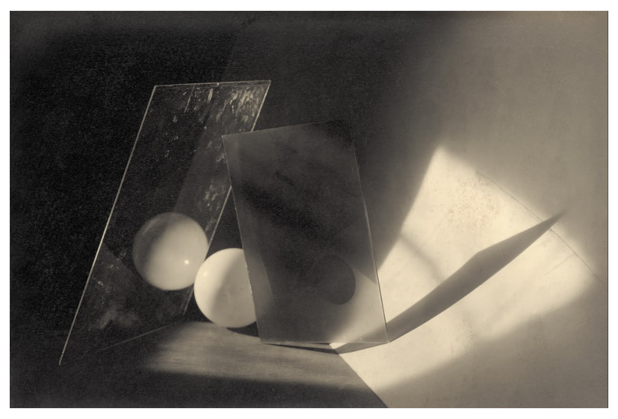
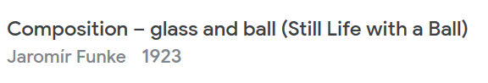
Monday 29th June/ Thursday 2nd July
Funke’s photograph is black and white, but it is the light that is interesting, creating almost geometric lines contrasting dark and light.
Key Questions
Which direction do the lines go in on each shape?
Which side is the light stronger on?
What simple shapes can you reduce this object to?

Slide 5
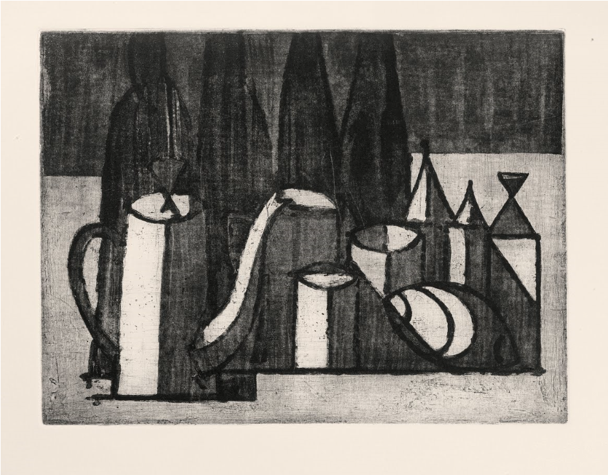
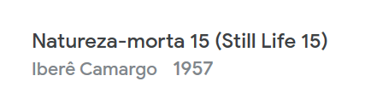
Monday 29th June/ Thursday 2nd July
Camargo’s is more abstract - the shapes and lines simplified, the colours reduced to greys.
Key Questions
Which direction do the lines go in on each shape?
Which side is the light stronger on?
What simple shapes can you reduce this object to?

Slide 6
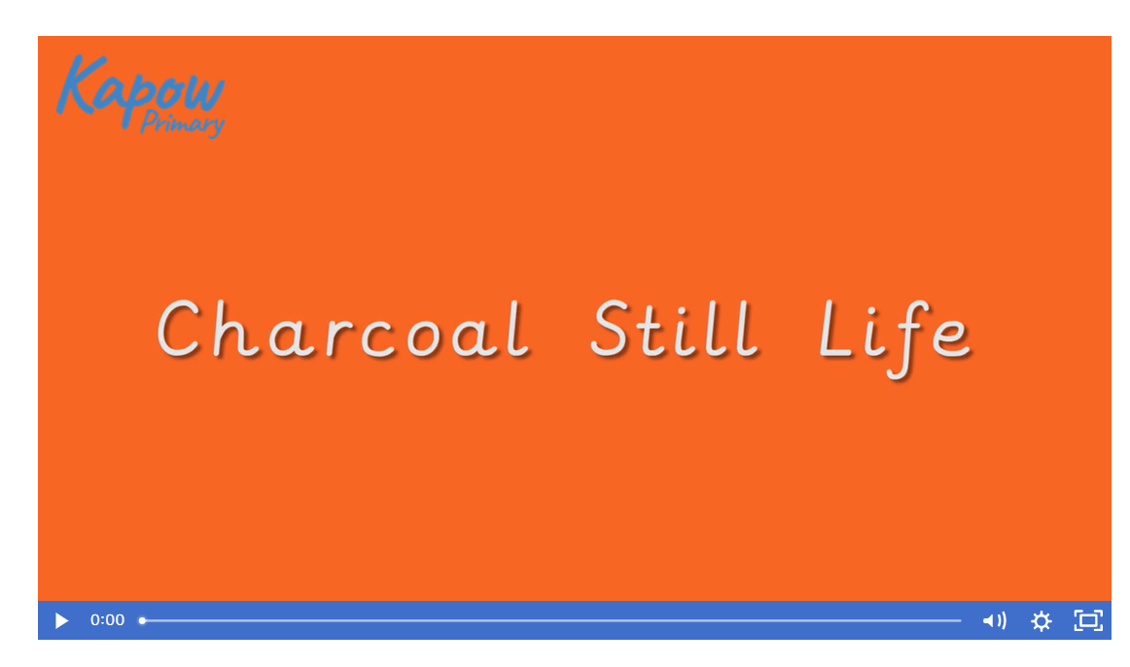
Monday 29th June/ Thursday 2nd July

Slide 7
Monday 29th June/ Thursday 2nd July
Make a faint charcoal background to work on, by rubbing the charcoal lightly across the page on its side, then smudging it to create a light grey.
Lines applied lightly on this can be smudged away easily (so you won’t need an eraser to rub out mistakes as long as the lines are applied lightly).
keep referring back to your sketchbook attempts while you draw.
We are primarily interested in getting the forms of the objects drawn accurately, focusing on the lines that make up each shape.
Like Camargo, we are trying to simplify these lines.
Draw each item with as few lines as possible, foregoing some detail if necessary and trying to fill the whole of the paper with the composition.
If all the lines of the objects are done, use the charcoal to shade in darker areas in the composition, looking for where the shadows fall and add in more charcoal, smudging to make it darker. Shade in whole sections without gradient - use blocks of colour to imitate Camargo’s style.
If an area needs a whitened highlight, use the white chalk to block in the area to lighten it.
LO: To draw a still life study in charcoal
Success criteria:
I can use charcoal and chalk to show light and shadow
I can create a piece of abstract art
I can create clear lines and shapes

