Slide 1
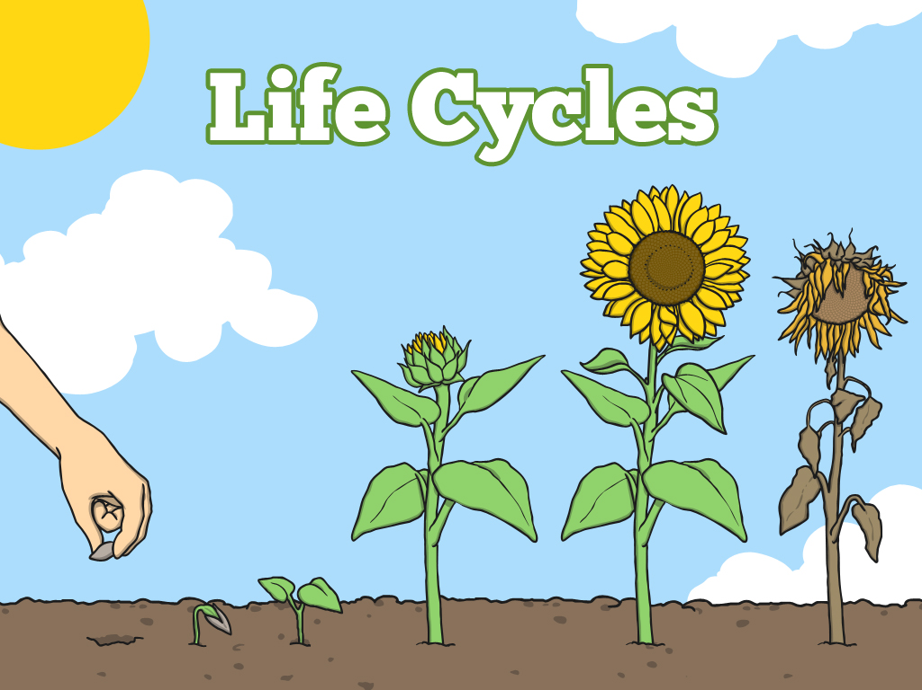


Slide 2
Aim
I can explain the life cycle of plants.
I can suggest a way we can tell that plants are living things.
Success Criteria
I can describe stages in the life cycle of a plant.
I can order the life cycle of a plant.
I can explain that plants are living things.
I can explain something plants do that shows us that plants are living things.

Slide 3
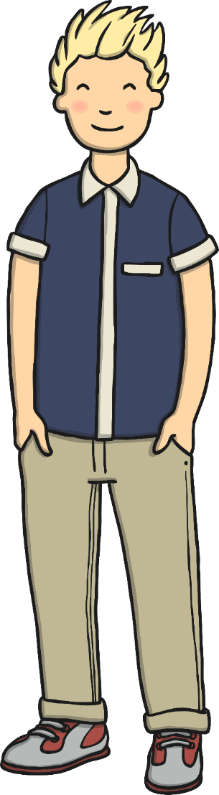

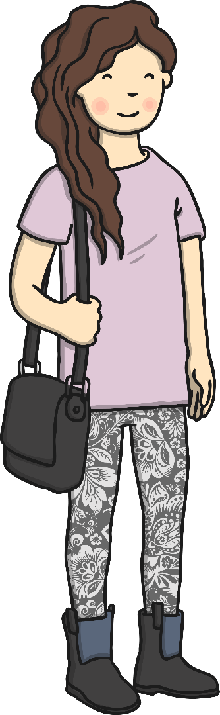
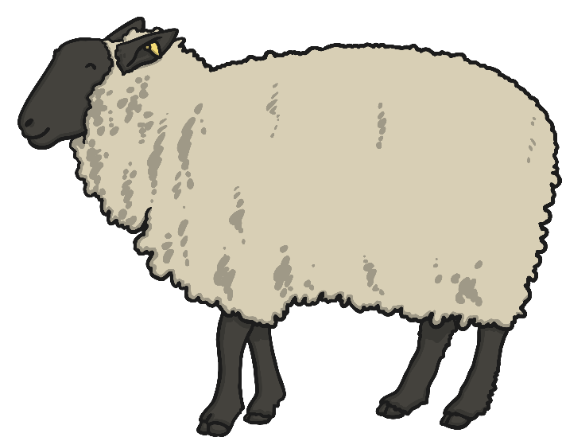
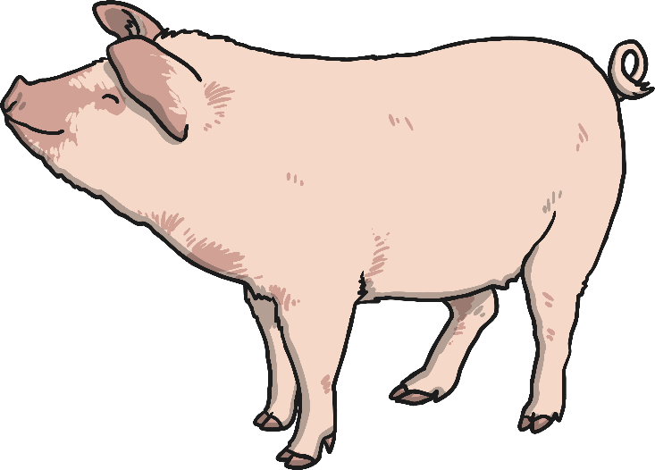
Plants Are Living Things
Plants and trees are alive like humans and other animals.
How can we tell that plants are living things?

Slide 4
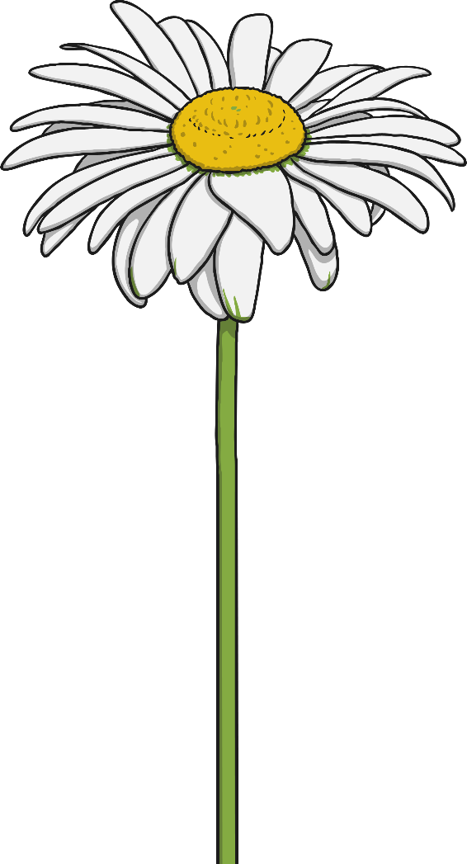

Life Processes
How can we tell that plants are living things?
All living things do certain things to stay alive. These are called life processes.
Animals, including humans, do these things. Plants do too, although they do them in different ways.
Click the button below to find out more.

Slide 5

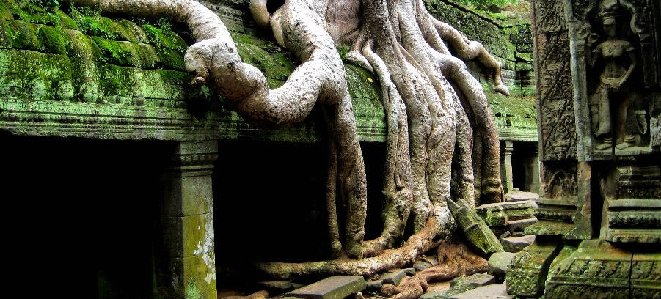
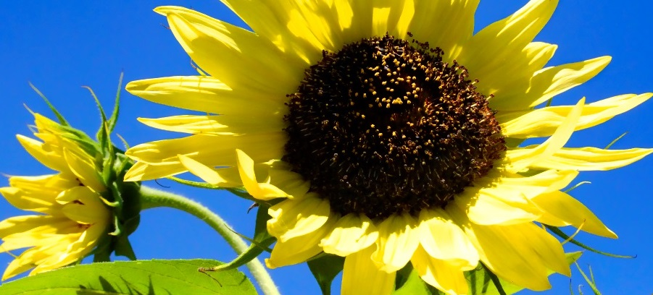
Life Processes
Plants can move and grow, and they sense changes in their environment.
How is this similar to what humans and other animals do?
Roots grow in all directions to find soil and water.
The mimosa plant curls up when you touch it! Click the button below to see the mimosa plant in action.
A sunflower moves to turn its face towards the sun.
Photos courtesy of Francisco Anzola, Scott Hudson (@flickr.com) and Hrushikesh (Wikimedia Commons) - granted under creative commons licence – attribution

Slide 6
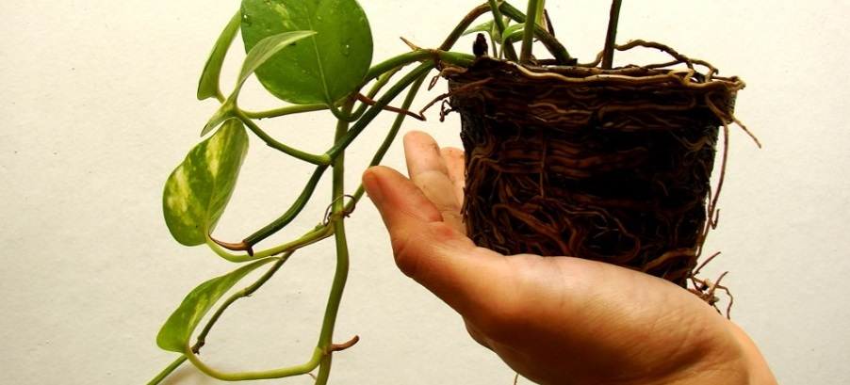
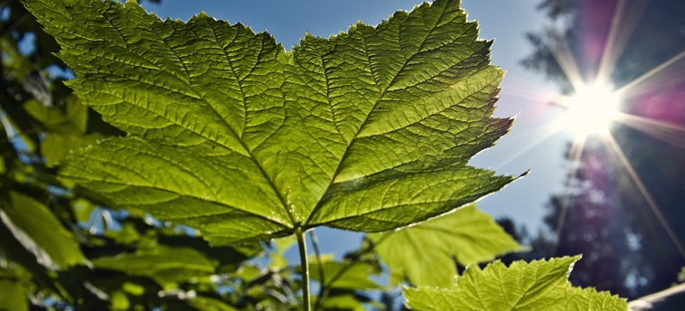
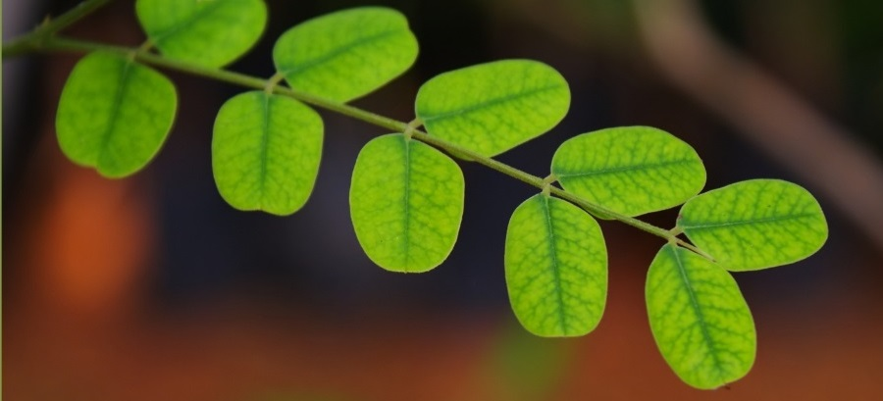
Life Processes
Plants need to take in nutrition and air to survive. They also need to get rid of waste.
How do animals, including humans, get what they need to stay alive? How do they get rid of waste?
Plants absorb water and nutrients through their roots.
Through their leaves, they take in light from the sun and carbon dioxide from the air.
Left over gases and water leave the plant from the leaves.
Photos courtesy of Quito sometimes Marcos, waledro, { pranav } (@flickr.com) - granted under creative commons licence – attribution

Slide 7
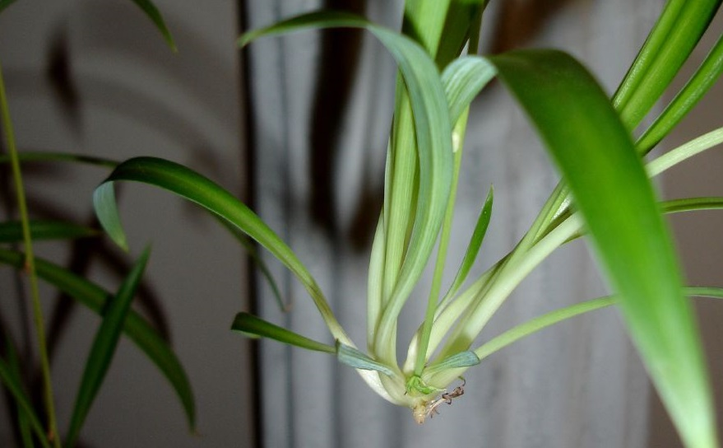
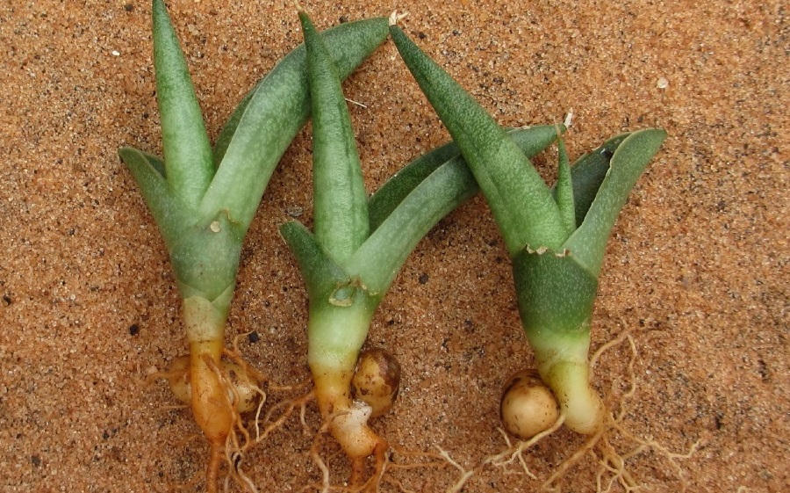
Life Processes
Plants can reproduce to make new plants.
Some plants make baby plants.
How do humans and other animals reproduce?
Some plants make seeds that grow into new plants.
Photos courtesy of tonrulkens, tinyfroglet (@flickr.com) - granted under creative commons licence – attribution

Slide 8
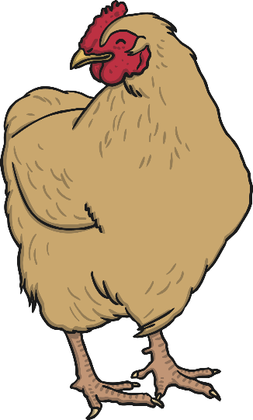
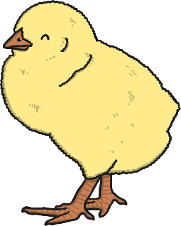
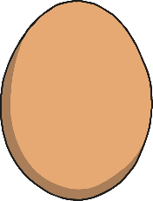
Life Cycles
Humans, other animals, plants and all living things have a life cycle.
This is the life cycle of a hen.

Slide 9

Bean Plant Life Cycle
The bean plant life cycle begins with a bean that has fallen or been picked from a bean plant.
The bean is a seed of the bean plant.

Slide 10
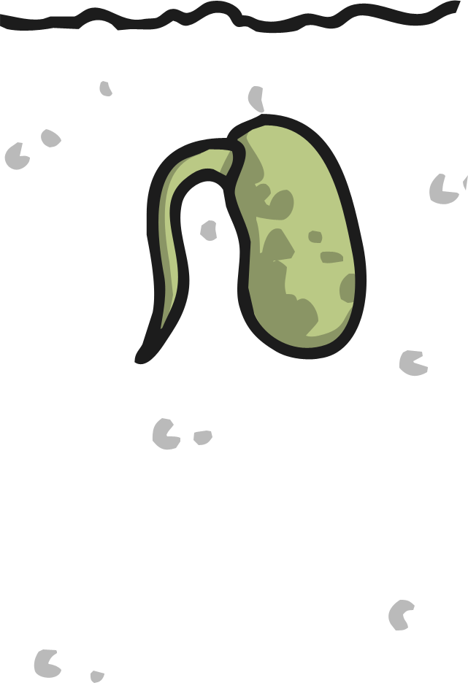
Bean Plant Life Cycle
A planted bean seed germinates and, after 2-3 days, a shoot appears.

Slide 11
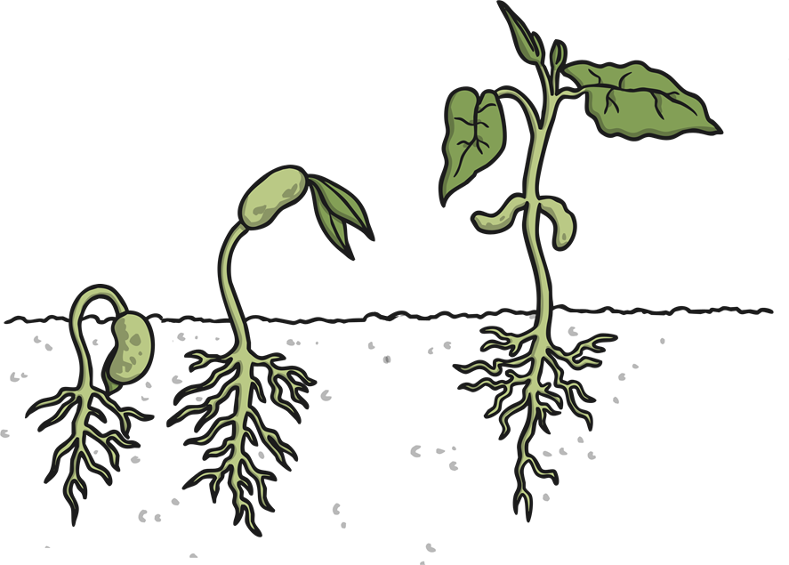
Bean Plant Life Cycle
The bean seed will start to take root and a stem will appear.
The bean uses the food in the seed to grow taller.

Slide 12

Bean Plant Life Cycle
If the bean plant has water and sunlight, it will grow tall and then it will flower.

Slide 13
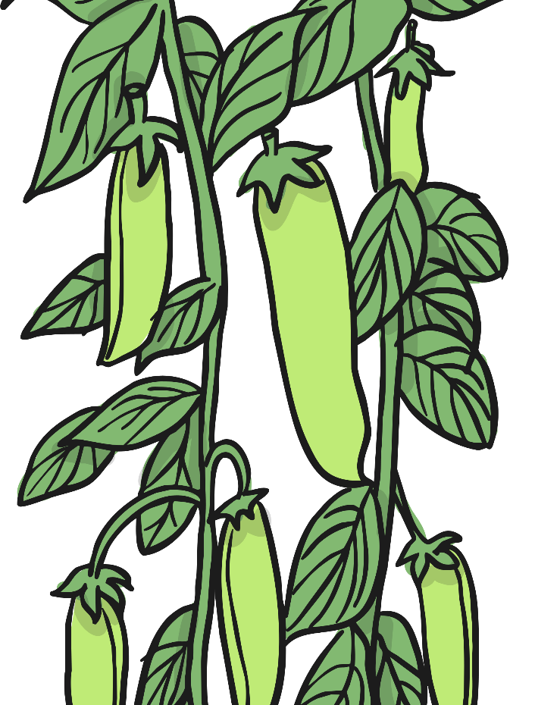
Bean Plant Life Cycle
Eventually pods of beans will grow on the bean plant. Each one of these is a seed.

Slide 14
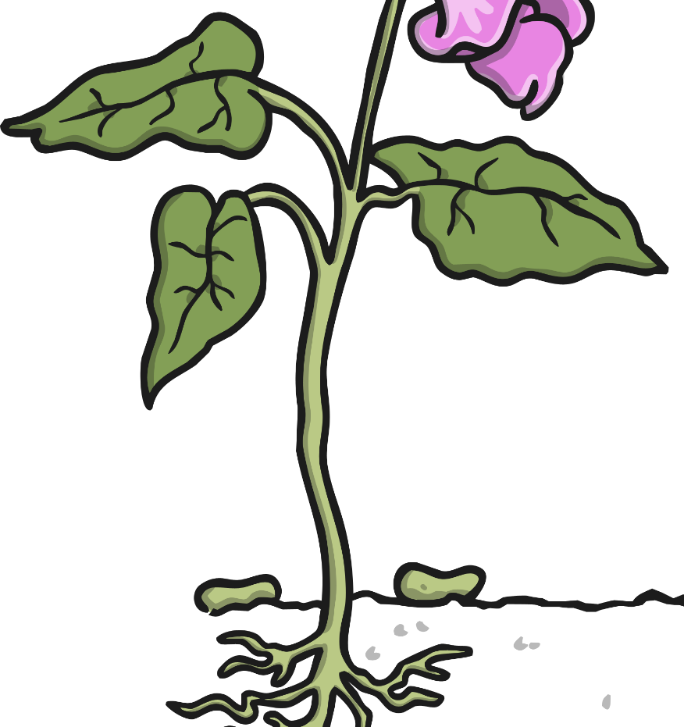
Bean Plant Life Cycle
Each seed can fall into the soil and become a new seedling, ready to grow into a whole new bean plant.

Slide 15

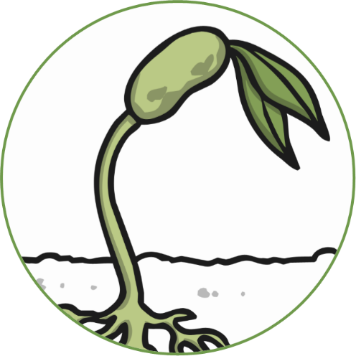


Bean Plant Life Cycle
Bean
Seedling
Bean Pods
Flowering Plant

Slide 16

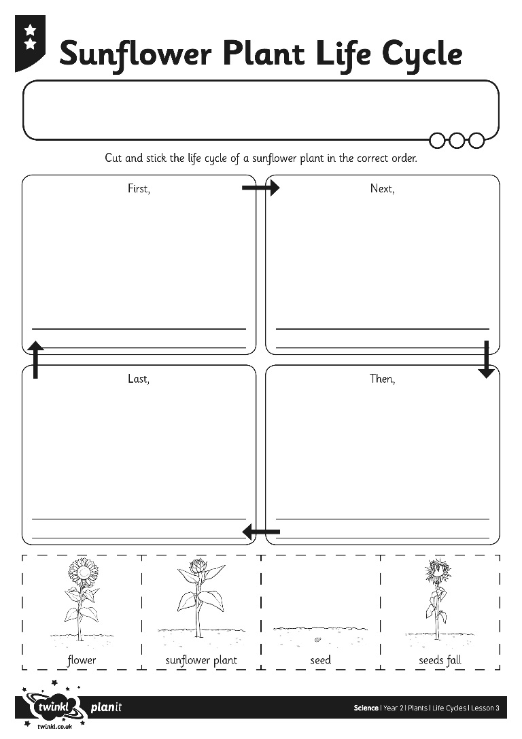
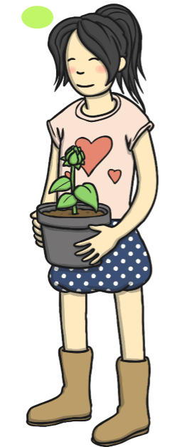
Sunflower Life Cycle
Can you order the life cycle of a sunflower?

Slide 17
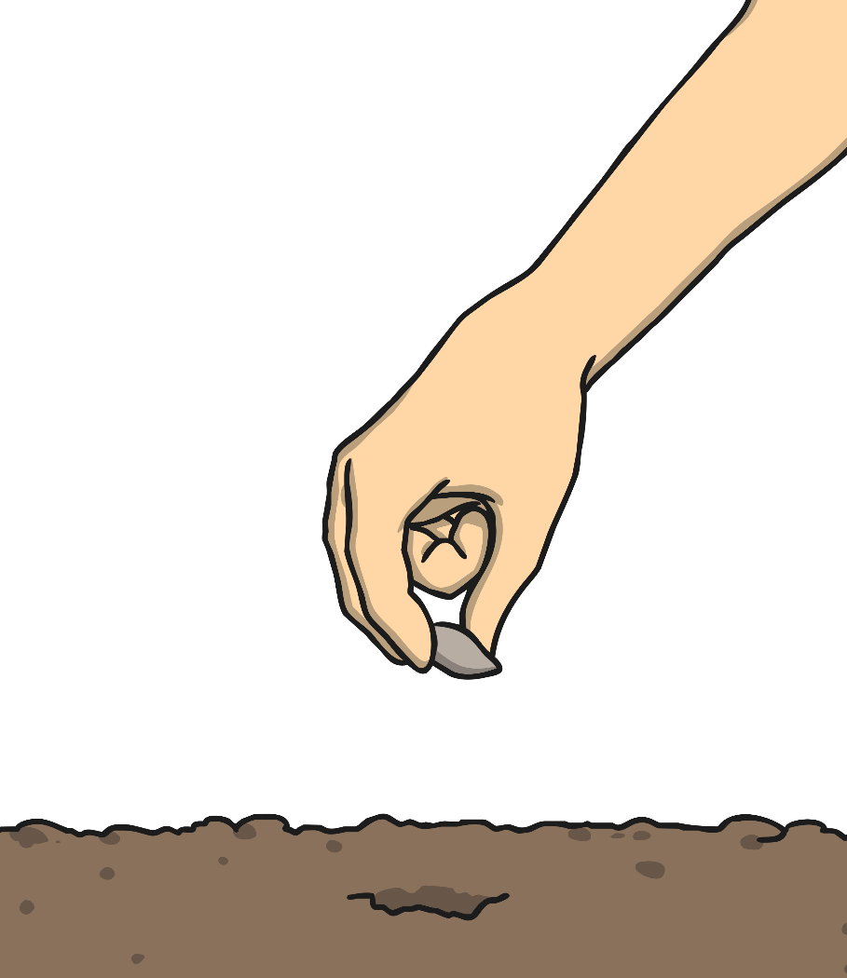
Let’s Pretend…
Everybody find a space.
You are going to pretend to be tiny seeds, snug and warm in the ground.
Can you curl up tight like a seed in the soil?

Slide 18
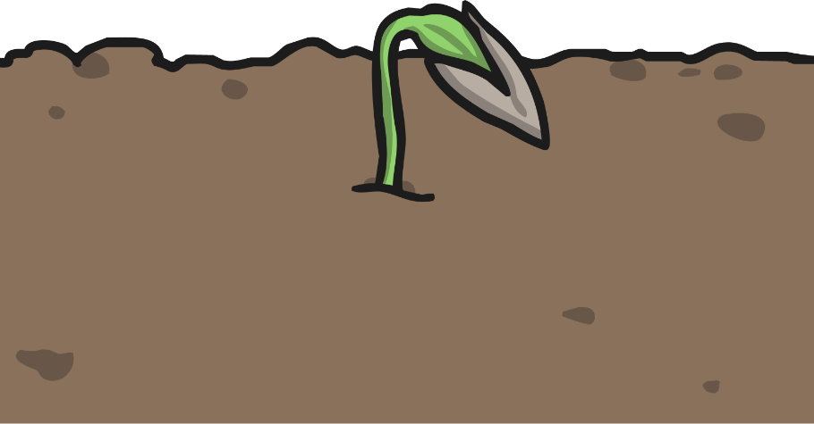
Let’s Pretend…
The rain is falling on the ground.
It’s lovely and warm in the ground.
Now is a good time to sprout!
Can you wiggle like seeds getting ready to burst?
When you’re ready, make a tiny little sprout!

Slide 19
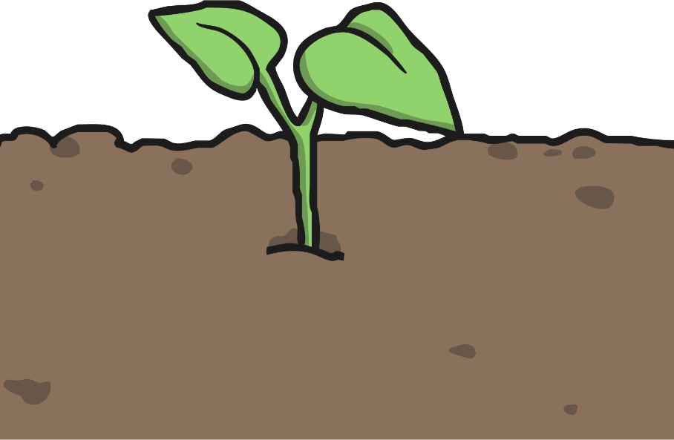
Let’s Pretend…
The warm sun is shining and the cool rain is falling.
You want to be outside!
Grow a little bit more and poke your head out of the earth.
Now you are a seedling!

Slide 20
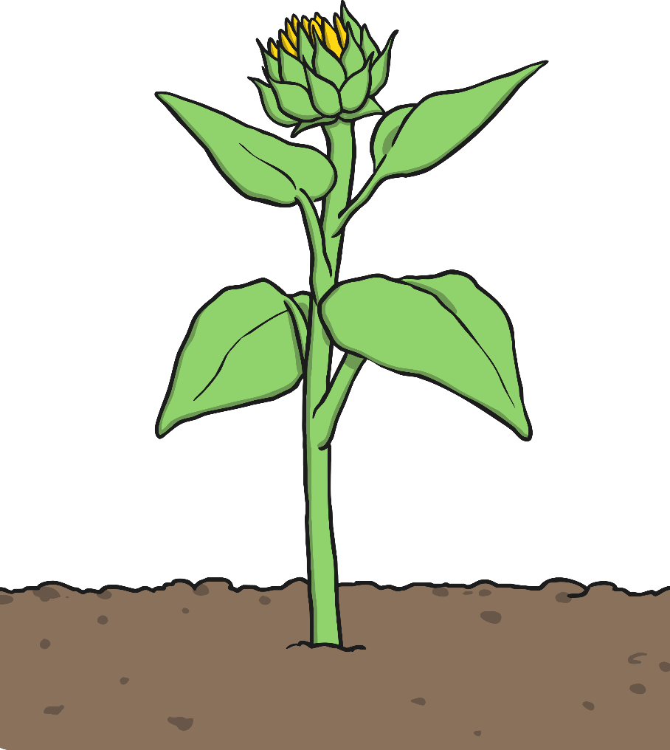
Let’s Pretend…
What a beautiful day!
Time to grow some big green leaves. Stretch those leaves out towards the sun.
The wind is blowing! Your stem and your leaves are blowing in the wind!
Make sure you keep your roots in the ground!

Slide 21

Let’s Pretend…
It’s time to grow a flower!
Can you use your hands to make a flower bud?
Can you make the flower open towards the sun?
Look at all those big, bright flowers!

Slide 22
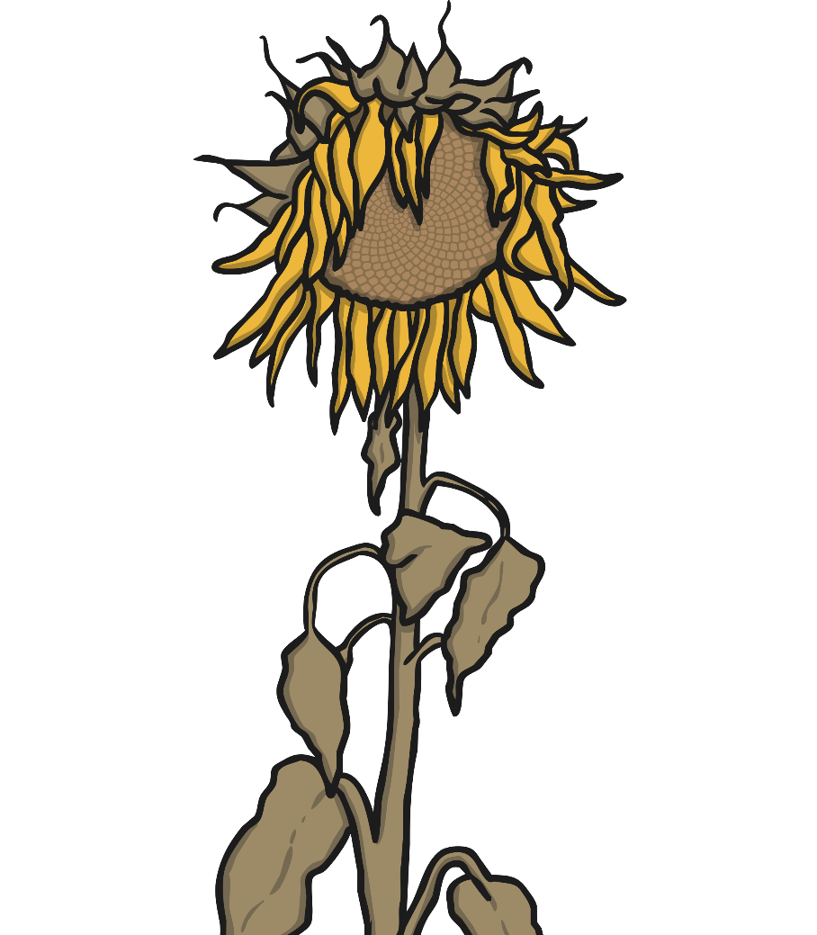
Let’s Pretend…
Your seeds are ready to fall.
Bend your flower towards the ground.
Can you use your fingers to show the seeds falling?

Slide 23
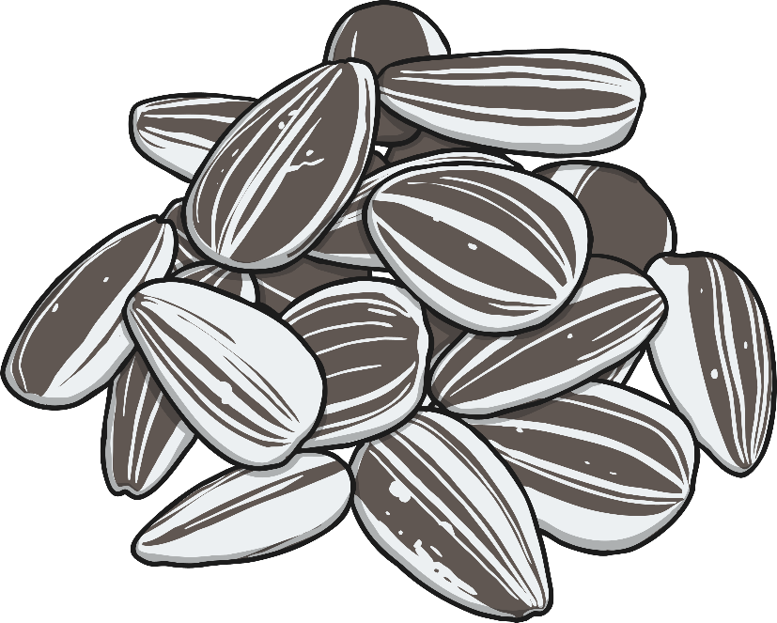
Let’s Pretend…
You are a tiny seed again, snug and warm in the ground. Curl up tight, and wait for the sun and the rain.
Do you know what will happen next?

