Slide 1
Friday 2nd July
LO: solve word problems with negative numbers

Slide 2
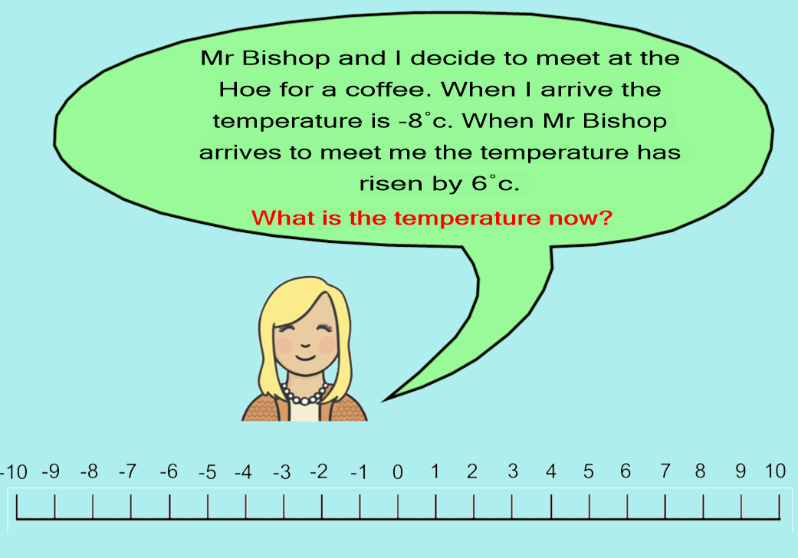

Slide 3
The temperature now is ______

Slide 4
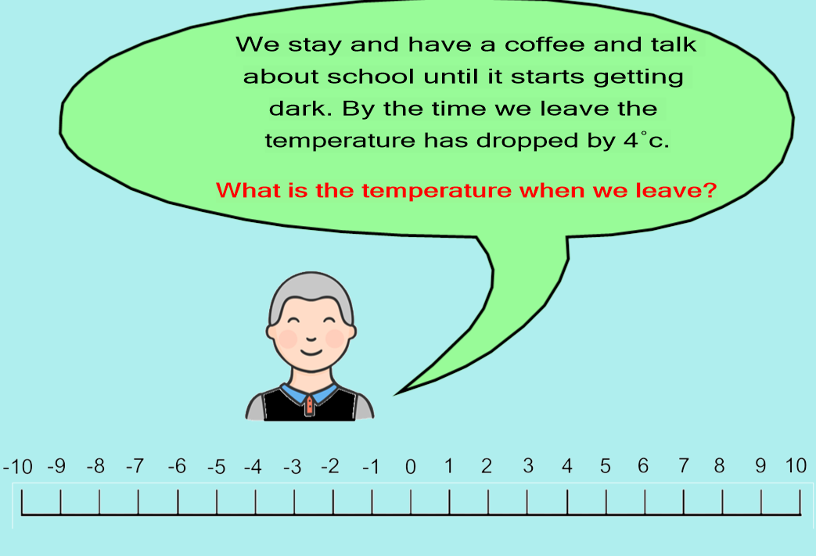

Slide 5
The temperature when you leave is ____

