Slide 1
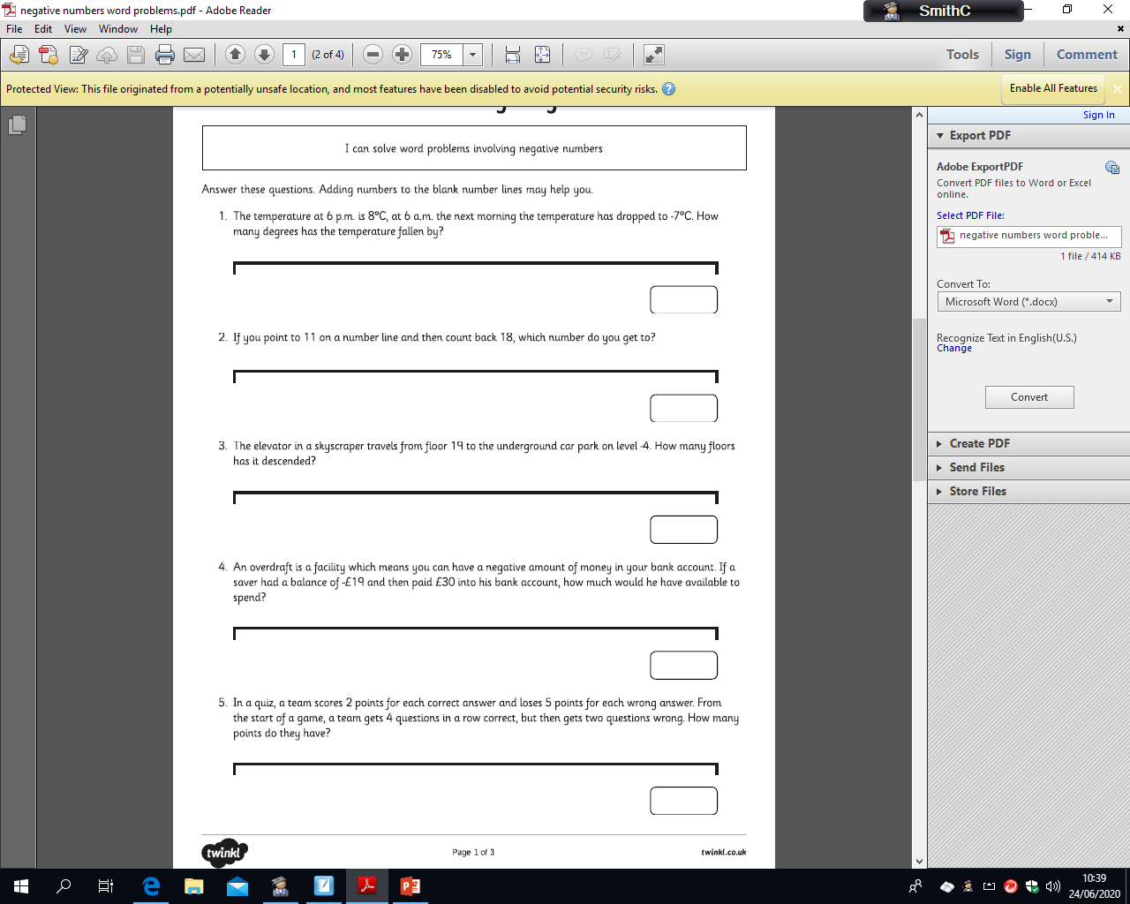
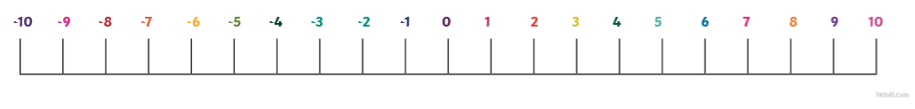
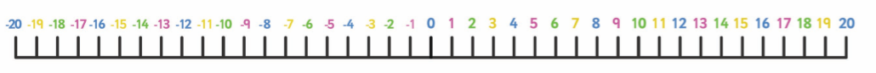
MILD
Friday 3rd July
LO: solving word problems using negative numbers
Answer these questions using the number line to help you.

Slide 2
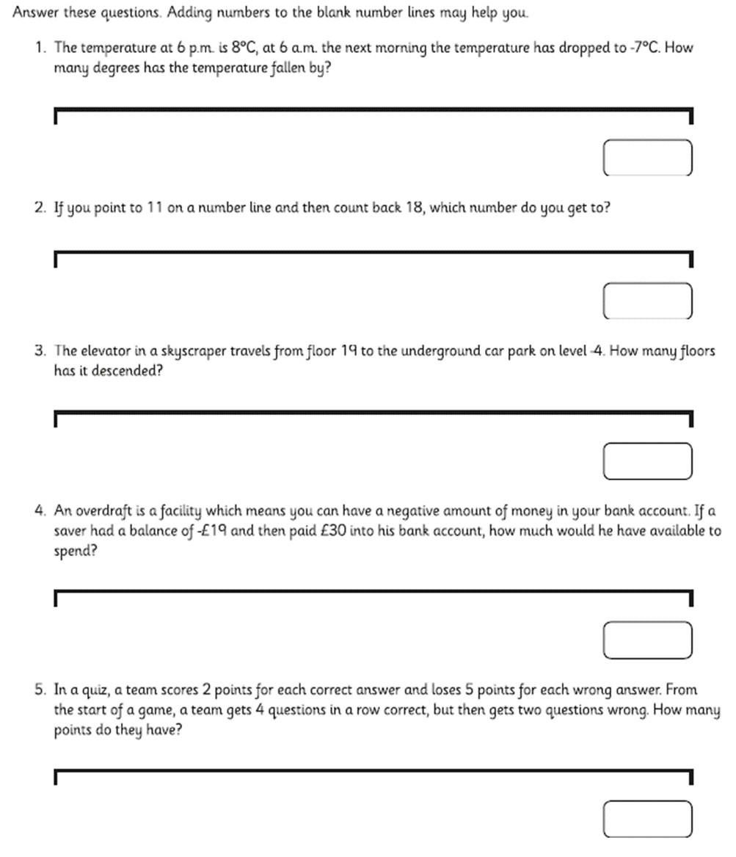
SPICY
Friday 3rd July
LO: solving word problems using negative numbers

Slide 3
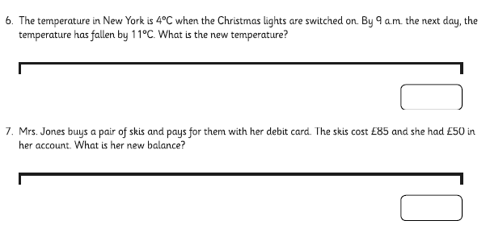
HOT
Friday 3rd July
LO: solving word problems using negative numbers

