Slide 1
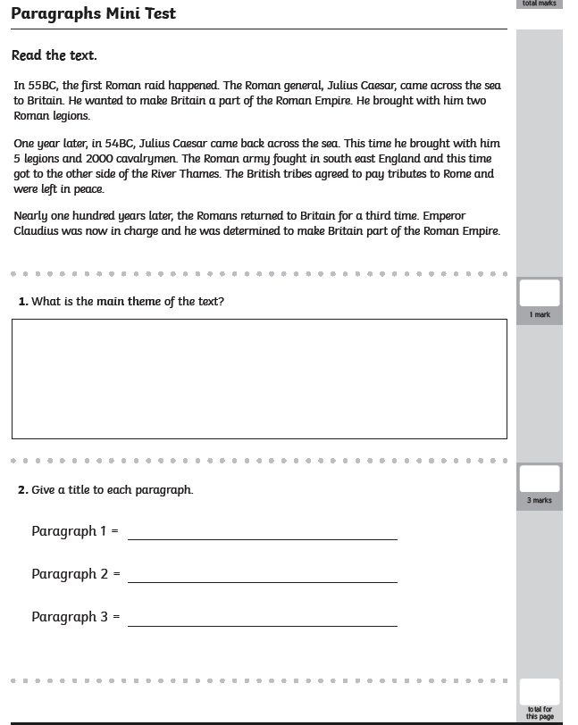
Friday 3rd July
LO: to understand how paragraphs are used
Test your knowledge to see what you have learnt about paragraphing from this week…

Slide 2
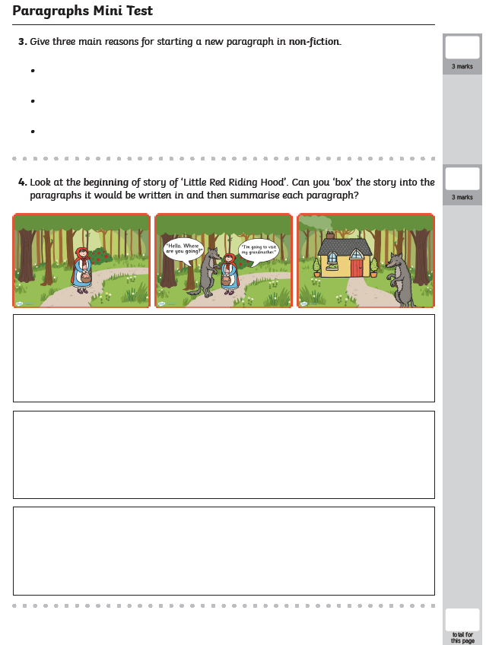
Friday 3rd July

Slide 3
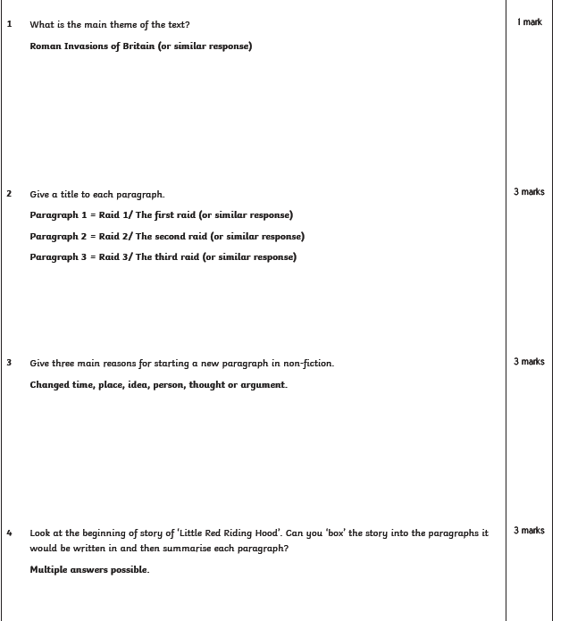
Friday 3rd July
ANSWERS

