Slide 1
Friday 3rd July
LO: What are electrical conductors and insulators?
Today you are going to research electrical conductors and insulators – using the sheets provided and your own research if you wish. Then you will create a poster explaining what electrical conductors and insulators are. Your poster should include a mixture of writing and drawings. Think about how you will make the information easy for a reader to understand and attractive so it appeals to a reader.
MILD
SPICY
HOT
You will need to include:
The meaning of an electrical insulator
The meaning of an electrical conductor
Examples of materials which are conductors
Examples of materials which are insulators
Real life examples showing objects where both electrical conductors and insulators are needed
Explanation of why conductors and insulators are important
Key language:
electrical insulators metal glass wire
conductors material wood plastic conductivity

Slide 2
Electrical Conductors and Insulators
Some materials allow electric current to flow more freely than others. These materials are called conductors. Other materials are resistant to the flow of electric current. These materials are called insulators. Conductors and insulators are both important in the field of electronics.
Electrical Conductors
Electrical conductors allow electric current to flow easily because of the make up of their atoms. In a conductor, the outer electrons of the atom are loosely bound and can freely move through the material when an electric charge is applied.
Conductive Materials
In general, the best electrical conductors are metals. Metals tend to have electrons in the outer layer of their atoms that are freely shared. The most conductive of all the elements is silver. Unfortunately, silver is too rare and expensive to use in most electrical equipment. Today, the most commonly used electrical conductor is copper. Copper is used in electrical wiring and electrical circuits throughout the world.
Superconductors
A superconductor is a material that is a perfect conductor. It has an electrical resistance of zero. All of the superconductors that have been discovered by scientists to date require a very cold temperature on the order of minus 234 degrees C in order to become superconductors.
Electrical Insulators
The opposite of a conductor is an insulator. An insulator opposes the flow of electricity. Insulators are important to keep us safe from electricity. The wire that carries electricity to your computer or television is covered with a rubber-like insulator that protects you from getting electrocuted. Good insulators include glass, the air, and paper.
Semiconductors
Some materials behave in between a conductor and an insulator. These materials are called semiconductors. Semiconductors are important in electronics such as computers and mobile phones because their conductivity can be controlled allowing for current to flow in just one direction or only under certain circumstances. The most commonly used semiconductor in electronics today is silicon.
Interesting Facts about Electrical Conductors and Insulators
Most good electrical conductors are also good conductors of heat.
Temperature can play an important role in the conductance of a material. In general, the higher the temperature the lower the conductivity as resistance increases with temperature.
Aluminum has a lower conductivity than copper, but is sometimes used in wiring for lower cost.
Many electronics companies are headquartered in "Silicon Valley", California, which is nicknamed after the semiconductor silicon.

Slide 3
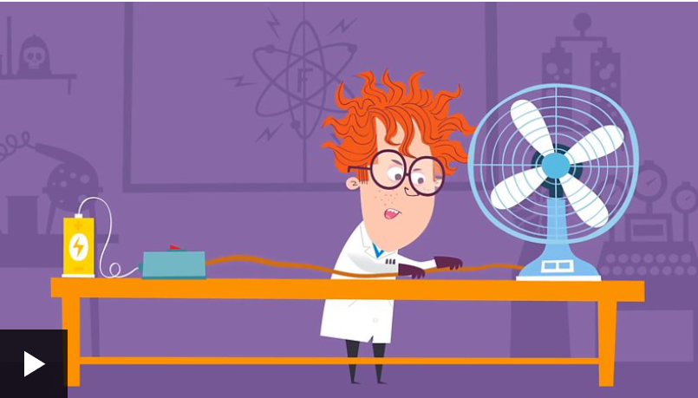
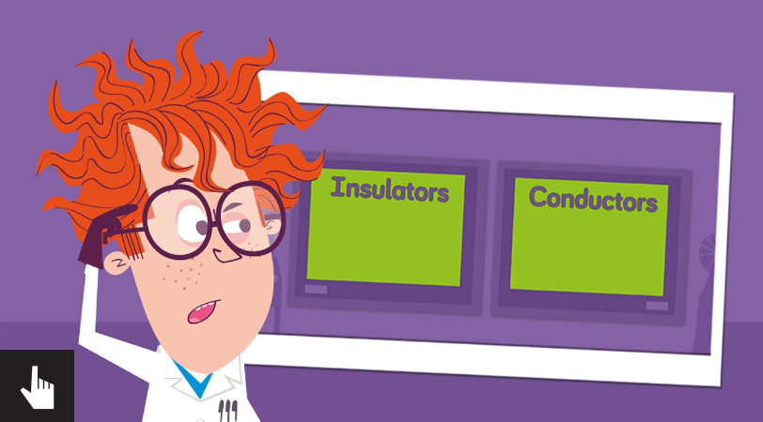
https://www.bbc.co.uk/bitesize/topics/z2882hv/articles/zxv482p
Watch this video
Play this game
Conductors
Some materials let electricity pass through them easily. These materials are known as electrical conductors.
Many metals, such as copper, iron and steel, are good electrical conductors. That is why the parts of electrical objects that need to let electricity pass through are always made of metal.
Metal is used in plugs to allow electricity to transfer from the wall socket, through the plug, and into a device such as a radio or TV.
In a light bulb, the metal filament conducts electricity and causes the light bulb to light up.
Insulators
Some materials do not allow electricity to pass through them. These materials are known as electrical insulators.
Plastic, wood, glass and rubber are good electrical insulators. That is why they are used to cover materials that carry electricity.
The plastic covering that surrounds wires is an electrical insulator. It stops you from getting an electrical shock.

Slide 4
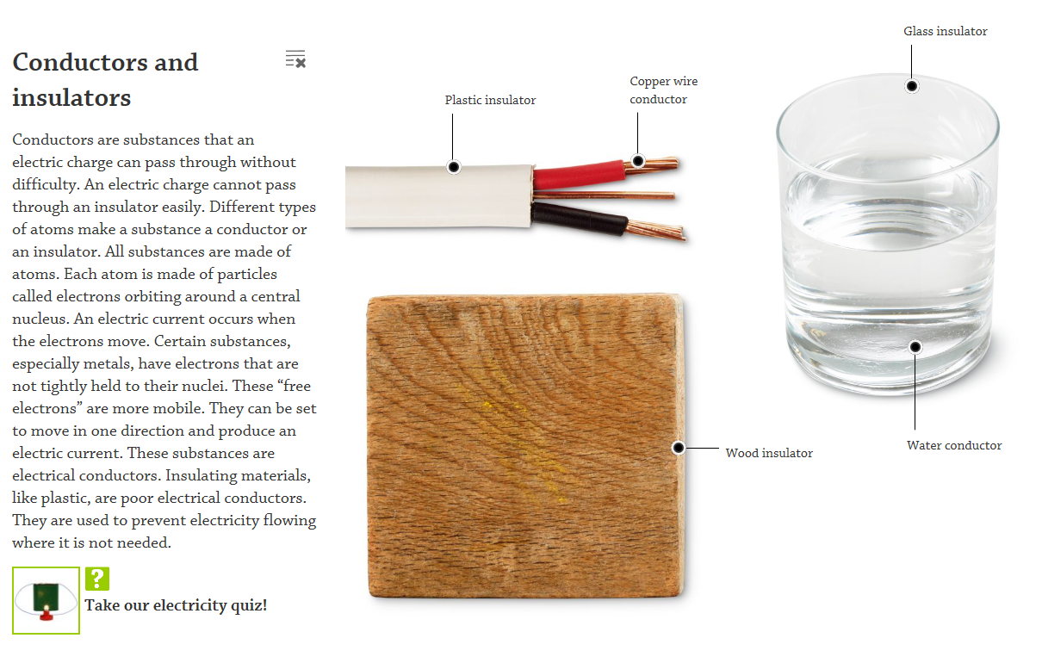
HOT explanation

