Slide 1
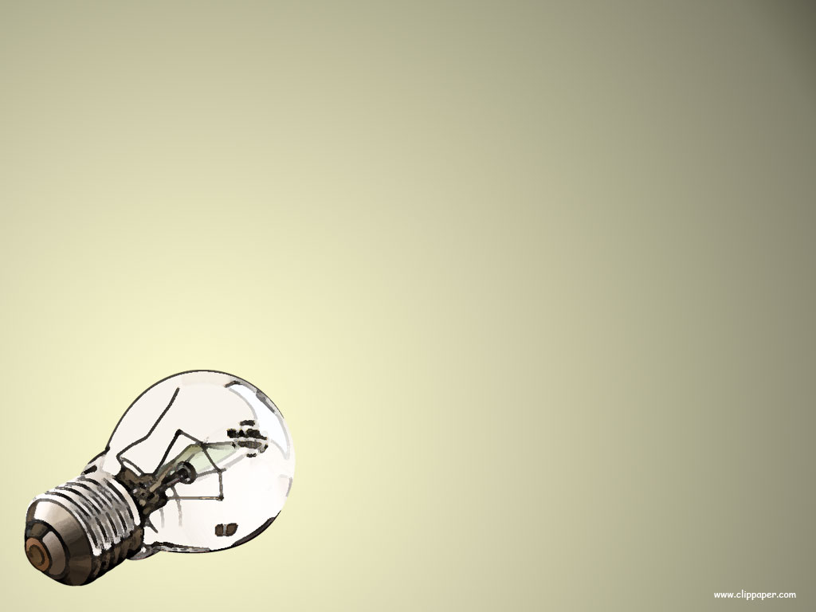
ELECTRICAL CONDUCTORS
AND
INSULATORS

Slide 2
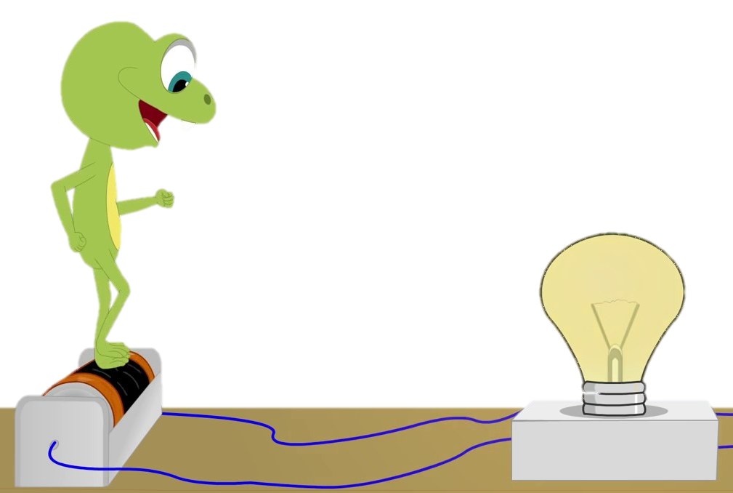
Electricity travels easily through electrical conductors, like metals.

Slide 3
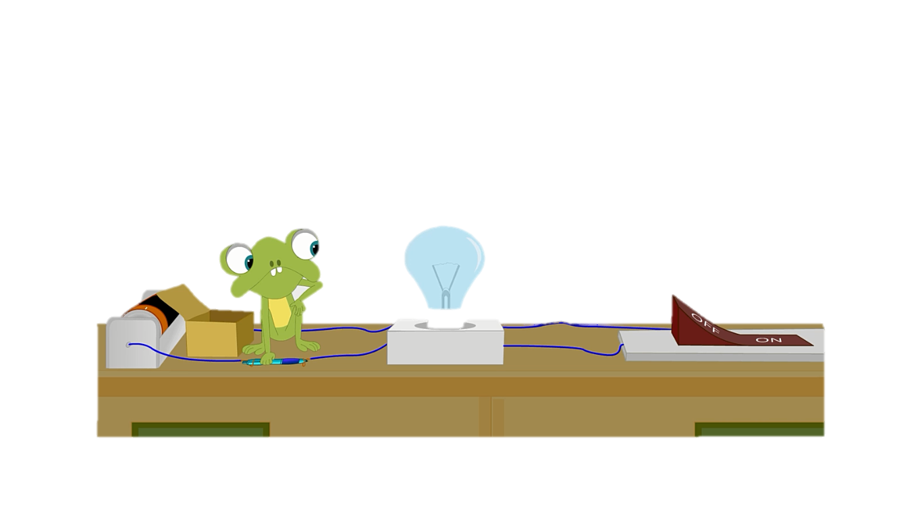
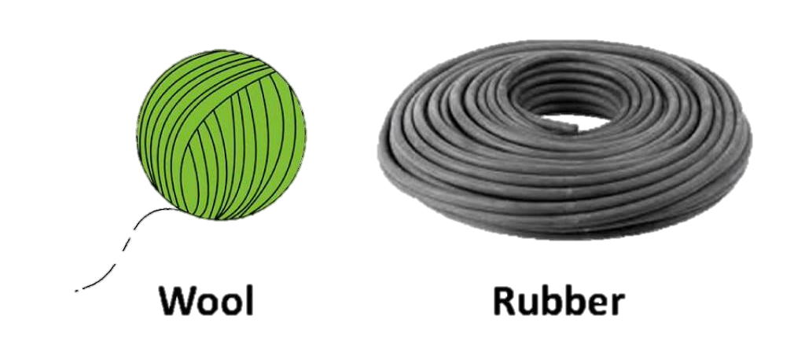
Materials that do not let electricity pass through them easily are called electrical insulators. Plastic, wood, glass and rubber are good electrical insulators.

Slide 4
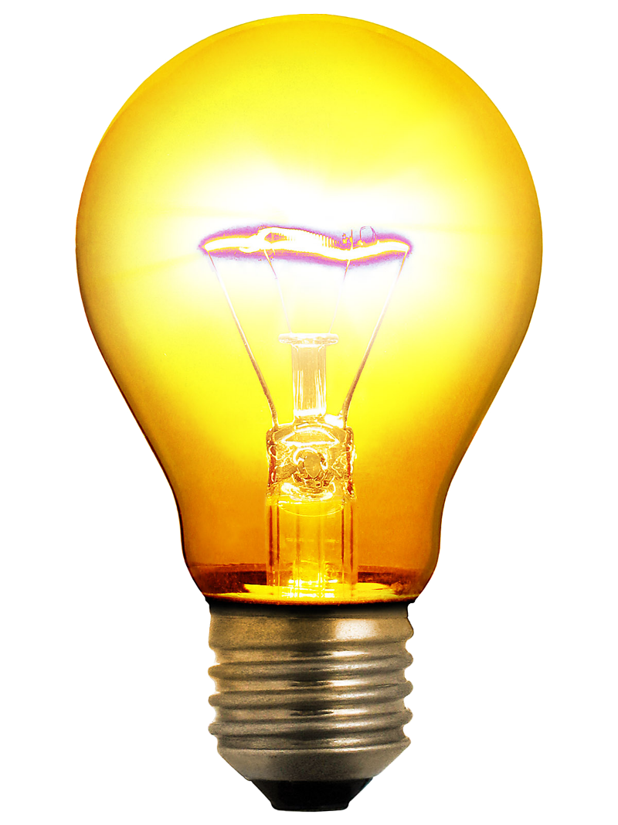
ELECTRICAL CONDUCTORS
Some materials let electricity pass through them easily. These materials are known as electrical conductors.
Many metals, such as copper, iron and steel, are good electrical conductors. That is why the parts of electrical objects that need to let electricity pass through are always made of metal.
metal

Slide 5
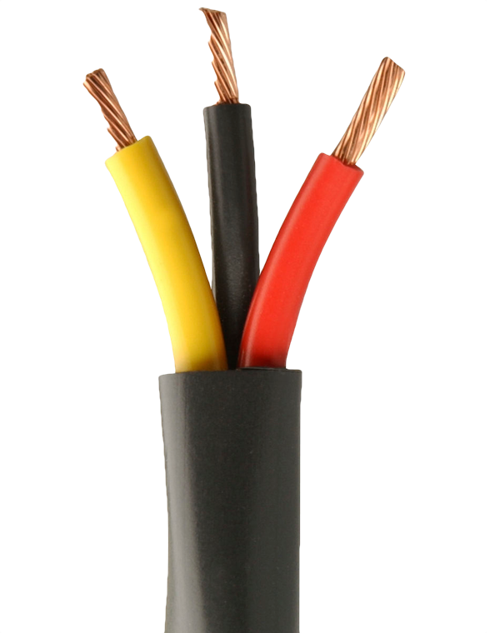
ELECTRICAL INSULATORS
Some materials do not allow electricity to pass through them. These materials are known as electrical insulators.
Plastic, wood, glass and rubber are good electrical insulators. That is why they are used to cover materials that carry electricity.
The plastic covering that surrounds wires is an electrical insulator. It stops you from getting an electrical shock.
Plastic cover
Plastic cover

