Slide 1
Monday 13th July 2020
L.O: To measure in metres
I can identify what a metre is
I can use metres to measure different items
I can estimate measures before measuring

Slide 2
Monday 13th July 2020

Slide 3
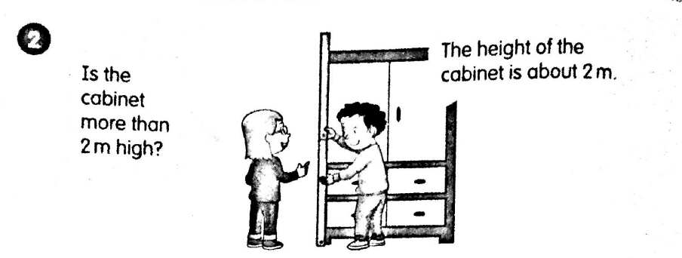
Monday 13th July 2020

Slide 4
Monday 13th July 2020

Slide 5
Monday 13th July 2020

Slide 6



Monday 13th July 2020
L.O: To measure in metres
Look at the table. You will need a string/ruler that is 1m tall.
For each item, predict/estimate whether it is more or less than 2m.
Then, using your string/ruler, measure each object.
Look at the table. You will need a string/ruler that is 1m tall.
For each item, predict/estimate whether it is more or less than 2m.
Then, using your string/ruler, measure each object.
Look at the table.
For each item, can you estimate the actual measurement in metres?
Then, see if you can measure accurately using the rulers/tape measures.

Slide 7
Tuesday 14th July 2020
L.O: To measure in centimetres
I can identify what a centimetre is and how many are in a metre
I can use centimetres to measure different items accurately
I can compare different lengths using longer and shorter

Slide 8
Tuesday 14th July 2020
Warm up: Reading Scales (rulers in cm)
https://www.topmarks.co.uk/maths-games/measuring-in-cm

Slide 9
Tuesday 14th July 2020
L.O: To measure in centimetres
Look at your ruler closely. The large numbers go up in centimetres.
The really small marks are called millimetres.
How many centimetres does your ruler go up to?

Slide 10
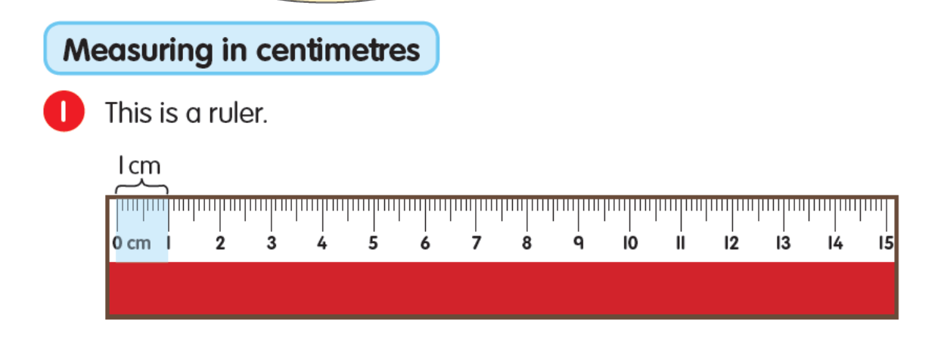
Tuesday 14th July 2020
L.O: To measure in centimetres

Slide 11
Tuesday 14th July 2020
L.O: To measure in centimetres

Slide 12
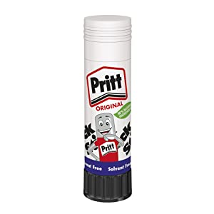
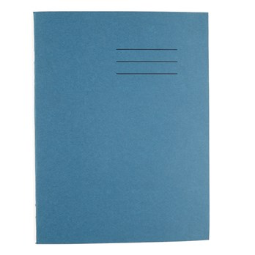
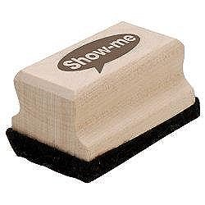
Tuesday 14th July 2020
L.O: To measure in centimetres
Gather these items. Can you measure the length and width of each item?
Get your adult to show you how to do the first one, then have a go yourself!

Slide 13
Tuesday 14th July 2020
L.O: To measure in centimetres
5cm
11cm
30cm
3.5cm
2.5cm
20.5cm
We write our measurements like this!
I have written .5 on some measurements. That means half a centimetre! If it is between two numbers, we use .5 to show this.

Slide 14
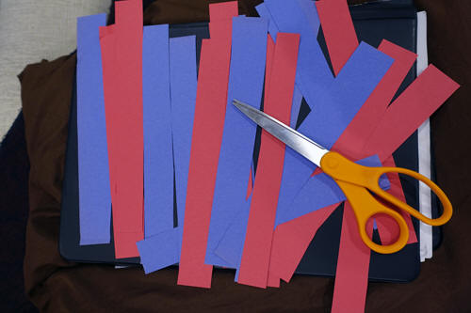
14.07.2020
L.O: To measure in centimetres
Measuring task!
You have been provided with some strips of paper of different size (you can cut these at home too!)
Measure each one, stick it in your book and write the measurements onto each strip.

Slide 15
Tuesday 14th July 2020
L.O: To measure in centimetres
Can you use a ruler to measure this line?
What would you use to measure this?

Slide 16
Tuesday 14th July 2020
L.O: To measure in centimetres
Tip: Use string, measure the string needed and cut it. Then, measure one final time in a straight line.

Slide 17
14.07.2020
L.O: To measure in centimetres
Practice Page 65.
Practice Pages 65 and 66.
Measuring length challenges

