Slide 1
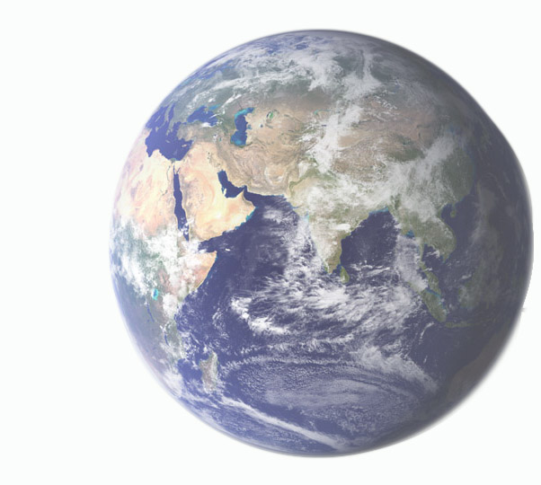
What is Geography?

Slide 2
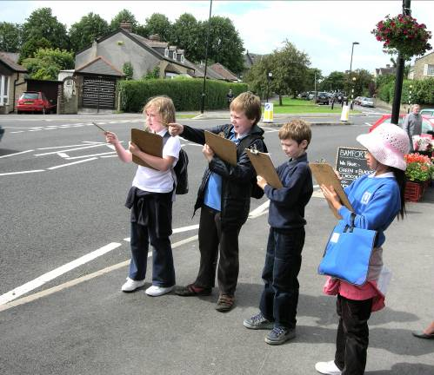
Geography is part and parcel of our personal survival kit.
It is a way of looking at the world that focuses our learning on:
what places and the environment are like
why they are important to us
how they are changing and
how they might develop in the future.
I didn’t expect that so many men would be coming in and out of GT News at this time of day.
Fieldwork provides children from Hallam Primary School, Sheffield, with an opportunity to engage with some of these questions.

Slide 3
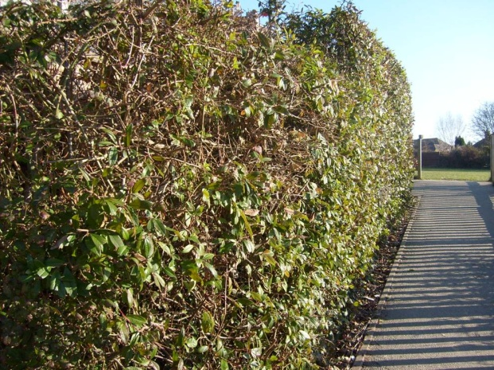
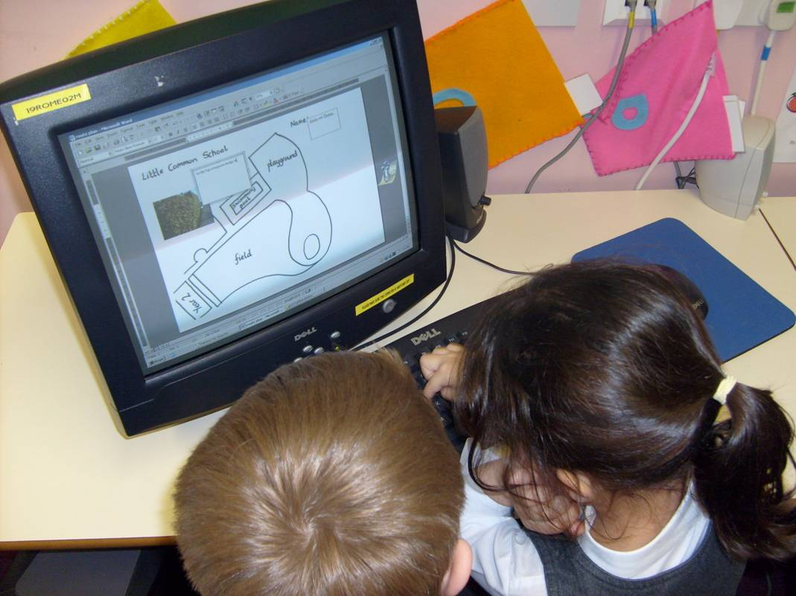
To make sense of the features and layout of our immediate and the wider world, we map it, both to see where things are and to help us understand how it is organised.
Children used the photographs taken on the walk and copied them onto the map
In the big evergreen hedge we saw a little birds nest. There was a bit of plastic in it!
http://www.geography.org.uk/projects/younggeographers/resources/littlecommon/

Slide 4
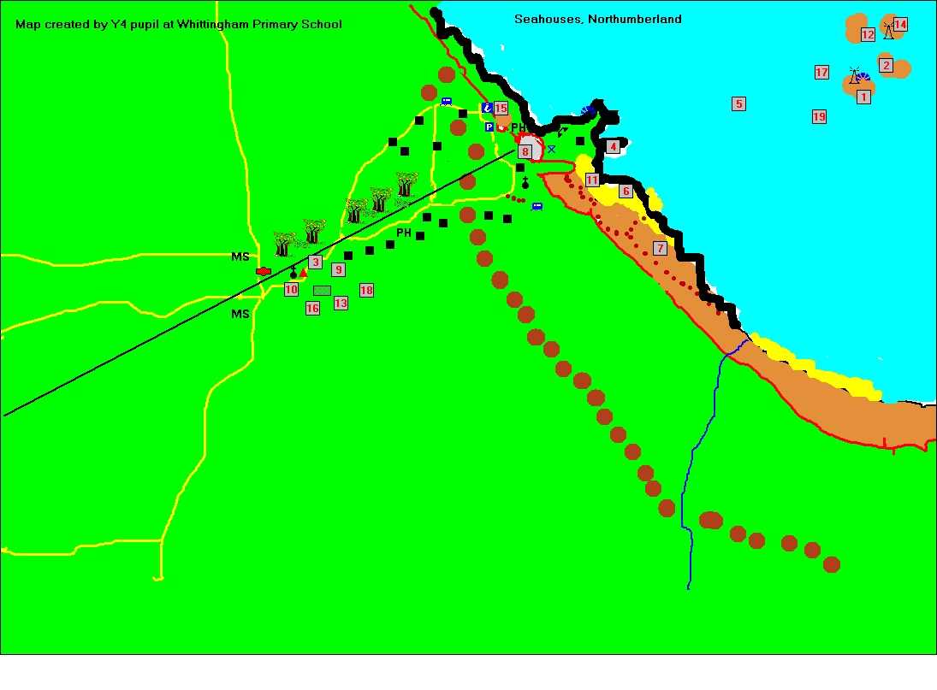
Recognising spatial patterns helps us to: understand the variety of natural and human processes at work in the environment. to plan ahead, whether to devise routes for travel or to reorganise parts of the locality.
Children created this map to show places they had visited and routes they had walked. It shows the spatial layout of Seahouses, e.g. Where roads are, where the beach and cliffs are etc. They used the software programme Local Studies.

Slide 5
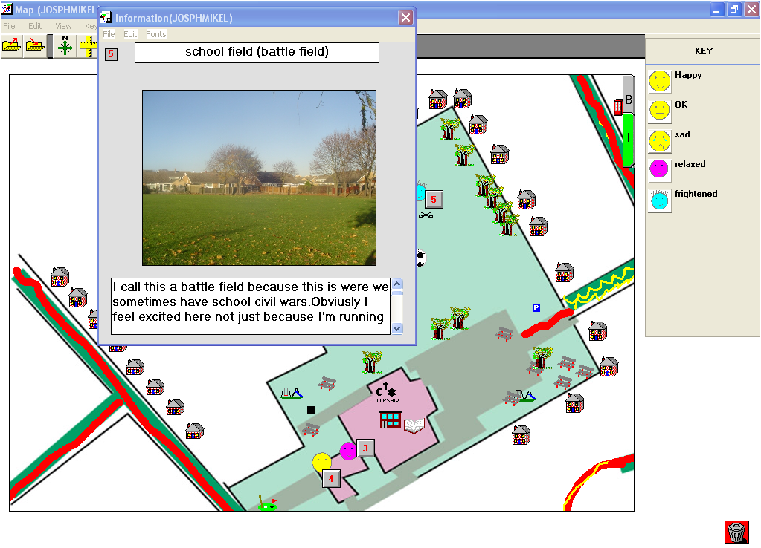
But such knowledge and understanding are only one part of geographical awareness. Of equal importance is how we feel about different places.
“Obviously I feel excited here”.
We learnt a great deal about the way children felt and used the space within the school grounds.
http://tiny.cc/ANmLS

Slide 6
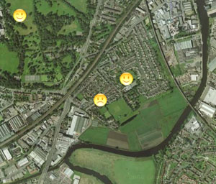
Places have meaning for us they are where we are, not just where we reside or go to school, to play or to work, but where we feel ‘at home’ or ‘out of place’. We relate to places, and this relationship is a key element of our personal identity.
Place
Identity
My place in the world:
Where do I live?
How does it look?
How do I feel about it?
http://www.quikmaps.com/full/47961

Slide 7
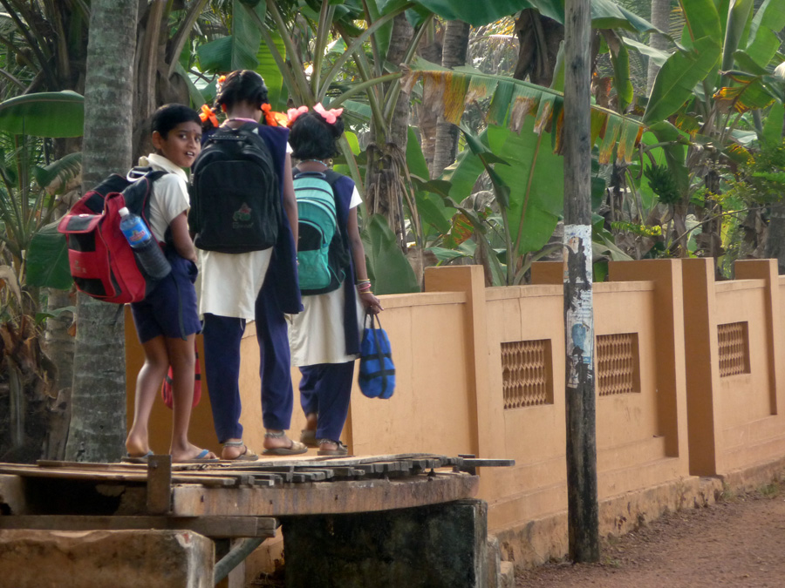
Identity
Place
My place in the world:
Where do I live?
How does it look?
How do I feel about it?

Slide 8
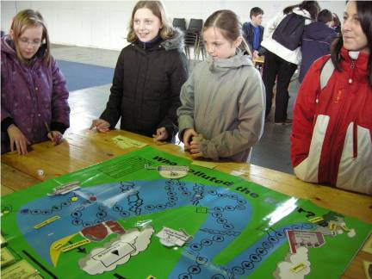
We also have a wider concern for the world around us.
We have a clearer understanding today about how we are affecting the environment than ever before. In our concern to improve our own lives and the lives of others, we have begun to realise that using resources wisely, managing the natural environment and repairing inadvertent damage is essential for our future.
Investigating flooding
I learnt that we need more materials like peat and soil that absorb water and less materials like concrete.

Slide 9
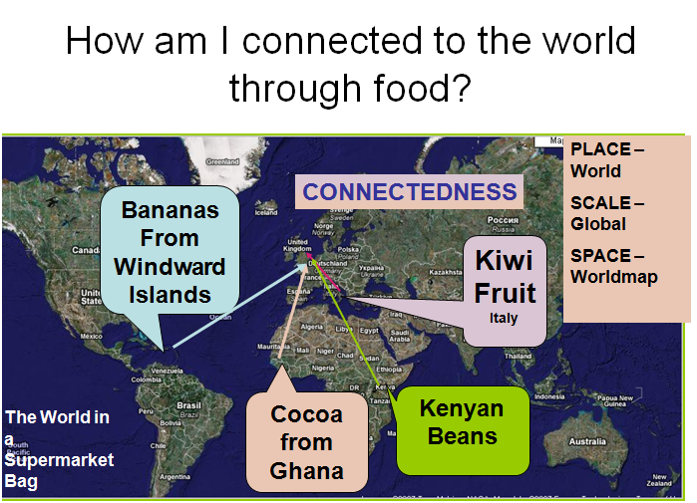
The idea of the global citizen who realises the interplay and interdependence of the local and the wider world and who argues for responsible action in day-to-day life lies at the heart of geography.

Slide 10
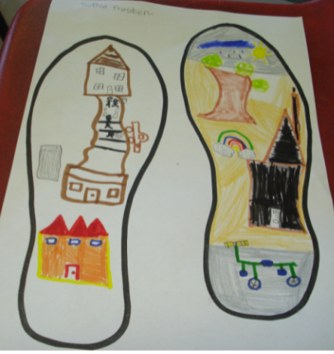
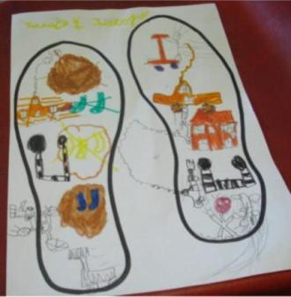
Encourages work in
The Local Area
especially fieldwork
Local Area topic: Footprints showing the street features of pupils journeys to school.

Slide 11
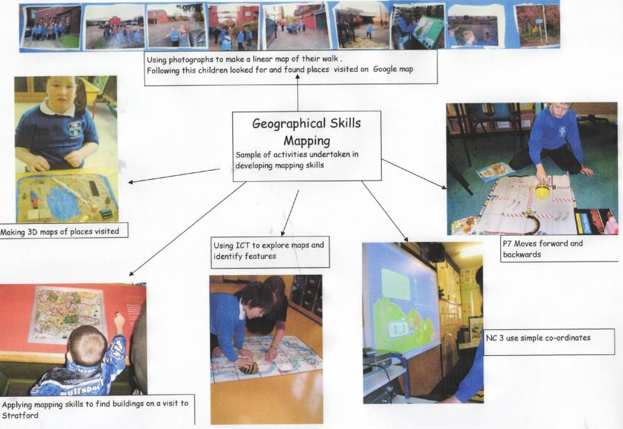
promotes map-work and graphicacy as essential parts of geography
Two Rivers Special School
Notes:
Children shouldn’t be at a disadvantage if their recording skills are poor

Slide 12
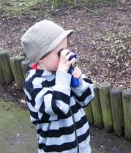
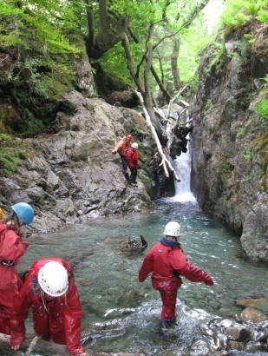
Encourages GeographicalThinking
Exemplar evidence:
How could this stream move this tree? Why do the rocks near the water have no vegetation?
Looking on the stream bed – what is it made up of? How and when does sediment move? This links to our work on rivers in year 6.
Making sense of the world through first hand experience
Spatial awareness
Making connections
Creative & critical thinking
Investigating issues

Slide 13
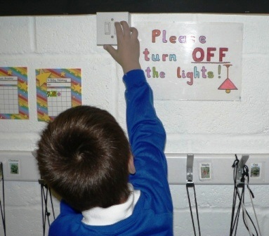
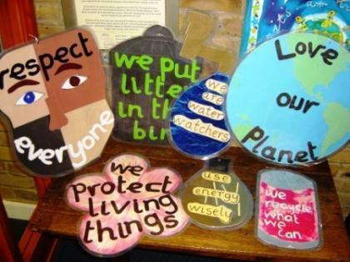
Seeks to develop active and informed future citizens
Exemplar evidence:

Slide 14
What could you do with your children at home to promote a love of fieldwork?
Journey sticks can be made anytime!
https://youtu.be/8fzB8yQAQs8

