Slide 1

Year Three and four Maths Home Learning
Virtual Parent Workshop
September 2020

Slide 2
New Primary Times Table Tests Explained
Primary –school children are expected to know ALL their times tables up to 12 x 12.
Under the current National Curriculum, children should know all their times tables by the end of Year 4.
This will now be formally tested.

Slide 3
Who will take the test and when?
This will be the first year children are required to sit the times table test.
It will be taken by children in Year 4, in the summer term (June) for all English schools.
How will children be tested?
Children will be tested using an on-screen check, where they will have to answer multiplication questions against the clock. The test will last no longer than 5 minutes and their answer will be marked instantly.
Children will be given six seconds to answer each of the questions, with a three second blank gap between each question.
The questions will be randomly selected by the testing programme. The test’s software has been programmed to show children more questions from the 6, 7, 8, 9 and 12 times tables, as these are trickier times tables focused on more in Years 3 and 4.
Notes:
25 questions will be asked using all the multiplication tables up to 12x12.
Multiplication facts will be the only things tested (there will be no problem-solving in the check)
School-level results won’t be made publicly available.

Slide 4
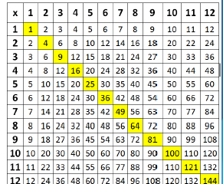
Learning times tables
This diagram shows all the multiplication facts that every child needs to commit to memory.
Children need to be able to recall any times tables answer within 2-3 seconds. This leaves no time for counting up to the answer. The answer has to ‘pop’ out of the memory fairly instantly.

Slide 5
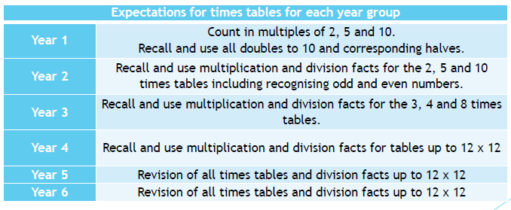
National Curriculum Expectations
Notes:
In the table below are the National Curriculum times tables expectations for each year group. The children will be tested on their times tables regularly in school.

Slide 6
Language and times tables
There are many different ways to say the tables and they’re all correct.
Children should be exposed to a range of language, for example;
  Three times eight is…
  Three multiplied by eight…
  Three eights are…
  Three lots of eight…
  Three groups of eight…

Slide 7
Useful tips
Stick to one table at a time to minimise confusion
Start with chanting and writing them out slowly in order
Then move on to completing the answers quickly in order
Finally, move on to completing answers in any order
Keep reminding your child that 3 x 4 is the same as 4 x 3
Talk about numbers as you encounter them “5 x 7 = 35 that’s our house number “ – that makes more memory hooks.

Slide 8

Research shows that daily practise is the best strategy for children to learn these important facts. Short bursts of daily practise are much more effective than spending hours once a week.
Parental support is critical in this area. For children to be fully motivated and for them to get the best out of the practice, they need an adult's help. Without a parent's praise and reminders, without sitting down together or checking their work, practising times tables will not feel important.

Slide 9


​When it comes to times tables, speed AND accuracy are important – the more facts your child remembers, the easier it is for them to do harder calculations.
​
To be a Times Table Rock Star you need to answer any multiplication fact up to 12×12 in less than 3 seconds!
Notes:
Times Table Rock Stars is a fun and challenging programme designed to help students master the times tables!

Slide 10

There are 2 Single Player modes:
Garage (main mode children should play)
The questions will only come from the times tables the teacher has set for the week. The Garage is best for getting quicker at a few facts.
Studio
The questions in the Studio can be anything from 1×1 up to 12×12. TT Rock Stars calculates the mean response time from their last 10 games in the Studio and translates that time into a Rock Status.
(If you don’t play in the Studio you don’t get a Rock Status.)
Soundcheck
When you play Soundcheck, you get 25 questions each with a 6-second time limit. The questions are multiplication only and evenly weighted in terms of difficulty each time you play.
Notes:
It will include multiplication and division questions. As pupils start to answer questions, TT Rock Stars works out which facts they take longer on and will give them more of these questions to answer.

Slide 11

Multiplayer
Rock Arena
The Arena allows players to compete against all other members of their Band/class (their Bandmates would need to join the same game in order to compete together).
Rock Festival
​The Rock Festival games are open to players from around the world. Like the Arena, there is no limit to the number of players who can join a game; however, unlike the Arena, questions are selected at random from 1×1 to 12×12.
Notes:
Rock Arena: A new Arena game starts every 15 seconds and once the clock starts they race to answer more questions than the others. In the Arena, questions will only come from the times tables the teacher has set for the week, similar to the Garage. They earn 1 coin per correct answer.

Slide 12
Short bursts of daily practise are more effective than a long period once a week.
To make a success of this program and ensure your child remains motivated on their times tables your help is imperative. Without your praise and reminders, without you sitting down next to them or checking their work, practising times tables will not feel important to your child.

Slide 13
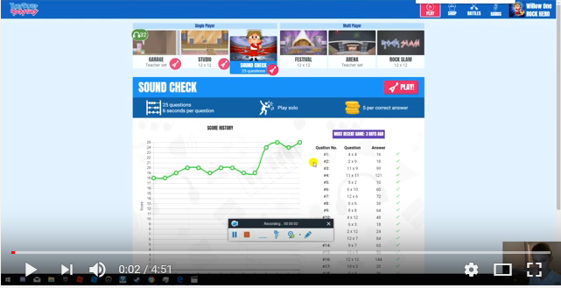
Watch this to see a speed to aspire to!
https://www.youtube.com/watch?v=rojZrvA22pY
Notes:
Beginning – 1.33 play

Slide 14
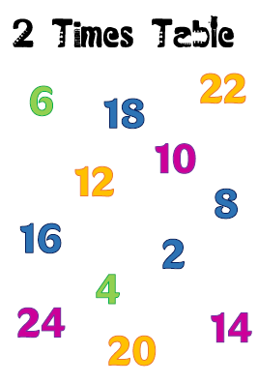
Scatter tables
Notes:
Adult reads out a question and child points to an answer.
To use them, you call out a question from the times table you are focusing on and your child should point to the answer on the page. For example, if you are concentrating on the 5 times table, then find the Scatter Table for the 5s and call out questions like, “9 times 5” (your child points to 45), “6 times 5” (your child points to 30) or “5 times 12” (your child points to 60). Your child should be trying to get them correct each time and not worrying about the speed.

Slide 15
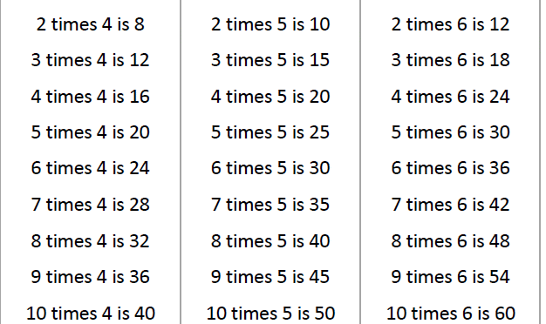
Chanting & reciting
Notes:
*Read the times tables that are focussing on. Do it a second time round but this time your child should be trying to say them without reading them from the page. It is more important that they say them correctly than say them quickly to begin with.
*Write the focus times table out, initially in order and then in a random order

Slide 16

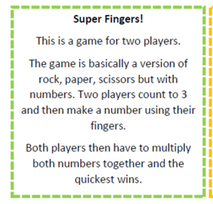
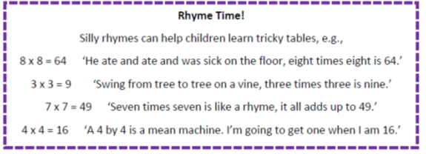
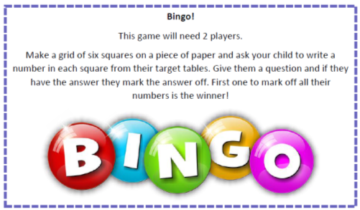
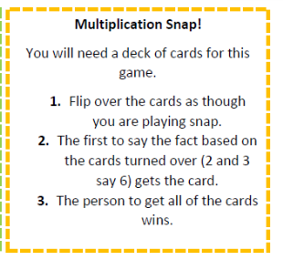
Games to try at home

Slide 17

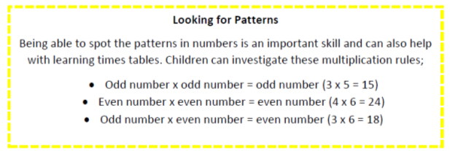
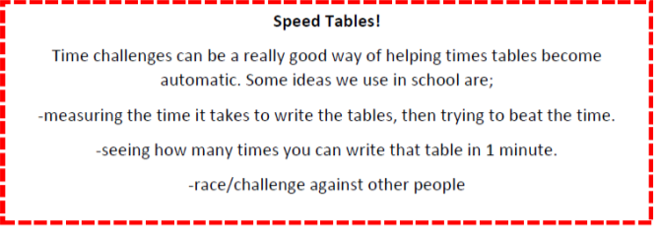
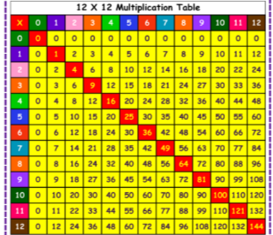
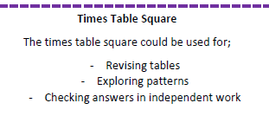
Chant, rap or sing times table songs

