Slide 1


SATs
Parents’ Information Evening
September 2020

Slide 2
Aims of the Session
To understand the format of the KS2 SATs for May 2021;
Have a clear picture about how SATs are organised;
Know how to support your child with their SATs preparation;

Slide 3
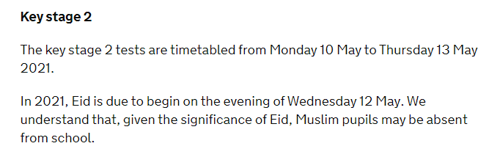
KS2 SATS timetable
The key stage 2 tests are timetabled from Monday 10 May to Thursday 13 May 2021.
Grammar
Spelling
Reading
Maths: Arithmetic
Maths: Reasoning 2
Maths: Reasoning 3

Slide 4
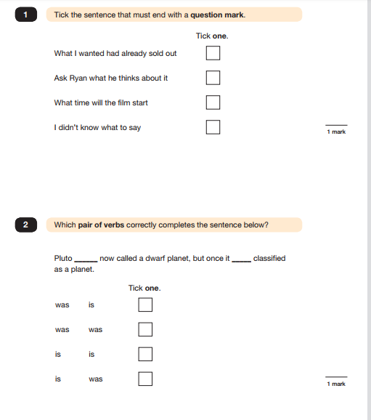
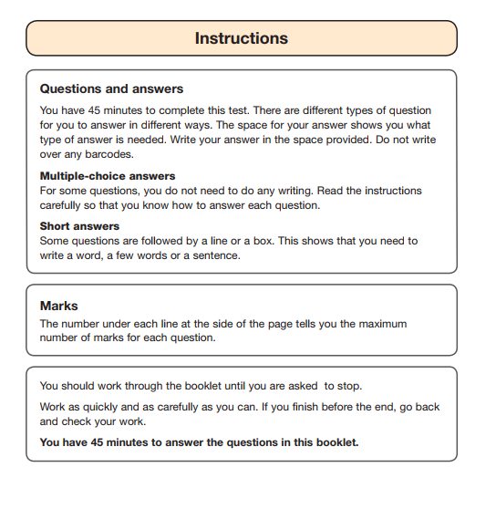
English Grammar Paper
(/50)

Slide 5
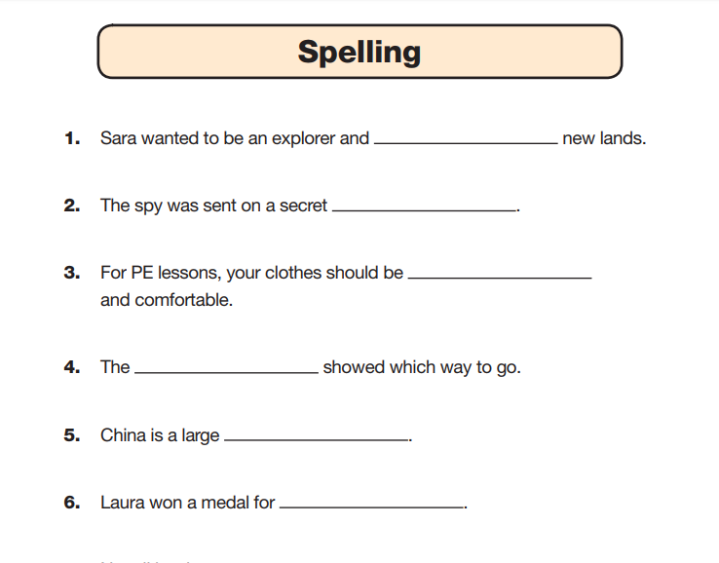
(/20)

Slide 6
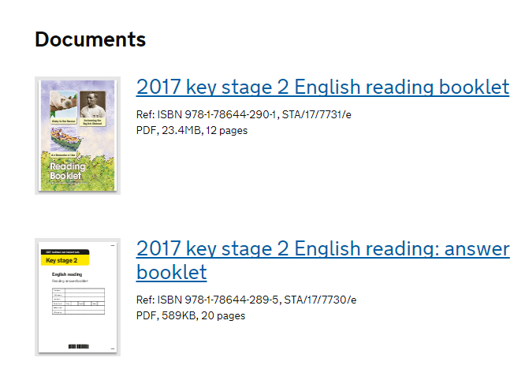
Reading
(/50)

Slide 7
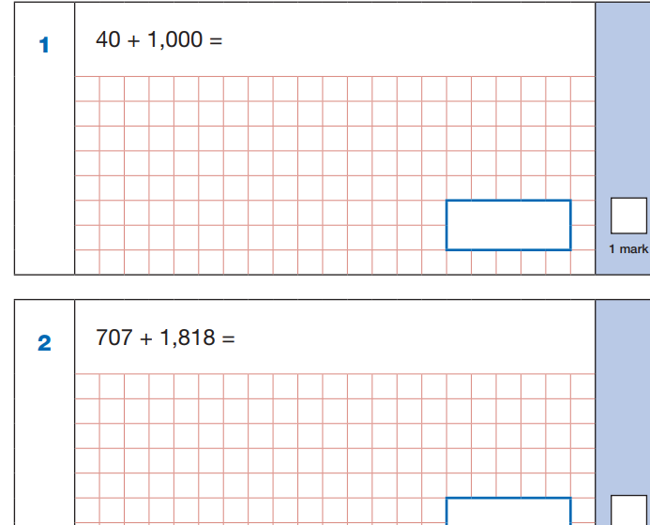
Arithmetic (/40)

Slide 8
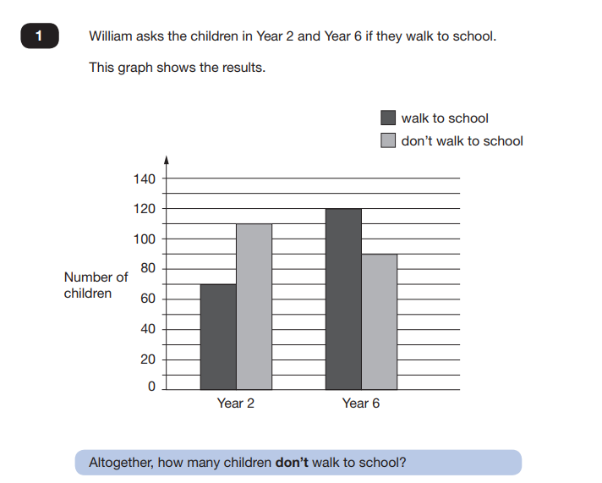
Reasoning (/35) each

Slide 9
Writing is assessed internally against a writing framework. Teacher assessment is used- this is statutory.

Slide 10
SATS Pupil Location Arrangements 2021
Year 6 Elder
Spare Year 6
PPA Room
Y6 Group Room
Y5 Group Room

Slide 11
So, what do the scaled scores mean?
Each child’s raw score in the test (32/50 in the reading test, for example) is turned into a scaled score, based on making comparisons with the other children across the country who took the same test.
The scaled scores are centred around 100. That means that:
  A score of 100 means the child is working ‘at the expected standard’ for a Year 6 child. 80 is the lowest possible score and 120 is the highest.
A scaled score of 99 or less means they haven’t reached the government’s ‘expected standard’.
In 2019, pupils needed 28 marks out of 50 to reach the expected standard in reading, 58 out of 110 in maths, and 36 out of 70 for spelling, punctuation and grammar.
The Standards and Testing Agency have published a scaled score conversion table, showing the raw score required to reach the expected standard in reading, maths and SPaG.

Slide 12
How will we help your child?
Quality first teaching – differentiated learning in the classroom to cater for all different levels of ability and offer support.
Ensure that we offer guidance and advice through effective feedback orally, and through marking.
Show children how to revise and identify their own strengths and weaknesses and help them build on these areas to gain confidence.
Extra booster groups throughout the year

Slide 13

How you can help
Support with spelling
Reading 5 x a week
Support with times tables

Slide 14
How you can help
Reassure children that as long as they do their best that is all that matters!
Avoid promoting messages that the outcomes of these will affect their secondary schooling – teacher assessment is the key.
Emphasise that SATs are simply one way to show what they know.
Make sure they have a quiet, organised place to revise and study.
Ensure that they always have a good breakfast.
Plenty of sleep!
Encourage them to ask a teacher or tell an adult if they are unsure of anything.
No pressure – learning may be hard work, but we always try to make it fun!

Slide 15
Useful websites

Slide 16

http://www.bbc.co.uk/education/levels/zbr9wmn

Slide 17
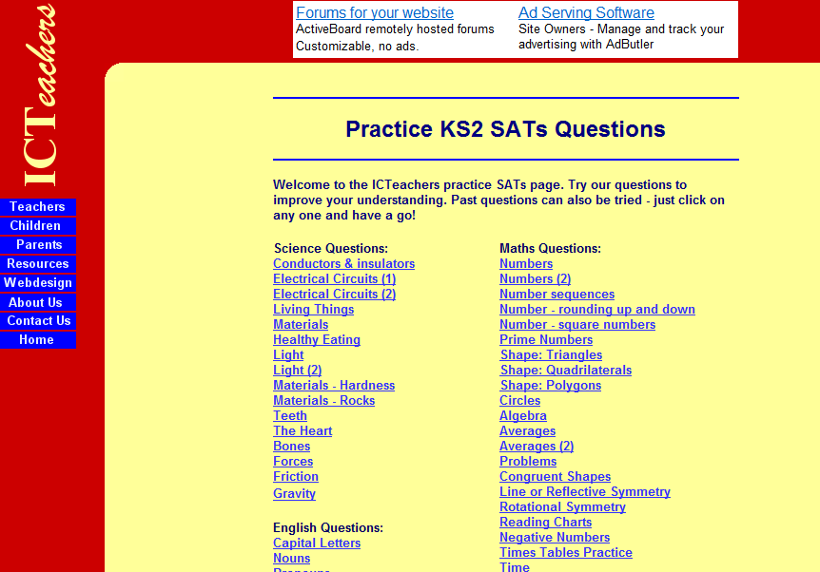
www.icteachers.co.uk/children/children_sats.htm

Slide 18

http://resources.woodlands.kent.sch.uk/

Slide 19
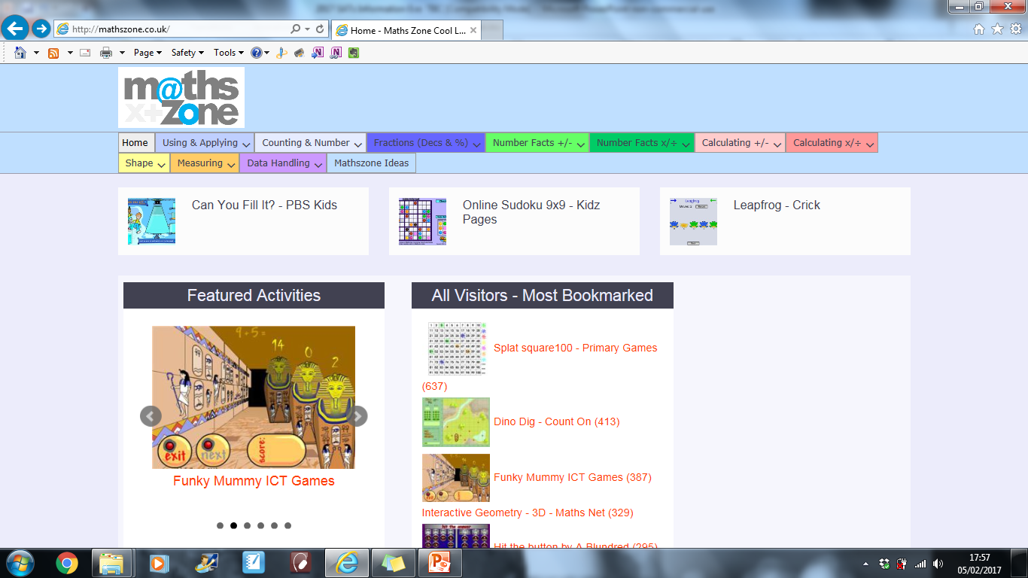
http://mathszone.co.uk/

Slide 20

https://www.cgpbooks.co.uk/

Slide 21

https://www.collins.co.uk/index.html

Slide 22

https://www.theschoolrun.com/primary-grammar-glossary-for-parents

Slide 23
Any questions?

