Slide 1
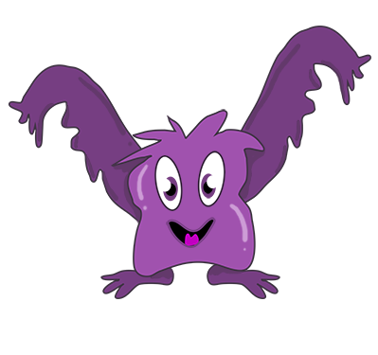

Phun with Phonics!
Notes:
Welcome to our presentation about how we teach phonics and reading in reception.

Slide 2
How often do we teach it?
We teach phonics EVERY DAY!
We enjoy phase 1 activities throughout the year – rhyming,
I spy, listening games
Phase 2 – 19 phonemes
Phase 3 – 26 phonemes
Phase 4 – ccvc and cvcc words
Phase 5a – 16 phonemes

Slide 3

What is a phoneme?
It’s a unit of sound.
How many sounds in cat?
c a t
•
•
•

Slide 4
How do we pronounce them?
It’s very important that phonemes are pronounced correctly.
Pronouncing them correctly will make blending words
much easier.
Here is a handy video to help you learn the correct pronunciation of the phonemes.
https://www.youtube.com/watch?v=TTe5_Em0BHQ

Slide 5


How do we teach it?
Learning through actions, pictures, stories and sounds.
Notes:
At Roebuck Academy we teach phonics through a scheme called Monster Phonics. This scheme follows the government guidance highlighted in the Letters and Sounds document.

Slide 6
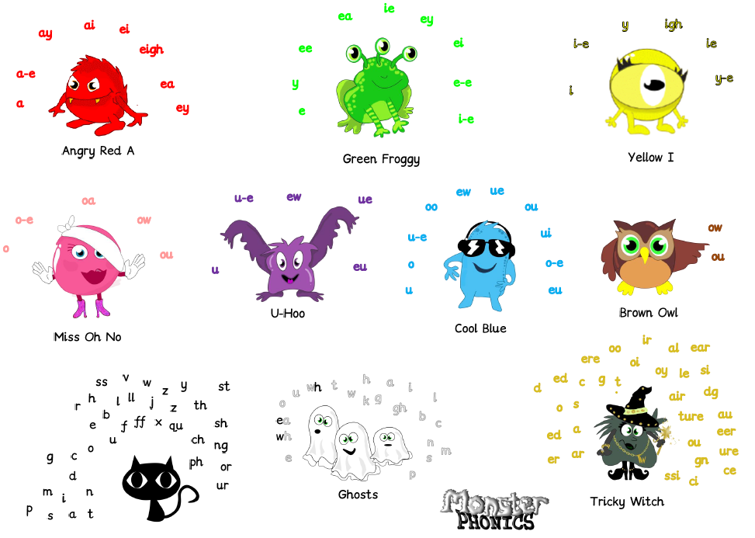
Notes:
Each phoneme we teach links to a specific monster. As you can see Angry Red A says ‘a’ in lots of different ways. The children love these monsters and very quickly learn the different sounds they make.

Slide 7
The first sounds…
We teach the sounds not the letter names.
The first set of sounds we teach are:
s a t n i p
Notes:
The first sounds we teach are S A T N I P your children will have already learnt these sounds, as you read with them see if they can spot them in their story.

Slide 8
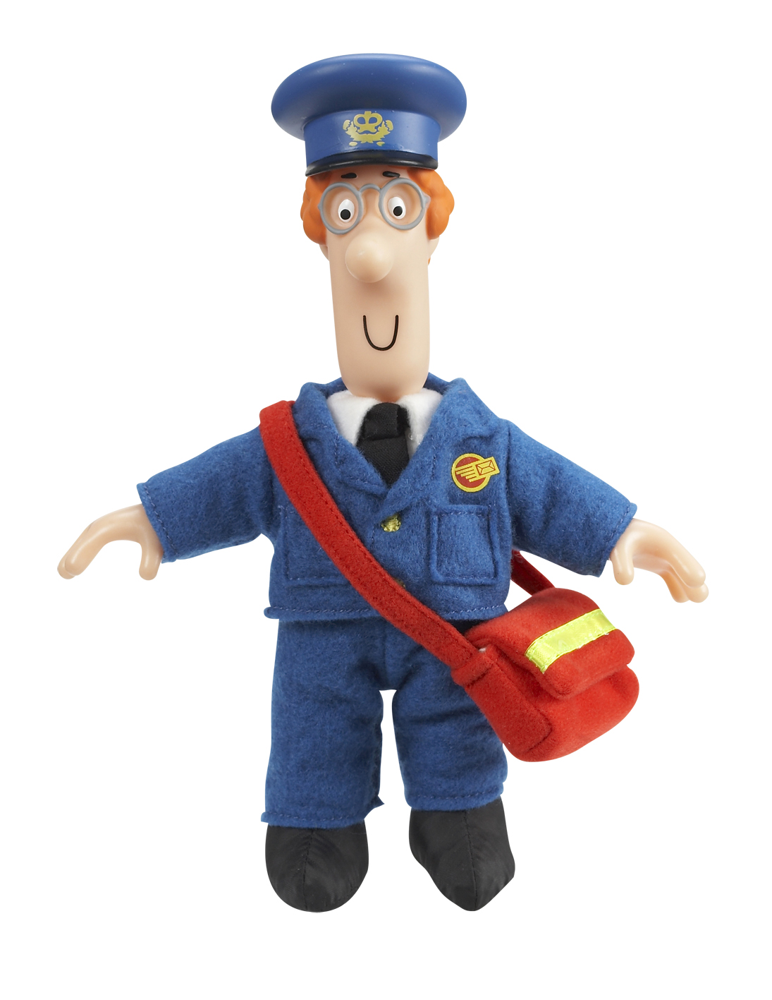

Making words
Once children know these sounds we can start making words.
sat
pin
nip
sit
pit
pat
pip
sip
Notes:
With just a few phonemes we are able to make lots of different words. We teach the children to say each sound indivudally, this is called segmenting. They then blend the sounds together to make the word.

Slide 9

Robot talk…
Notes:
One of the ways we teach children to blend their sounds is to pretend to be a robot. Saying each sound faster and faster until the phonemes blend together into a word they recognise. For example – p_i_g.

Slide 10


Phonics at home
https://www.youtube.com/watch?v=vMEvxTGvi4c&list=PLqh11DN6jmbCsIPschffPaxvCdS9d6qPN
Mr Thorne
Notes:
Here are a couple of websites that you can use at home to help your children become more familiar with phonics.

Slide 11

Where it gets a bit tricky…
There are 42 phonemes to teach in total.
Some of these phonemes are made up of more than one letter including…
ai as in rain
oa as in boat
sh as in shop
These are called diagraphs – 2 letters that make 1 sound

Slide 12
Now it gets even trickier…
Tricky words are words that can’t be sounded out – we just have to remember them!
the go no I he me she we
We will be sending home reception words in the front of your child’s reading record book. Please learn them with your child. The more that they are exposed to these words, the easier they will find it to read and write them.

Slide 13

Reading is not just about the words…
- Before opening the book, talk about what the book might be about.
- Practice the sounds on the inside cover.
- If you only try a page or 2, that’s OK. The key is little and often.

Slide 14

Stages of reading..
If your child memorises the words, don’t worry this is normal as children have a very good memory for things like this. To give your child a little bit of a challenge see if they can point to any sounds they recognise. You can also ask them questions about the pictures and the story.
Our school policy is that you read with your child at least 5 times a week but this could be any book including you reading to them. Please log this in their reading record every time you read or share a book.

Slide 15
Importance of reading
Being able to read fluently will greatly increase the opportunities your child will have in life.
The following link talks about a study which has been conducted in the UK and has proven that children who can read have better life chances.
https://www.ted.com/talks/helen_pearson_lessons_from_the_longest_study_on_human_development/footnotes#t-102679

Slide 16
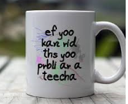
Writing phonetically…
The teecha can hlp the childurn to rIt.
Yoo can hellp too
Fank yoo for cumng hear
Notes:
Once we have learnt how to recognise phonemes we then begin to learn how to write them. Children will use their phonics which means some words will be spelt funny. This is normal and to be encouraged. The only words that must be spelt correctly are the tricky words provided in the front of your reading record.

Slide 17
Thank you!!!
In your child’s bookbag this evening is a handout that will complement this presentation.
We want to work together to provide the best learning for your child.
Thank you for listening and if you have any questions please speak to your class teacher.

