Slide 1

End of KS1 assessments
Year 2
Information and tips for parents

Slide 2
Challenges
The class are used to assessments being referred to as ‘challenges’.
This is carried out in the classroom.
The children know the challenges help the teachers to identify gaps and know what to teach them next.

Slide 3
Assessments
Test results inform teacher assessments.
We use interim teacher assessment frameworks
Moderators will look at test results and books from the year.
To score Age related they need to achieve
a scaled score of 100.

Slide 4
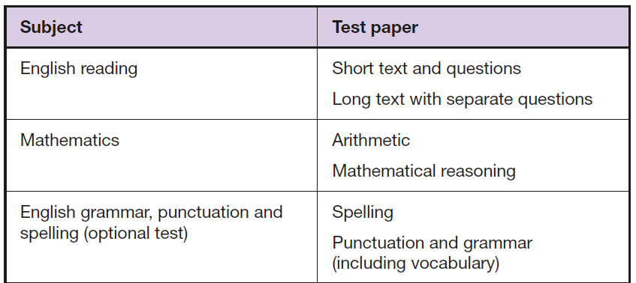
Type of papers
Reading-2 papers
Maths 2 papers-Arithmetic and reasoning
Writing task (all unaided writing looked at from recent weeks)

Slide 5
Pupils who should not take the tests
Pupils should not take the tests if any of the following apply:
they have not completed the relevant KS1 programme of study
they are working below the overall standard of the KS1 tests (and are considered to be unable to answer the easiest questions)
they are working at the standard of the KS1 tests but are unable to participate, even when using suitable access arrangements
The pre-key stage standards for pupils engaged in subject-specific study and who are working below the standard of the KS1 national curriculum assessments.
If a headteacher decides a pupil should not take one or more of the tests, they must report this decision to the parents.

Slide 7
How can you help?
Maths
No apparatus or resources are allowed to be used.
In home work- encourage the children to draw pictures to help them
Notes:
Share examples

Slide 9
Growth mindset
I can’t do it yet!
Show me!
Prove it!

Slide 10
Continue to help
Good attendance- please ensure your child is here every day
Complete all homework
Read at least 5 days a week (Thank you for your support)
Breakfast, sleep, come to school calmly and relaxed.

Slide 11
Summary
We complete SATs to help inform our teacher assessments
I can decide to give breaks, stop etc based on individual children’s needs.
Remember spelling, reading, maths-little and often really does help.
Questions-Tell me 3 things you learnt today.
What was the best bit about today? What did you not enjoy? Anything tricky?
Thank you

