Slide 1
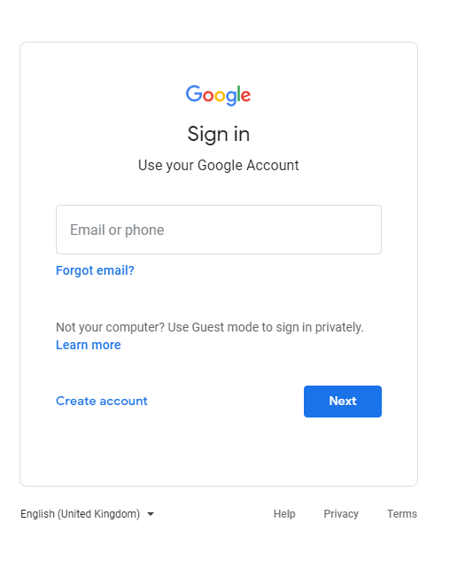
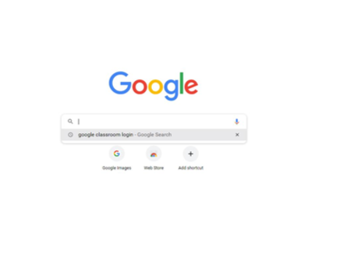
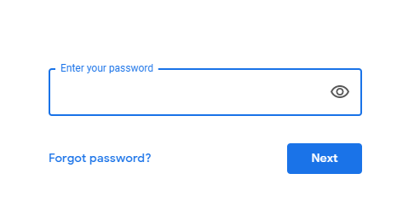
How to log into Google Classroom
As part of our online learning provision in case of a second lockdown, as well as developing ICT skills for the children we have set up google classroom for every child. Work will be set here for the children to access and will provide a platform for teachers to respond to work and monitor the completion and progress of what is being set.
Below is the steps for logging into google classroom.
1. Open a web browser and search for google classroom.
2. This is where you input the email and password your child’s class teacher has sent you.

Slide 2
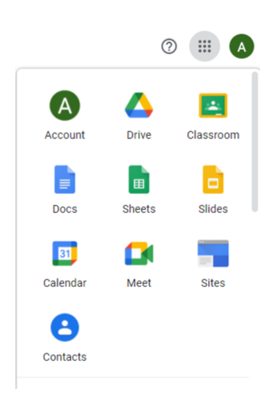
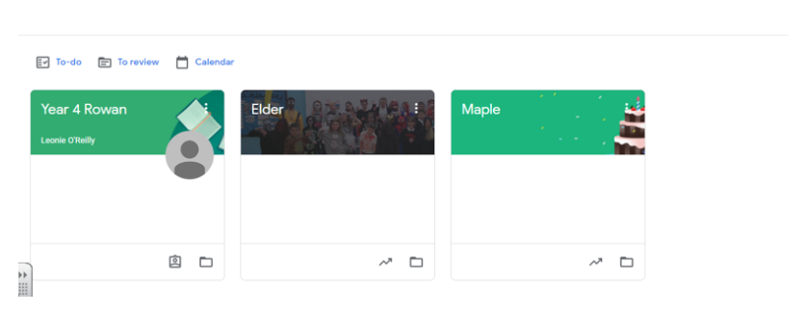
3. Click on the keypad icon in the top right hand corner of the page. Then, click on the Classroom button. This will take you to your assigned classroom.
4. Your child’s class should appear here and you can click onto it to access information and files posted in the class. Click on your class.

Slide 3
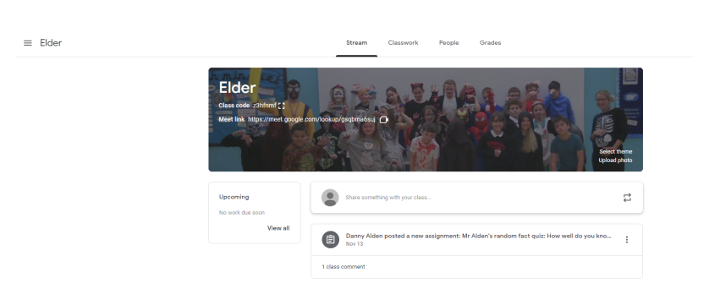
Once on the class page you can click onto the stream or select Classwork, People in your class or grades.
The stream allows pupils to see updates and assignments that have been posted and the ability to respond to items that have been posted
On the classwork page , children can see all the materials posted in the class. This will include assignments posted by the teacher
Here is a Google meet link for their class meetings. The children can click here to join meetings

Slide 4
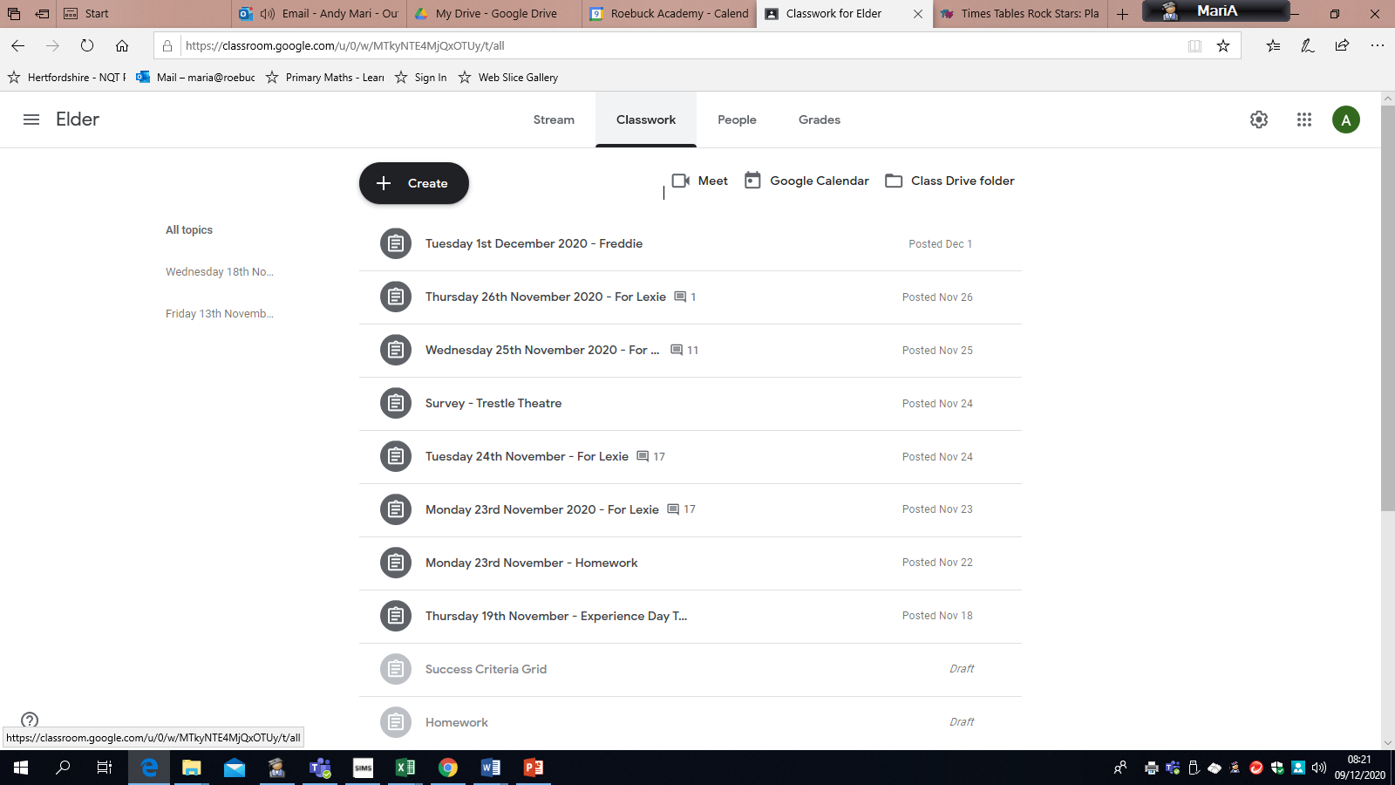
Classwork set- will appear her in chronological order
People in the classroom
Work set- conversations included
Work can be created here.

Slide 5
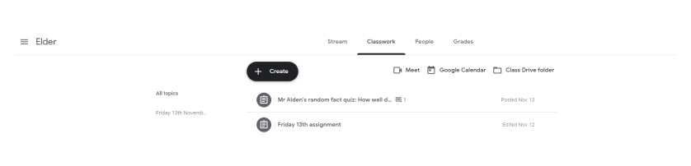
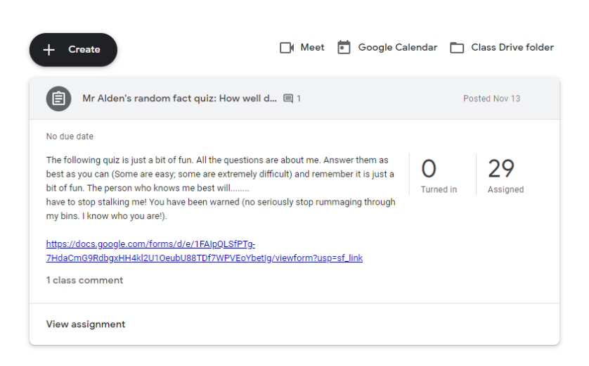
Assignments sent by the teacher appear here.
By clicking on them you can access the assignments and any documents, links that are relevant for that piece of work.

Slide 6
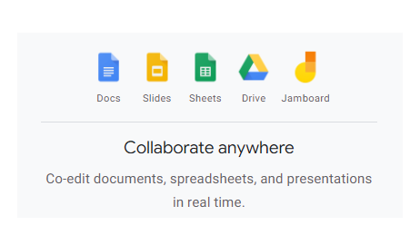
The children also have access to G Suite apps which help create a variety of documents similar to:
Microsoft Word > Docs
PowerPoint > Slides
Excel > Sheets
Children also have their own Drive space for storing work and documents

Slide 7
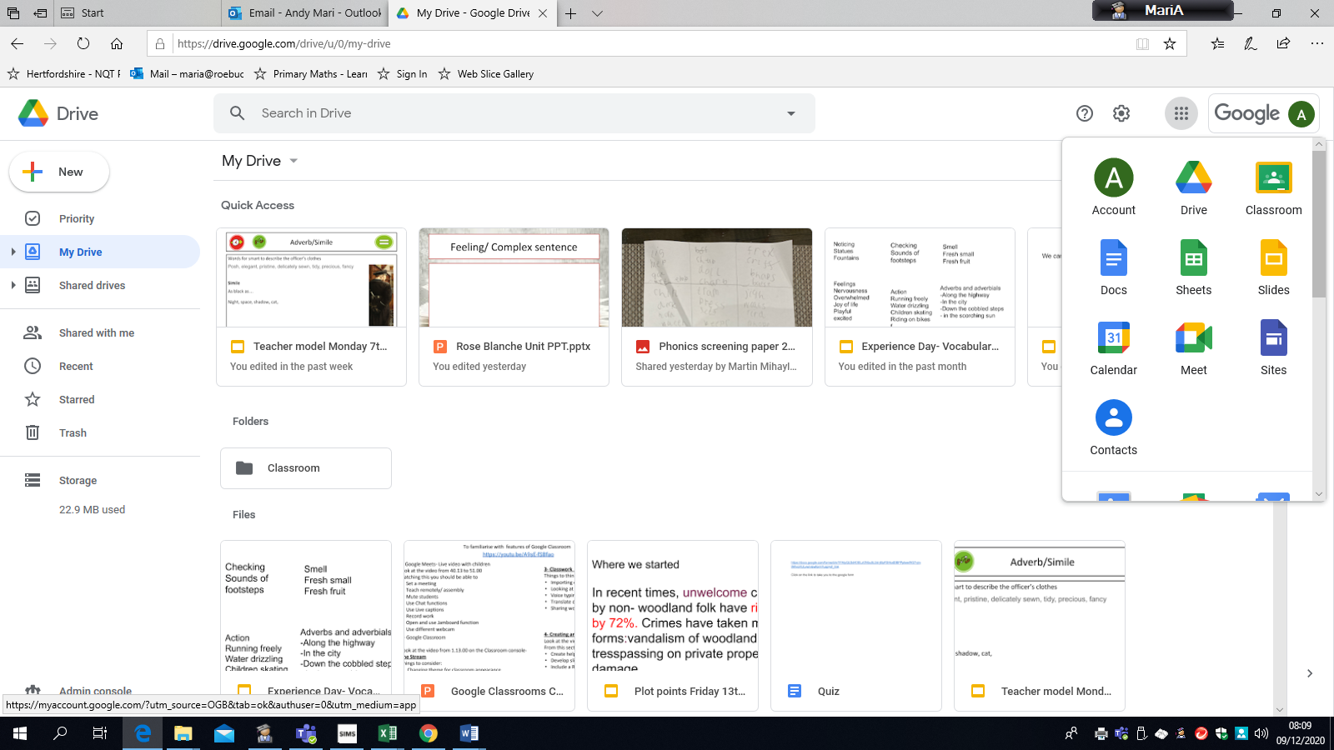
Docs- Word
Sheets Excel
Slides- Power Point
Meet- video conferencing
Calendar

