Slide 1
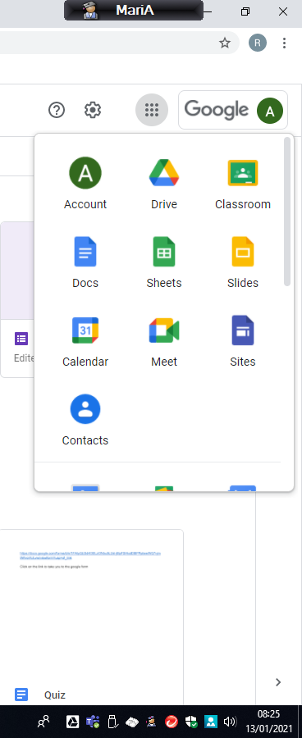
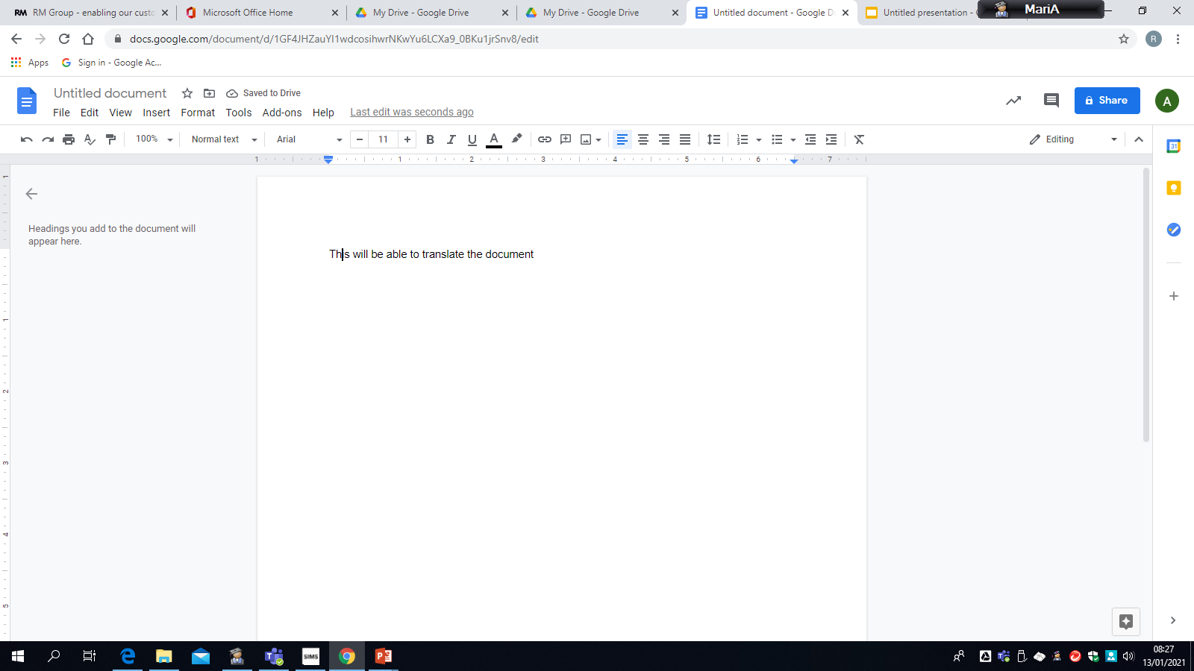
To use Translator in Google Docs
Once in Google
Open up a new Google Doc
Type into the document

Slide 2
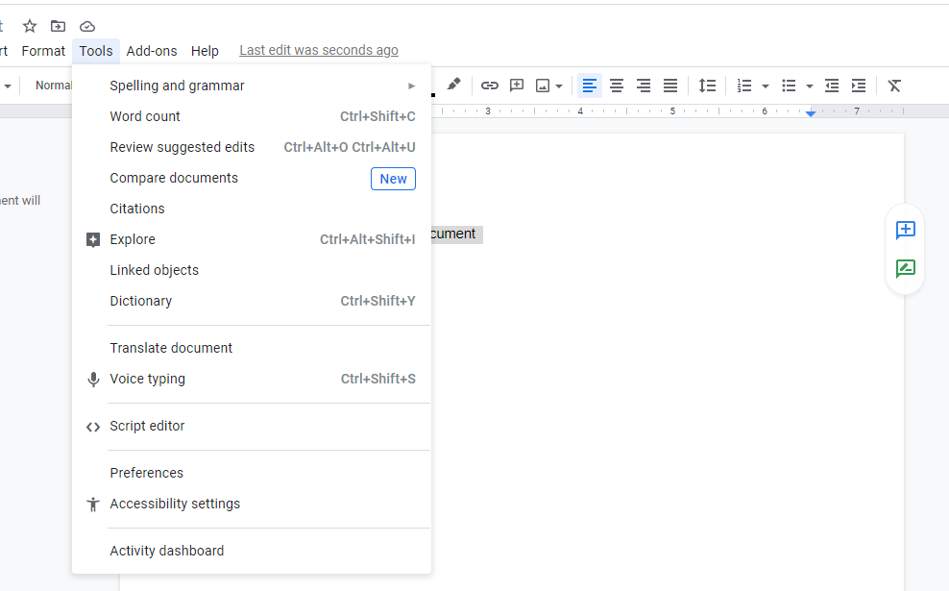
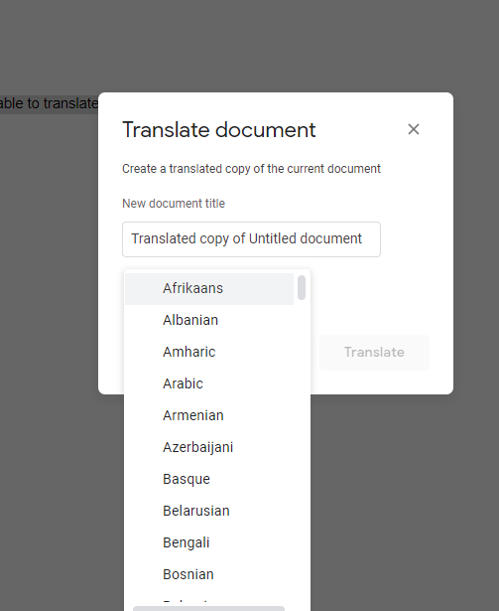
Once you have completed the typing, highlight the content you want translated.
Select Tools and then Translate document. Use the drop down menu to select the language for translation. Select Translate.

Slide 3
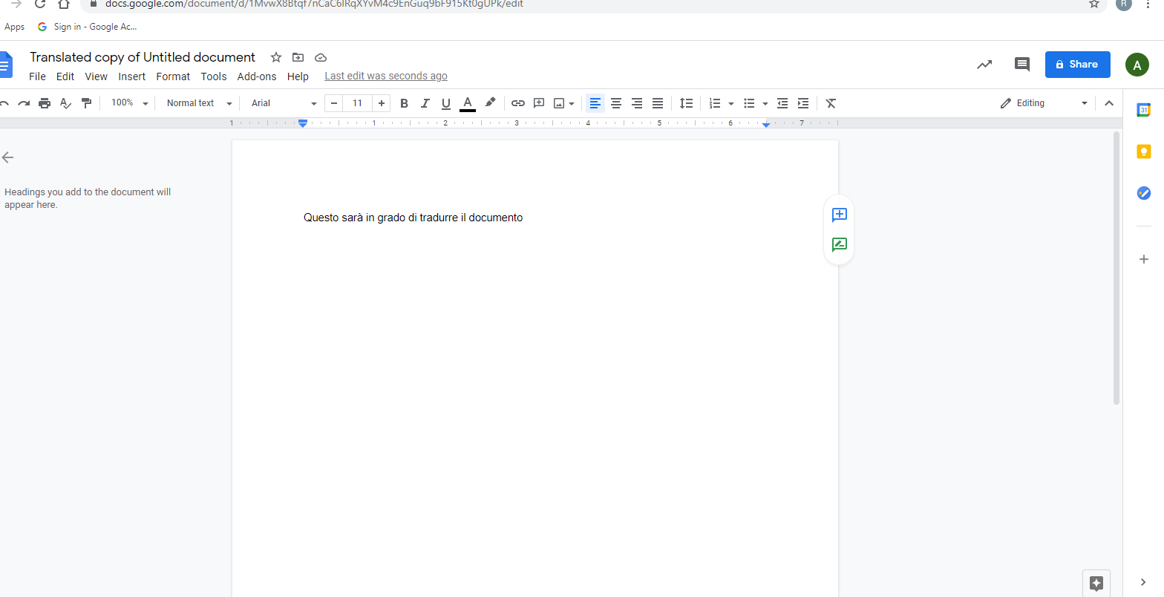
A new document with the translated document will open and saved into to your Google Drive

