Slide 1
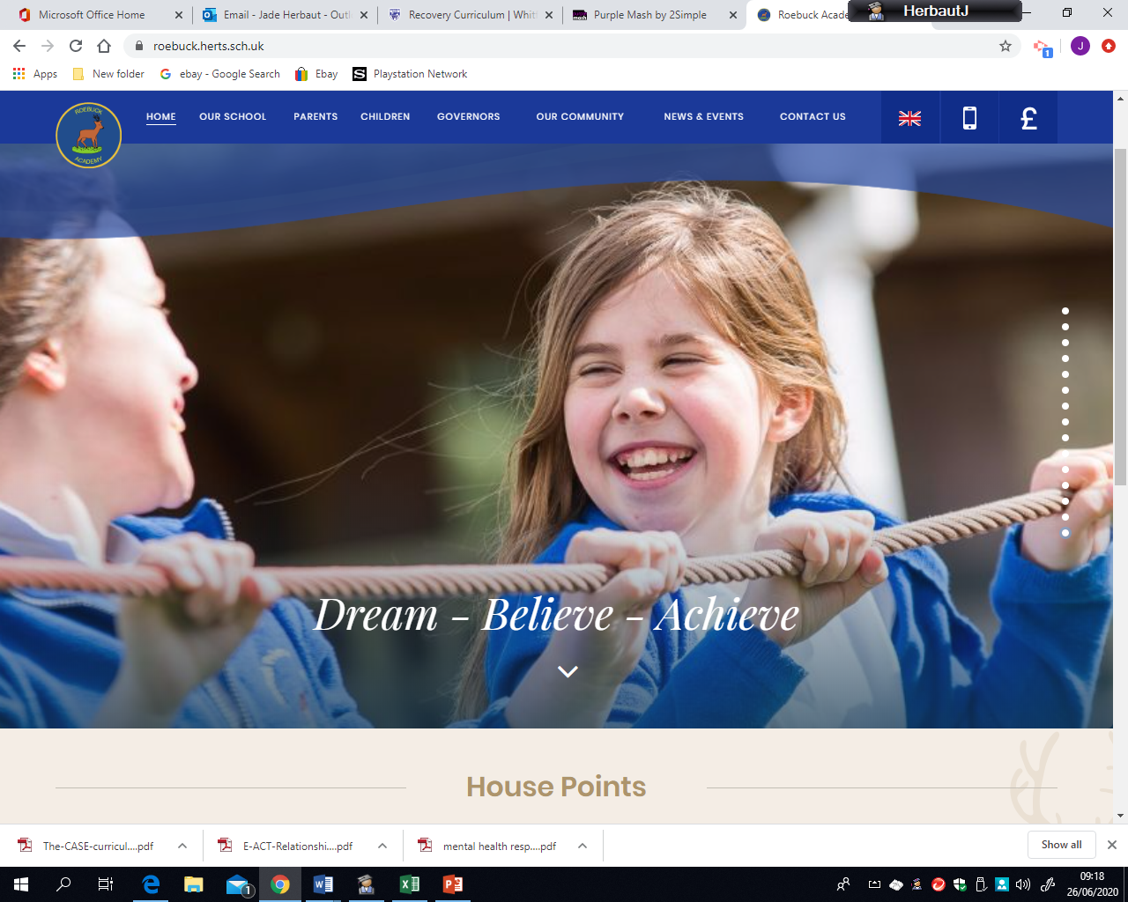
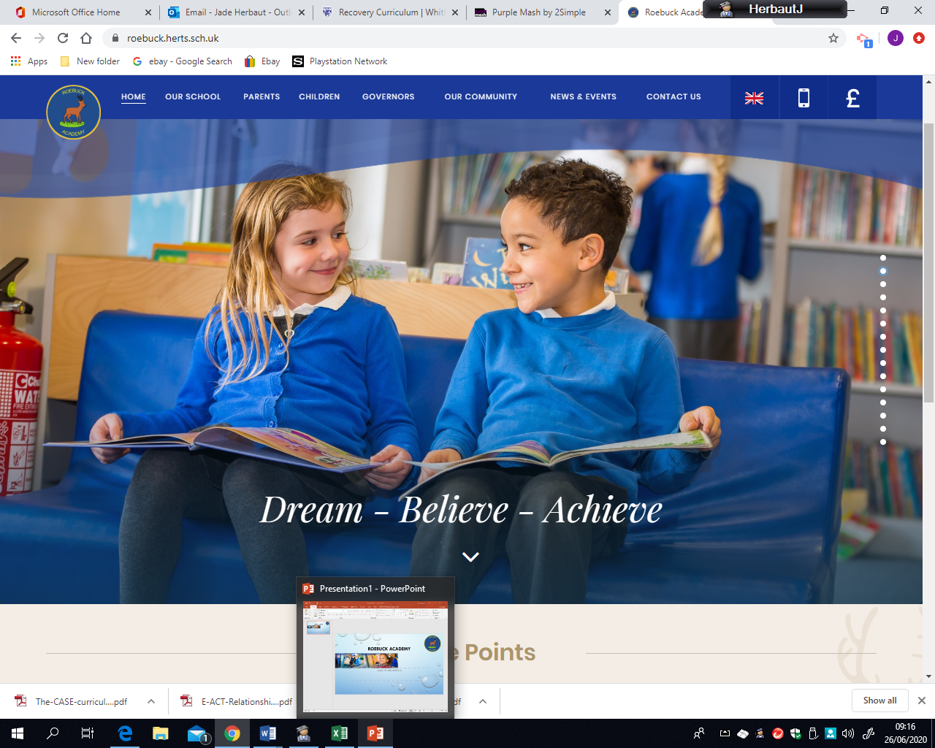
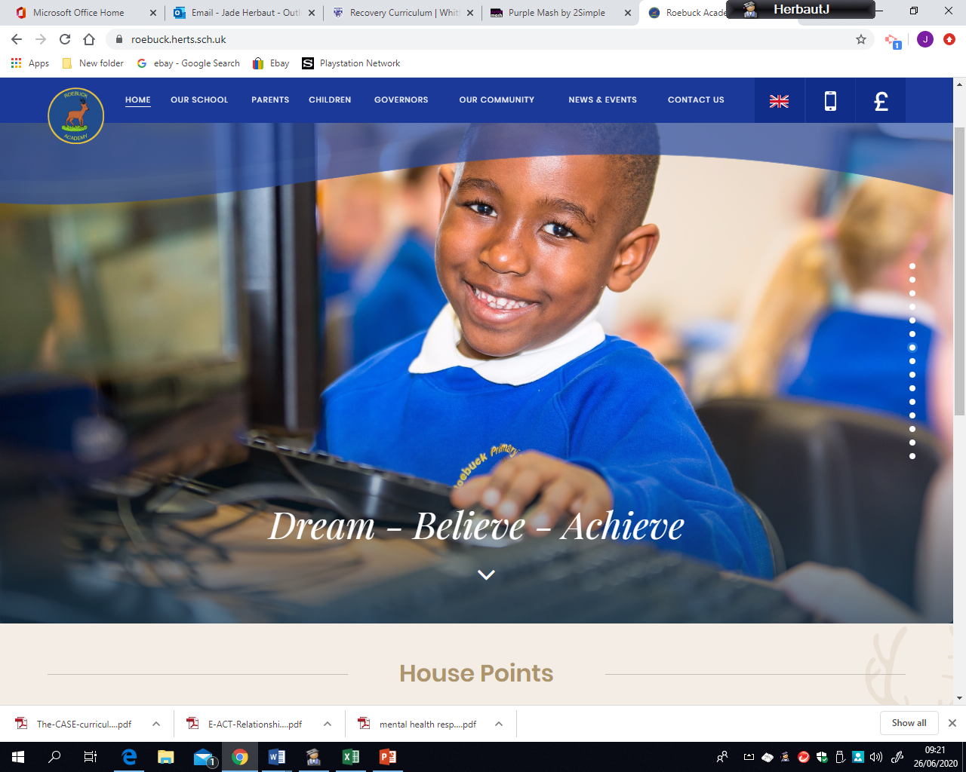
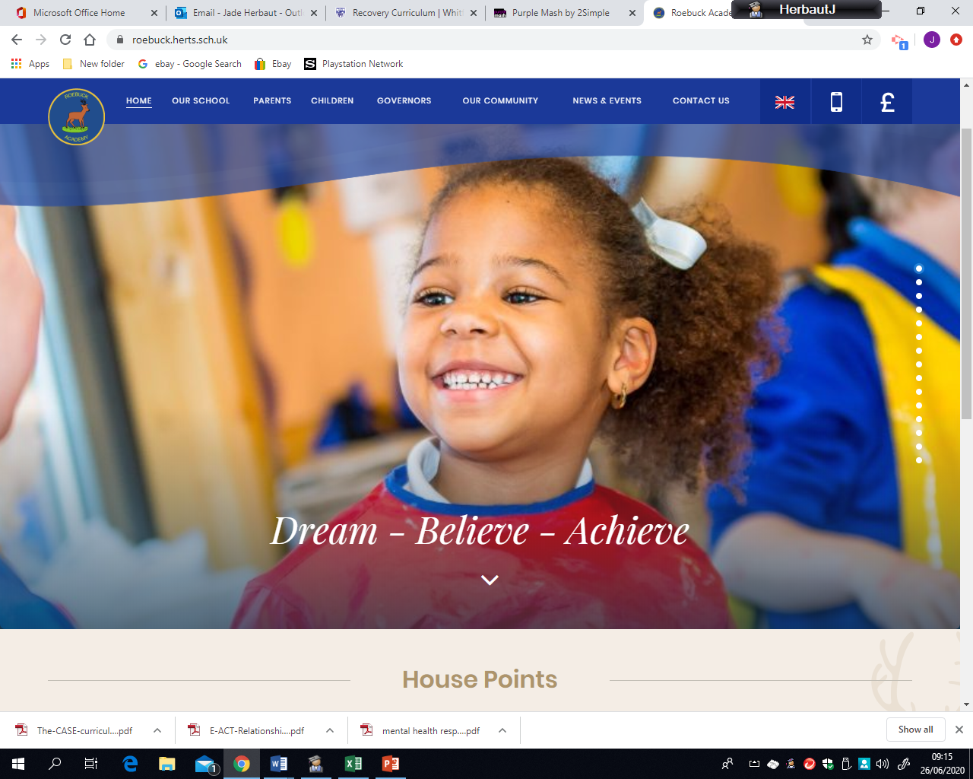
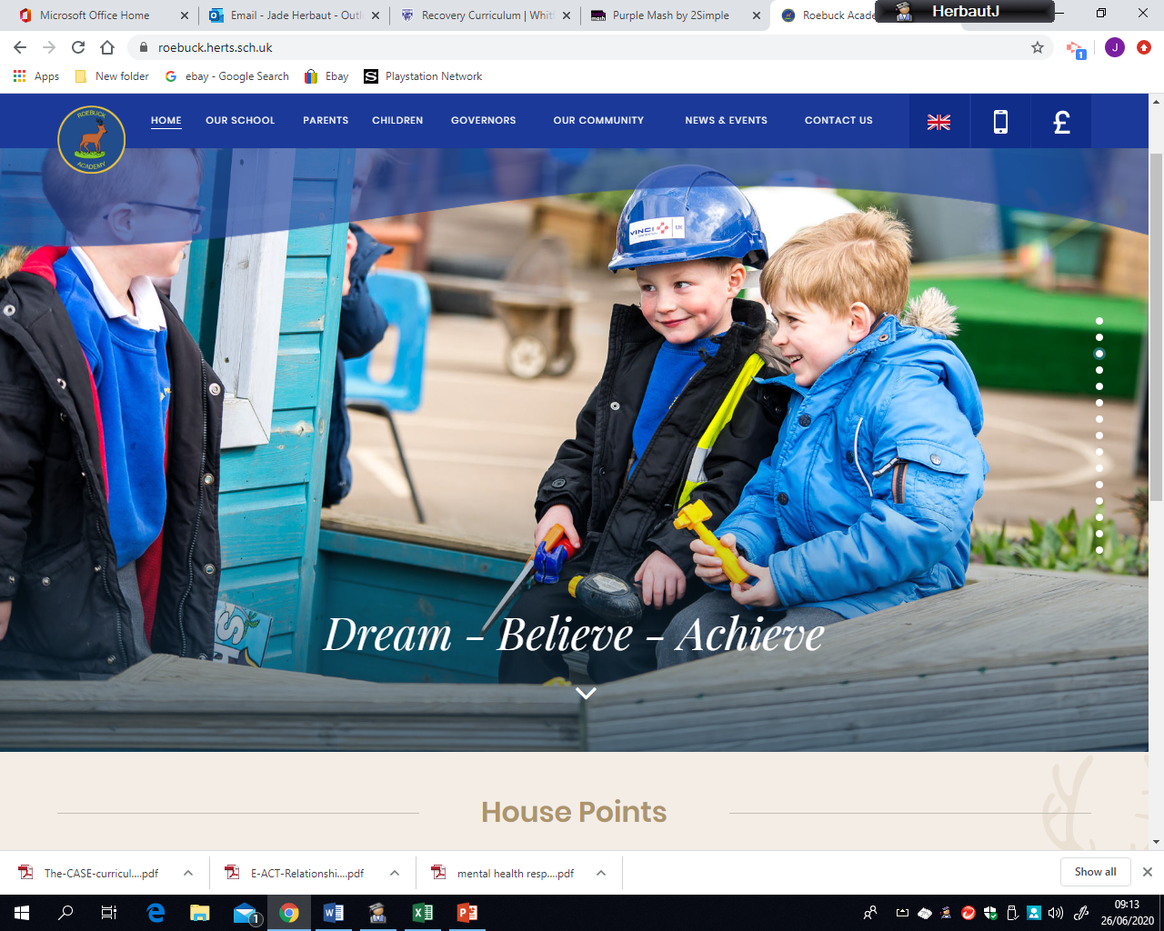

Roebuck Academy,
Always Moving Forward Together
At Roebuck Academy we continually strive to develop a passion for learning at the school, which is driven by high-quality teaching and learning, a broad, balanced, and exciting curriculum and a genuine pursuit of excellence for all. This has not changed even in these difficult times. We feel that we know and understand our children extremely well and aim to continue to support them and our Roebuck families in the best ways we can.
In order for us to adapt to the current situations we are providing the best home learning offer we can which includes: key worker provision and continued support for all of our families. We are continually developing and finding ways to meet the needs of our pupils and are doing our best to act on any feedback given. We value the thoughts, opinions and comments of parents and carers and would like to keep you updated with how we have acted on feedback we receive.

Slide 2
You said - We did...
We need provision before and after school.
We need work for when we can’t get online
We are unsure how to use Google classroom
We want live sessions to engage our children
We have no reading books at home
We opened Buccaneers for before and after school provision for those that need it and have maintained bubbles through careful organisation and planning.
Home learning packs are prepared in advance so families can collect to support those without devices, printers or those that need the scaffolds to support recording.
Maths and literacy are taught live every day and teachers are adding more live sessions to support in many other areas.
‘How to’ videos have been made and shared with parents including:
How to log on and navigate;
How to join the live sessions;
How to use voice-typing;
and How to make a document and send to your teacher.
Rising Stars Reading Planet was purchased and set up assigning hundreds of books to children. ‘How to’ guides and videos have been sent to parents and some children have read to adults through Google meets already.

Slide 3
You said - We did...
We need technical support
We can’t always join the live sessions as we have one device and multiple children who share it
We are worried about the mental health and well-being of our children
We are struggling to engage our children
We need stationary and equipment
Phone calls, how to videos and even devices have been provided for families who have needed further support to access online learning.
Staff have committed to provide a broad curriculum in a variety of ways including; live lessons; pre recorded videos; assignments to complete but have also engaged children with story reading; quizzes; games and physical challenges .
Stationary packs have been prepared and handed out to families who need them.
We are recording our live sessions so they can still be accessed after the session and all PowerPoints and tasks are available in the online class work.
Great care is taken to support children’s mental and emotional wellbeing through lessons, growth mindset and the relationships we maintain even through social distancing. Phone calls home provide extra support, help and the opportunity for a chat. The SEND and Pastoral support has been a source of support and guidance throughout.

